Slide 1
NICE Guidance: Tobacco: preventing uptake, promoting quitting and treating dependence NG209 2021
Treating pregnant smokers: summary of the basics, new guidance and a recap on the use of Nicotine Replacement Therapy during pregnancy
Yvonne Hermon RGN RM PG Dip
Public Health Specialist Midwife – Tobacco Dependence
NCSCT Smoking and Pregnancy Consultant and Trainer

Slide 2
Today’s presentation will include: -
Recap on key NICE recommendations
Note any changes and what has stayed the same
Review the evidence on Nicotine Replacement Therapy (NRT) safety during pregnancy
Clarify the change in emphasis in the revised guidance
Identify the role of e-cigarettes to support quitting smoking
Reflect on where services could generally do better to meet NICE guidance

Slide 3
Identifying women who smoke and referring them for stop smoking support
The evidence about opt-out referral systems was reviewed and found to be mixed.
However, the most recent evidence around opt out referral systems, resulted in higher self-reported quit rates and more engagement with stop-smoking support.
Latest evidence on CO testing for referral remains at 4ppm aligning with Saving Babies Lives’ (2019)
NEW Additional guidance
Provide carbon monoxide testing at ALL antenatal appointments to assess the women's exposure to tobacco smoke
Explain what her carbon monoxide reading means:
Taking into consideration the time since she last smoked
The number of cigarettes smoked (and when) on the day of the test

Slide 4
Identifying women who smoke and referring them for stop smoking support
Guidance remains the same for referrals:
Opt out
Quit in the last 2 weeks
CO reading of 4ppm or more
Women have previously been referred, but have not engaged with services

Slide 5
Safety of NRT in pregnancy
Long-term studies have shown no harm to the fetus from using NRT in pregnancy
Unlike smoking, NRT delivers a ‘clean’ therapeutic form of nicotine
Nicotine inhaled via cigarettes produces a stronger vasoconstrictor effect causing reduced blood flow to the placenta and fetal tissues, therefore increasing fetal heart rate
          NRT is absorbed slowly and does not have this impact or effect
NRT is prescribed on a risk vs. benefit basis
NRT is FAR safer to use in pregnancy compared to continued smoking
‘Cut down to quit’ using NRT is not a recommended strategy in pregnancy
Notes:
KEY POINT
In pregnant women who smoke, the benefit of using NRT ALWAYS exceeds the risks… in other words… the BENEFIT (of using NRT) far outweighs the RISK of continued smoking .
NRT is a matter of choice, any individual cautions or contraindications for not using e.g., allergy to certain products and previous experience of using and preference.
16 hour invisipatch is recommended to use

Slide 6
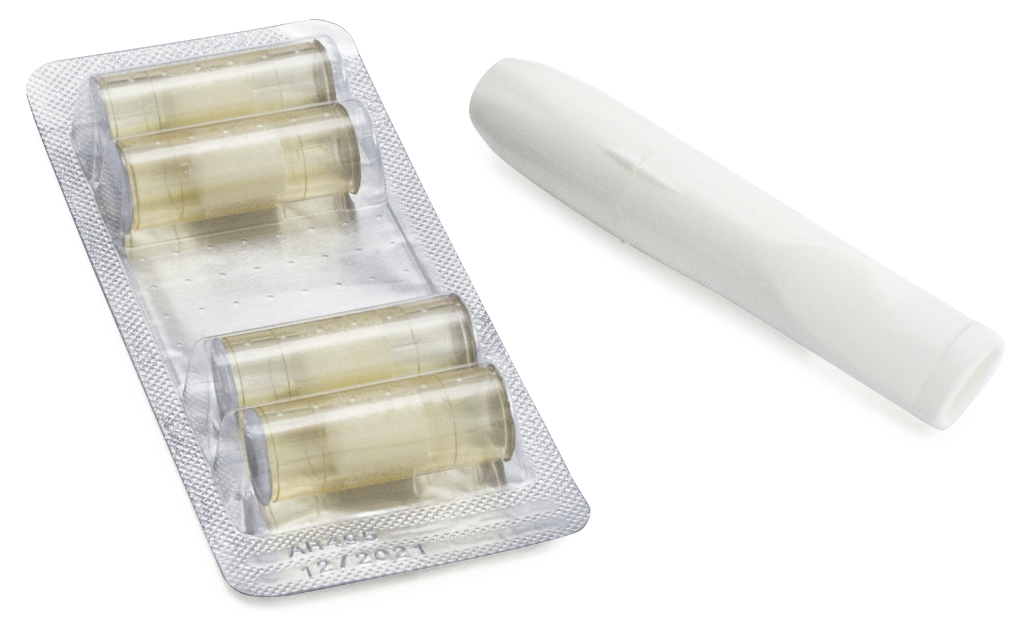


How effective are stop smoking medications?
Single NRT
Combination NRT
2x
3x
Combining stop smoking medications with behavioural support
further increases success with quitting
Notes:
In terms of their effectiveness:
Varenicline - 3x’s more likely to quit
Combination NRT (2 products) - 3x’s more likely to quit
Single NRT (1 product) – 1.6 to 2x’s more likely to quit
Bupropion – 2x’s more likely to quit
Combining stop smoking medications with behavioural counselling further increases success with quitting
The decision in terms of which stop smoking should generally be based on efficacy, patient preference or past experience, and clinical history. Cost may also be a factor.
The two medications with greatest efficacy on long term abstinence rates are:
Varenicline, or
The combination NRT (patch + oral form)
With both of these medications you can achieve 3 fold increases in smoking abstinence. Meaning 27-45% of patients will be successful with long term smoking abstinence.
Both have been shown to be most effective in increasing rates of long term smoking abstinence, and both outperform NRT monotherapy or bupropion.
Cahill K, Stevens S, Perera R, Lancaster T. Pharmacological interventions for smoking cessation: an overview and network meta‐analysis. Cochrane Database of Systematic Reviews 2013, 5. Art. No.: CD009329. DOI: http://dx.doi.org/10.1002/14651858.CD009329.pub2

Slide 7
Evidence on the use of NRT
Evidence found all NRT products are effective, especially in combination with behavioural support.
Proven to be effective and recommended are:
a combination of a short-acting and a long-acting NRT
NOT Recommended is:
Using a long-acting NRT e.g. patch without combining with a short-acting NRT. [2021]

Slide 8
Recommendations on treating tobacco dependence in pregnant women
  Evidence showed that advice from healthcare professionals, particularly midwives, was valuable to pregnant women and contributed to their decisions about using NRT and any concerns they may have.
  KEY information to emphasise with women
  Most smoking-related health problems are caused by other components in tobacco smoke, not by the nicotine
  Any risks from using NRT are much lower than those of smoking
Advise pregnant women who are using nicotine patches to remove them before going to bed
Notes:
This clarifies the importance of quitting as early as possible in pregnancy and reassure about using NRT in early pregnancy
Addressing cutting down
16 hour patch recommendation continues, but now we can use combination therapy and e-cigs

Slide 9
Recommendations on treating tobacco dependence in pregnant women
Consider NRT at the earliest opportunity in pregnancy and continue to provide it after pregnancy if the woman needs it to prevent a relapse back to smoking, including if the pregnancy does not continue [2021]
  Give pregnant women clear and consistent information about NRT and explain:
  How to use NRT correctly, including how to get a high enough dose of nicotine to control cravings, prevent compensatory smoking and stop successfully. [2021]
  Nicotine levels in NRT are much lower than in tobacco, and the way these products deliver nicotine makes them considerably less addictive than smoking. [2021]

Slide 10
Key messages on NRT
Initiate NRT without delay
Use as much NRT as is needed
Consider the 50 – 60% increased metabolism of pregnant women
The use of combination NRT is important to address background and breakthrough (cue driven cravings)
Use NRT for as long as needed to prevent relapse
Advise to remove patch before bedtime
  Train midwives around the safety and use of NRT to increase women’s confidence in its use

Slide 11
E-Cigarettes
As e-cigarettes are not licensed medicines, they are regulated by the Tobacco and Related Products Regulations (2016)
Acknowledged that although not completely risk free there is not enough evidence yet to know whether there are long-term harms from e-cigarette use
However, use of e-cigarettes is likely to be substantially less harmful than smoking
Reiterate that any smoking is harmful, so people using e-cigarettes should stop smoking tobacco completely [2021]
Smokers should be given up-to-date information on what is known about e-cigarettes to help them make an informed decision about whether to use them.
Notes:
Dual use of tobacco and e-cigarettes do not reduce the risks for pregnant women

Slide 12
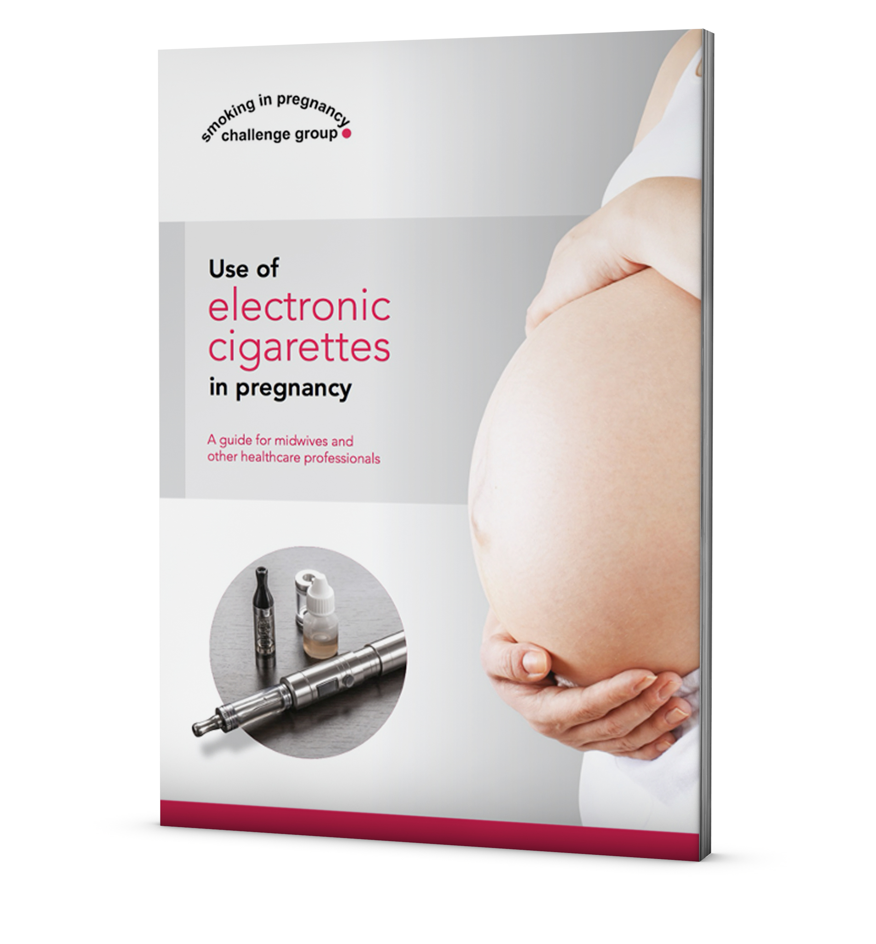
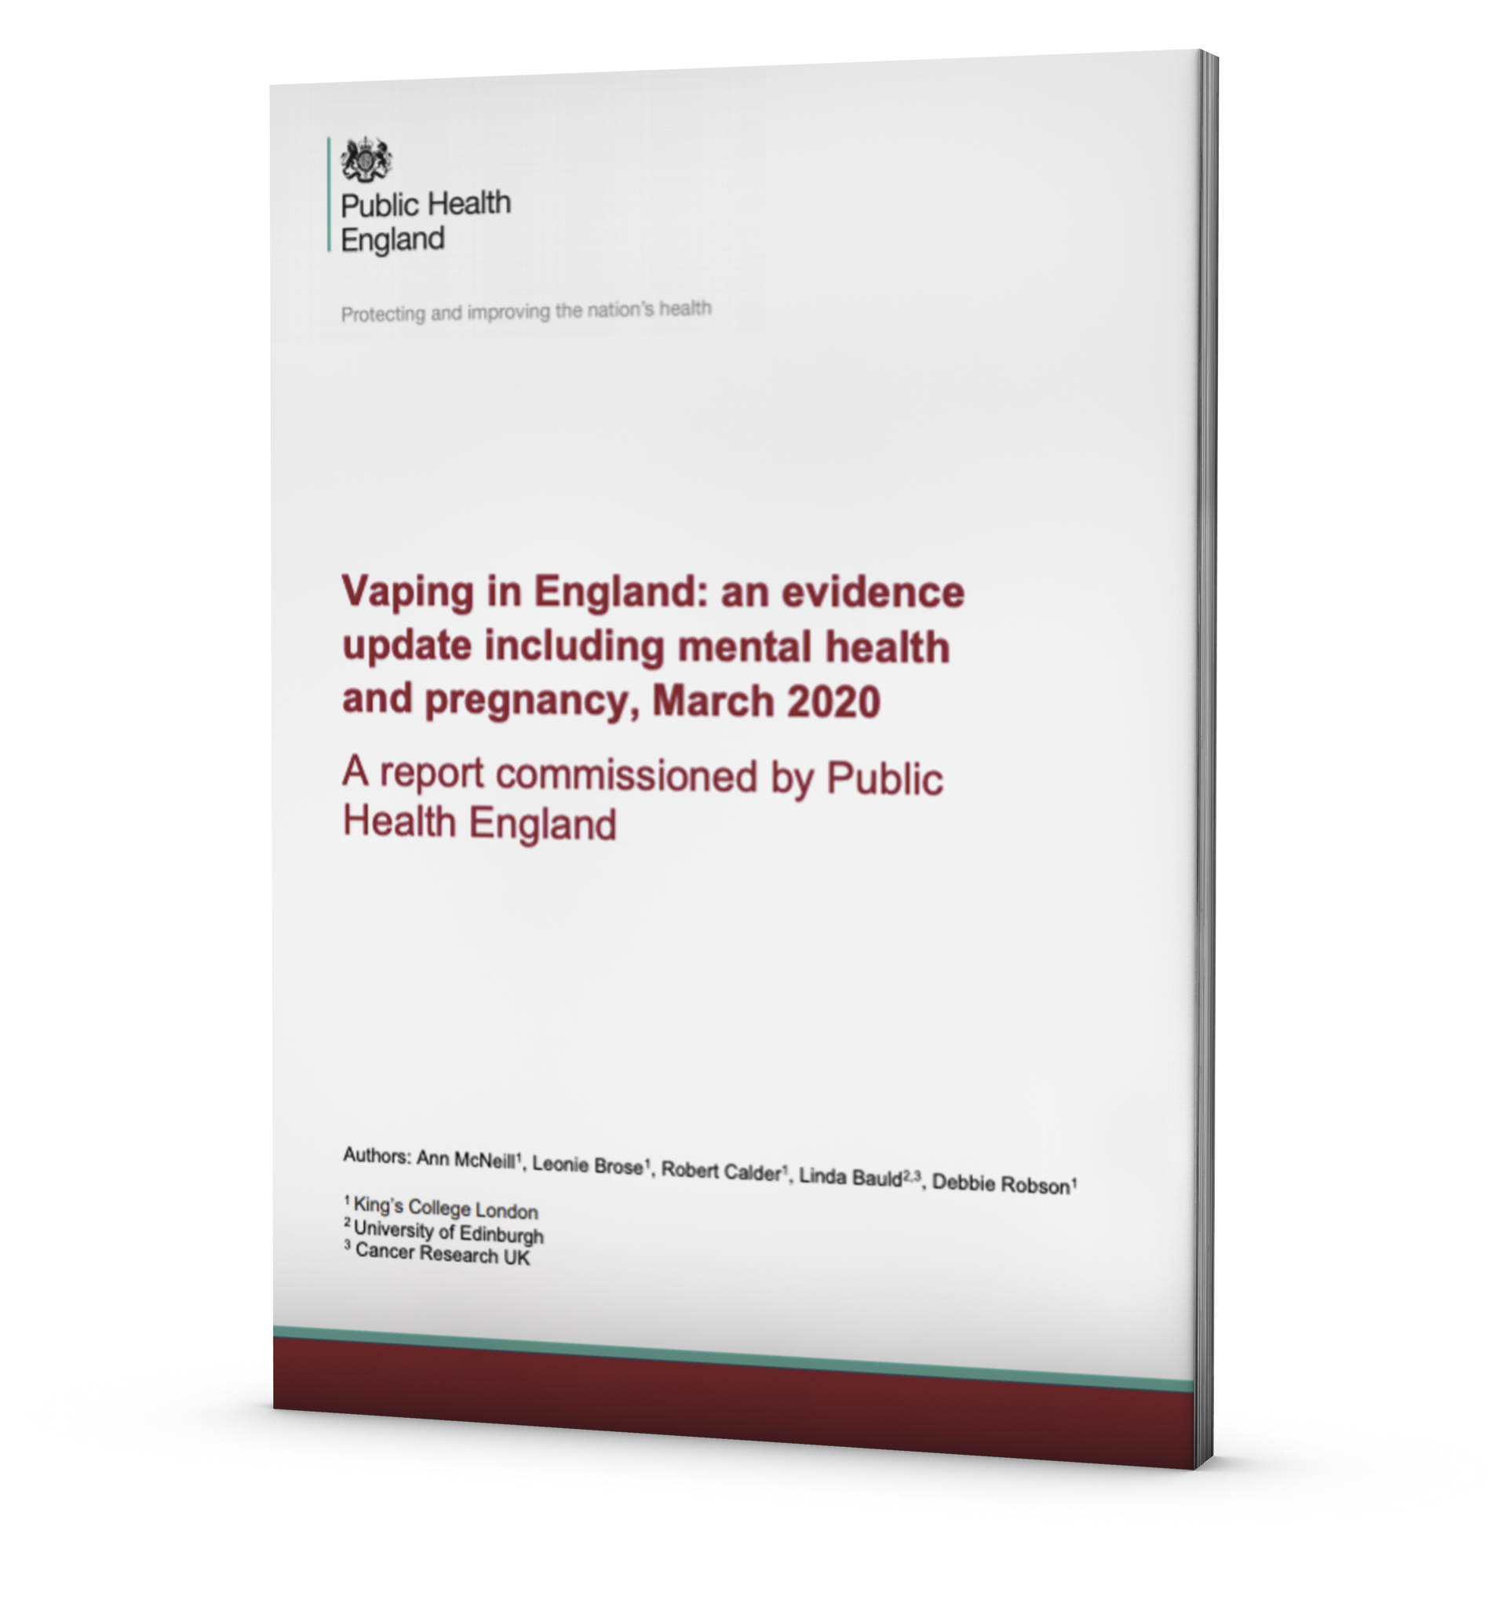
E-Cigarettes
As nicotine-containing e-cigarettes are not licensed medicines they cannot currently be provided on prescription.
However, there are ways of increasing their accessibility, for example by giving evidence-based advice about them and information on where people can access them.
Ensure women know that e-cigarettes are not tobacco containing products

Slide 13

Comparing harm between nicotine-containing products
Estimating the Harms of Nicotine-Containing Products Using the MCDA Approach, Nutt et al, 2014
Notes:
Most things that we do carry some risk and so it is unlikely that we will ever be able to say that vapes are completely safe.
However, when considering the safety of vaping we need to take into account that virtually all vape users are either current or ex-smokers. It is therefore more appropriate to ask the question: how much less harmful than smoking is vaping?
Short-term exposure to vaping appears to pose few if any risks. Mouth and throat irritation are the most commonly reported symptoms (drinking more water helps with the typical dry mouth that new vapers experience), and these subside over time. There are no high-quality safety data from long-term vape use, but there is no good reason to expect that their use would be anywhere near as risky as smoking.
This slide puts things in perspective. When we compare the risk of various nicotine containing products with smoking cigarettes (with a reference point of 100) we can see where products lie relative to the risk of continuing to smoke cigarettes.
Reference: Estimating the Harms of Nicotine-Containing Products Using the MCDA Approach: Nutt, Phillips, Balfour, Curran, Dockrell, Foulds, Fagerstrom, Letlape, Milton, Polosa, Ramsey, Sweanor. Eur Addict Res 2014;20:218-225

Slide 14
E-cigarettes and pregnancy
At the time of putting together this guidance, no effectiveness or safety had been established on the use of E-Cigarettes in pregnancy to help women stop smoking, therefore recommendations were made for further research.
Research recommendations:
What are the views and concerns of:
pregnant women who smoke
the healthcare professionals who care for them about the use of nicotine-containing e-cigarettes during pregnancy? [2021]
Which factors may prevent people who currently smoke tobacco from using other forms of nicotine such as NRT and nicotine-containing e-cigarettes? Does this vary according to population group, particularly among under-served groups? [2021]

Slide 15
Enabling all pregnant women to access stop-smoking support
Guidance remains the same
Involve pregnant women who find it difficult to use or access existing stop- smoking support in the planning and development of services.
Collaborate with the family nurse partnership and other outreach schemes to identify additional opportunities for providing intensive and ongoing support to pregnant women to stop smoking. Nb. Continuity of Carer midwives have a similar aim.
Work in partnership with agencies that support pregnant women who have complex social and emotional needs. This includes substance misuse services, youth and teenage pregnancy support and mental health services. [2010]

Slide 16
Helping partners and others in the household who smoke
Recommendations in the previous NICE Guidance - Smoking Cessation in Acute, Maternity and Mental Health settings (2013), remain the same
Key Points:
At the earliest opportunity, ask if any of the following people smoke:
      partners of pregnant women
      Anyone else in the household.
      Offer pregnant women's partners who smoke help to quit
Notes:
Partners who smoke are a significant barrier for pregnant smokers, and often quitting is too difficult.

Slide 17
Training for Maternity Care Providers on supporting pregnant women to stop smoking
Midwives and others working with pregnant women
Provide additional, specialised training on providing stop-smoking support for those working with specific groups, for example people with mental health conditions and pregnant women who smoke. [2008, amended 2018]
Ensure all midwives are trained to assess and record people's smoking status and their readiness to quit.
They should also:
know about the health risks of smoking and the benefits of quitting
understand why it can be difficult to stop
know about the treatments that can help people to quit, including NRT
know how to refer people who smoke to local services for treatment.
Notes:
This is existing guidance… however, training is variable in quantity and quality.
It also recommends training is provided to the range of maternity care providers such as:
GP’s, obstetricians, sonographers, fertility staff, health visitors

Slide 18
Training for Maternity Care Providers on supporting pregnant women to stop smoking
Ensure that midwives and specialist stop-smoking advisers who work with pregnant women:
  know how to ask them questions in a way that encourages them to be open about their smoking
  always recommend quitting rather than cutting down
  have received accredited training in the use of carbon monoxide monitors
  Nb* The NCSCT has just reviewed and updated their online training on Very Brief Advice on smoking for pregnant women.
  Train all midwives who deliver intensive stop-smoking interventions to the same standard as stop-smoking advisers.
Notes:
Building Rapport… Use motivational communication, be empathetic, be clear, be consistent, do not collude.
CO Testing helps to identify smokers, but those who perform CO testing, need to understand the limitations and anticipate questions by women. E.g. low readings, what else can affect the result, time of testing, exploring routine of cigarette smoking

Slide 19
Reflections on where services could generally better meet NICE guidance
Prioritise quality and evidenced based training for all maternity care providers
Provide a proactive specialist stop smoking service for pregnant smokers and their families
Ensure NRT is made easily available, free and a good choice of products are offered
E-cigarettes are an alternative nicotine containing product and staff should know their use in treating tobacco dependence
Be innovative, consider the use of incentive schemes and offer of free e-cigarettes
Work with Integrated Care Systems to widen the offer of stop smoking interventions e.g. family nurses/continuity of carer midwives
Notes:
This is a starting point. With training, staff will have the skills and knowledge and therefore the confidence to discuss a smoking intervention effectively.
Proactive service – effective, responsive,

Slide 20
Thank You

