Slide 1
National smokefree pregnancy overview

Slide 2
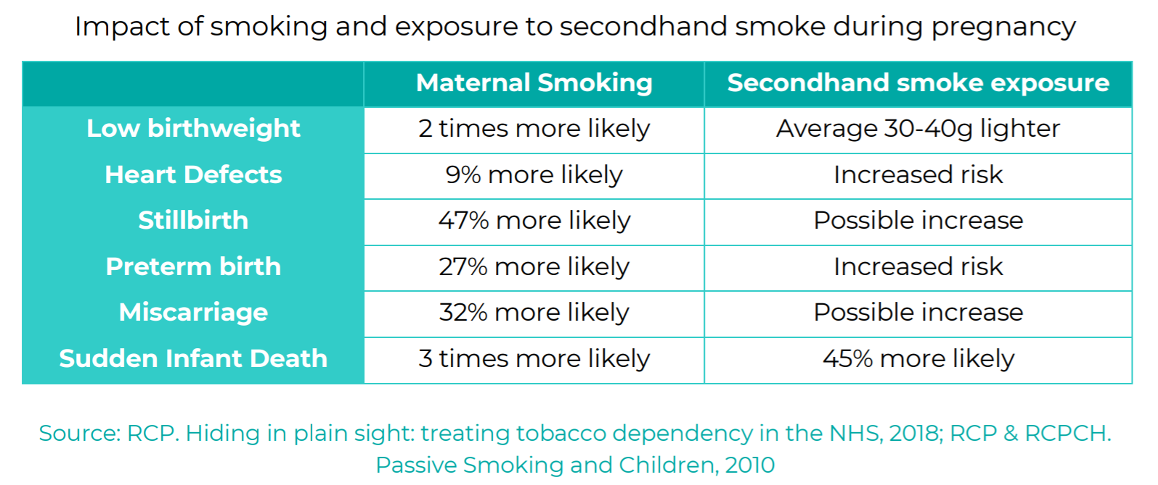
The burden of maternal smoking
Smoking is the main modifiable risk factor for a range of poor pregnancy outcomes
Around 61,500 babies in England are born to mothers who smoke each year.
National ambition in the government`s tobacco control plan to reduce smoking at time of delivery to 6% or lower by 2022.

Slide 3
Progress in smoking rates
Q1-3 2020/21 SATOD is 9.8%

Slide 4
Tobacco Control Plan for England
Ministers have approved the development of a new Tobacco Control Plan for England by Summer 2021
PHE have been tasked by DHSC to begin scoping work and to engage with stakeholders under the theme of Smokefree 2030
Ministers have expressed interest in additional focus on recovering from the impacts of COVID-19, tackling health inequalities and addressing smoking in pregnancy
Specific proposal being scoped around the introduction of financial incentives for reducing maternal smoking
This will also be informed by updates to the NICE guidance which is due for public consultation this Summer

Slide 5

Supporting the NHS Long Term Plan implementation
For smoking and pregnancy this involves:
On an opt-out basis, women will be able to access stop smoking advice and nicotine replacement therapy from within Maternity teams
From 2020/21 there will be support for early implementer sites to roll out action based on the Greater Manchester SmokeFree Pregnancy model (minus incentives). Plan for full national coverage by end of 2023/24.
Once the SmokeFree Pregnancy model is established, the potential for incentivisation will be explored, along with how best to support fathers
PHE has appointed to 7 regional posts for two years to help practically support the roll-out of the NHS LTP commitments

Slide 6


Specific resources
New:
e-lfh training. Modules on the role of health visitors, and also on CO resumption
Smoking Townscape
Coming soon:
SiP Return on Investment model
CLeaR is an improvement tool for tobacco control, initially developed by ASH, and now managed by PHE.
Notes:
PHE is developing a return on investment model for interventions related to treating pregnant smokers
This will allow areas (whether LA, Trust, CCG, LMS, etc) to enter its current package of stop smoking interventions for pregnancy, then compare this to other packages (e.g. adding incentives, enhanced support, etc)
The model will show the cost of alternative packages, but also the expected return on investment. Plus, estimate number of women that can be supported to quit by the various packages
Aiming for RoI model to be tested and available in Quarter 1
CLeaR is an improvement tool for tobacco control, initially developed by ASH, and now managed by PHE.
It enables localities to score themselves against established standards of good practice such as NICE guidance.
It is designed to highlight local strengths and areas for development, which can inform local improvement plans.
The original CLeaR model covered the breadth of tobacco control, but now has “deep dive” tools to look in more detail at specific issues such as smoking in pregnancy
Offer of PHE support to help with the assessment process
https://www.gov.uk/government/publications/clear-local-tobacco-control-assessment

Slide 7
Summary
Smoking in pregnancy remains the main modifiable risk factor for a range of poor pregnancy outcomes. Partnership is key to effective and sustainable action.
The Tobacco Control Plan for England, NHS LTP, NICE, and Maternity Transformation Programme will all provide an opportunity to progress cross-agency working.
It`s positive that, as we increasingly emerge from the focus on COVID, more places are starting to discuss SiP as a specific issue.
Tackling maternal smoking saves lives (and money) in the short, medium and longer term.

