Slide 1


E-cigarettes in Local Stop Smoking Services Case Study: North and West Northamptonshire
Richard Holley – Area Manager

Slide 2
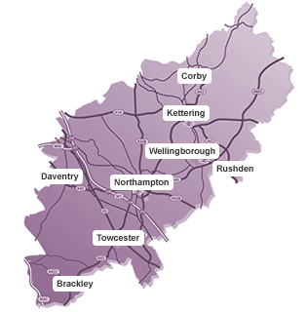
How it Began
2019: Changes to delivery model across Northamptonshire
How best to increase quit rates without increasing costs?
History of working with vape stores
Impressive results from neighbouring stop smoking services
DPH – pro-harm reduction
By the end of 2019 the decision was made to procure the service its own supply of e-cigarettes

Slide 3

Securing a provider
No industry links
TPD compliant
Flavour/device diversity
Customer service and ongoing support
Technical expertise
Provider secured Jan 2020 – rolled out fully Feb 2020

Slide 4
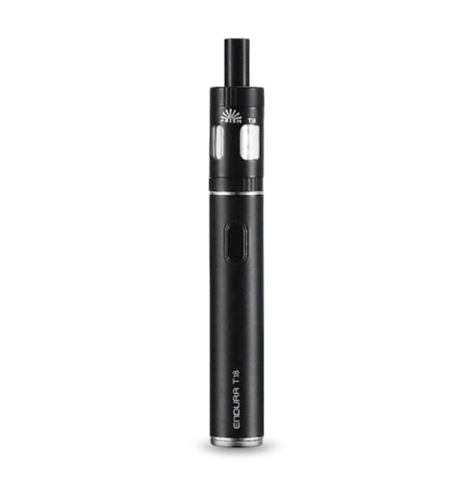
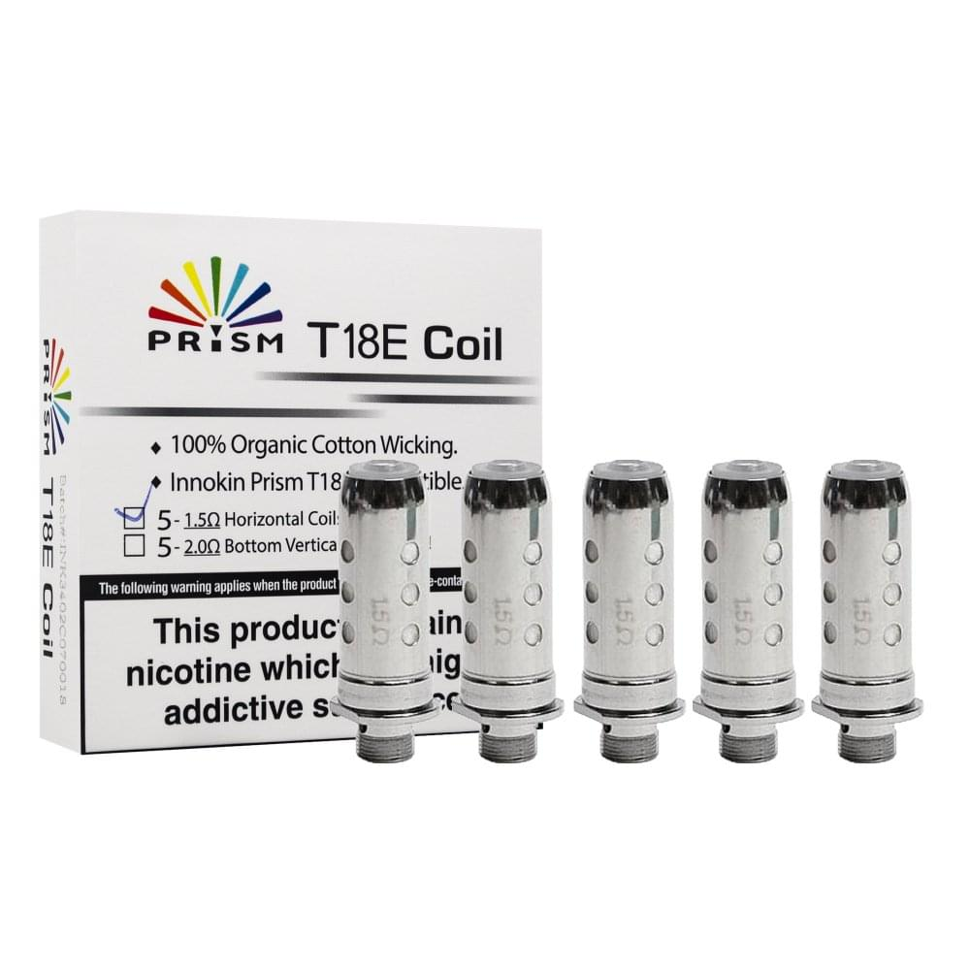
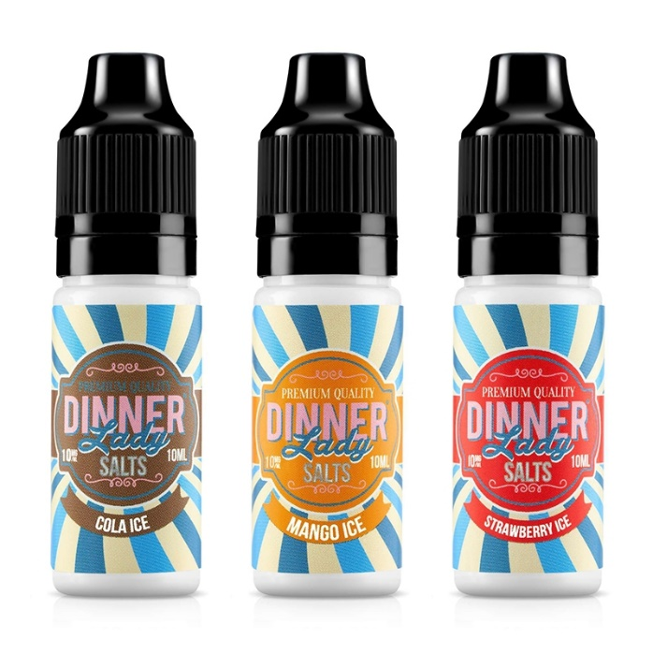
The current Offer

Slide 5
Results
Product | No. of Users | 4WQ | Quit Rate%
Any E-Cig | 2,041 | 1,505 | 73%
E-Cig + NRT | 1,437 | 1,153 | 80%
E-Cig | 604 | 352 | 58%

Slide 6
Difficulties in implementation
Vape Stores
Access
Storage

Slide 7

Summary
Vaping formed part of a service wide transformation
Logistical difficulties galore
Excellent results
Reduced costs
Richard.holley@northnorthants.gov.uk

