Slide 1
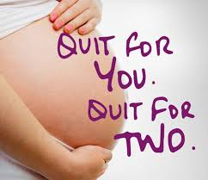

Supporting women to a smoke free pregnancy;
A new midwifery model
Hannah Leonard
Consultant Midwife
University Hospital Southampton
Christina Nurmahi
Women & Newborn Lead Pharmacist
University Hospital Southampton

Slide 2
Background
2019- Commissioned smoking cessation services for Southampton City were withdrawn
The only support available online or via an app.
Our smoking at time of booking rates – 14.4%
Areas of high need with 25% smokers in some caseloads
Our response - To develop an in-house model
A new midwifery led service with:
  Smoking cessation trained midwives
  NRT provision at point of contact
  Fortnightly support and a 12 week quit programme
  Alongside routine CO monitoring in antenatal care

Slide 3
Process
Staff training
NRT supply legislation– permitted under midwives exemptions
Infrastructure to provide NRT to community Hubs
CO Monitoring
Funding agreed
  Public Health midwife appointed to lead model
Pathway for smokers developed
  Identification of smokers
  Triage
  Booking
  Smoking cessation support and quit journey
  Data capture
  NRT provision for inpatients

Slide 4
Southampton SFP Pathway
Identification of smokers at point of referral to service
Smokers triaged to SFP Midwife for booking appointment
Women able to opt out of support, however midwife continues to offer care and revisits as required. Able to take up offer at any time
Support accepted-
Initial consultation
NRT discussed/provided
Quit date set
CO monitoring for all women
At every antenatal appointment
Smoke Free Pregnancy Midwife
Consultation every 2 weeks
2 weeks NRT supplied
CO Validated
12 weeks support
Women living in Hampshire continue to be supported by commissioned service.

Slide 5
Challenges and Next Steps
Experience within the service has shown that uptake for public health interventions by pregnant women is better when the advice, support and message is delivered by a midwife due to continuity of care. Research has shown that women most likely to make lifestyle changes in pregnancy.
Challenges
Covid
Formulary limitations – 16hr / 24hr patches
Next steps
Improved data collection- Badgernet
Additional staff to be trained –Starting with NEST teams
Risk perception clinic
Develop in-house smoking cessation team to support inpatients
Role out to Hampshire women
Future opportunities
Partner support
Vape initiatives
Expand MSW role to support service provision
Postnatal care and ongoing support in community?

Slide 6
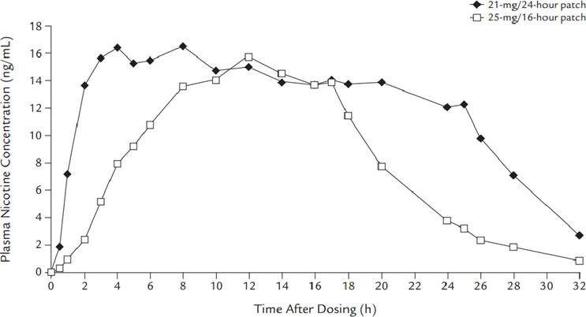
Nicotine patches
16hr and 24hr release profiles
24hour patches used and women asked to remove patches for at least 8 hours overnight to allow nicotine free period for fetus.

Slide 7

Thank you
Questions?

