Slide 1
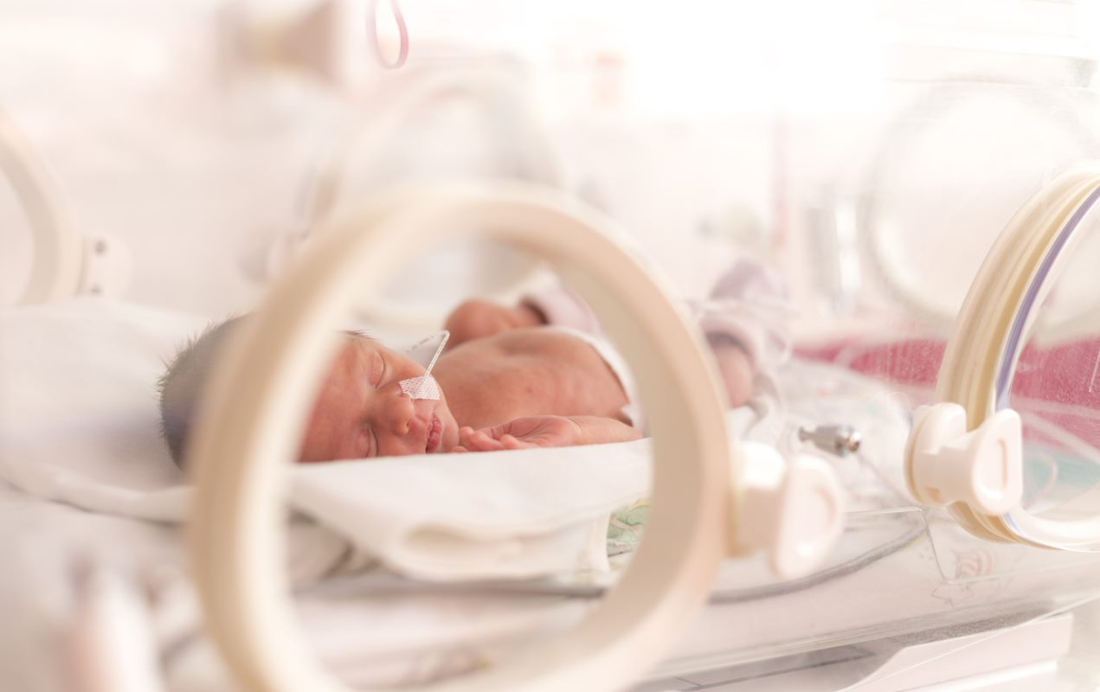



Professor Caitlin Notley
Norwich Medical School
University of East Anglia
c.notley@uea.ac.uk
@AddictionUEA
No Conflicts of interest
Notes:
Thank you. Acknowledge funders. No financial or other COIs. Pre-recorded – here for questions.

Slide 2
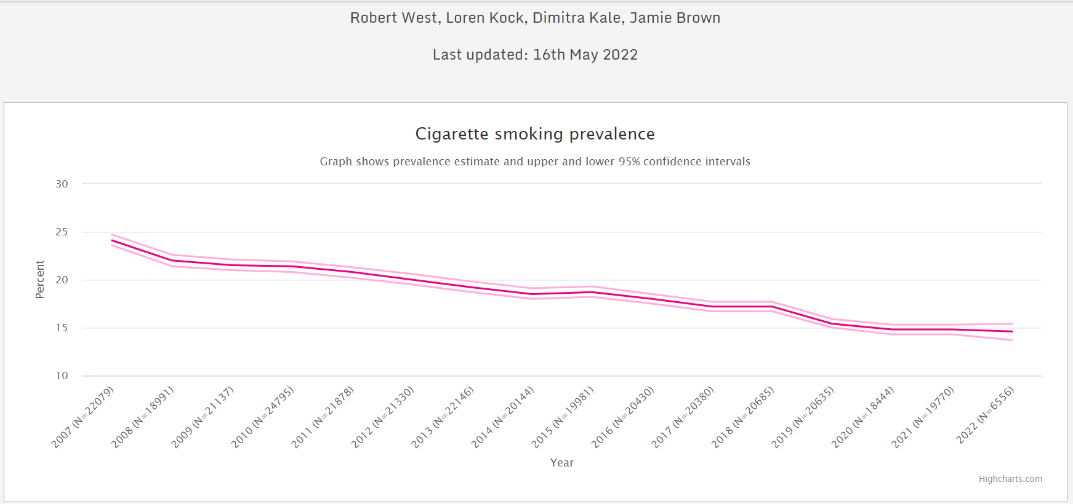
SMOKING PREVALANCE (Who still smokes?)

Slide 3

SMOKING PREVALANCE (health disparities)
Women of childbearing age - 20.1% of women aged 15-44 were current cigarette smokers (Lopez et al, 2018)
around 1 in 4 (23.4%) people in routine and manual occupations smoked, this is around 2.5 times higher than people in managerial and professional occupations (9.3%) (ONS, 2019)
Only 27.8% ( of NICU) families earning less than $25,000 reported having a total smoking ban in place relative to almost 60% of families earning more (p < .01). (Stotts et al, 2011)
Notes:
Higher smoking prevalence in young women of childbearing age, people on lower income, unemployed or in routine or manual occupation, and less home smoking bans for families on lower incomes

Slide 4





SMOKING PREVALANCE – NICU families
Nichols A, Clarke P, Notley C Parental smoking and support in the NICU. Archives of Disease in Childhood - Fetal and Neonatal Edition 2019;104:F342.

Slide 5
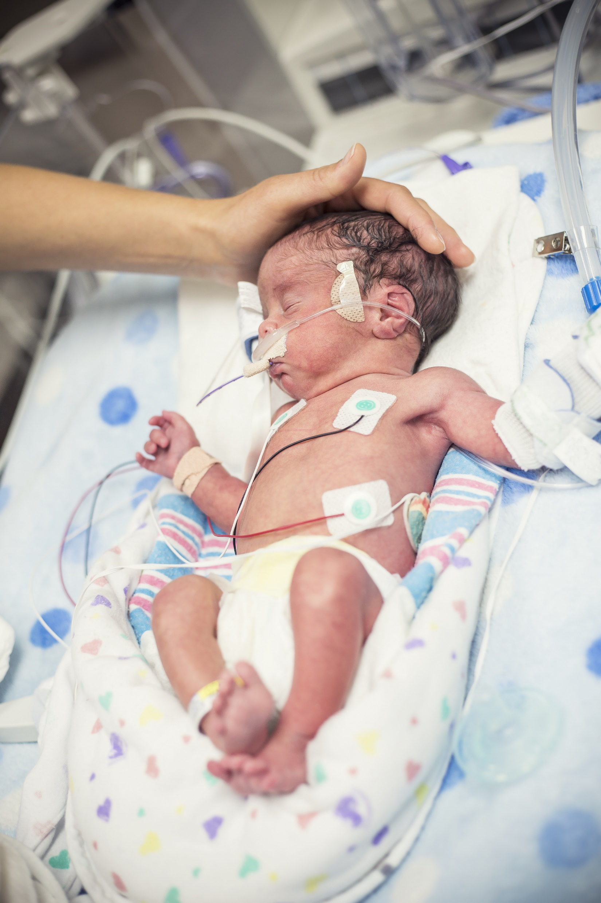
IMPACTS (Northrup et al)
Smoking particles have been found on NICU furniture and incubators
Smoking chemicals found in urine of NICU babies of smokers (including formula fed babies or where only partner smokes)
Babies of smokers likely to stay longer on NICU (Adams et al, 2002)
NICU babies with greater exposure to smoking particles have less diverse microbiome
Notes:
Focus on research relating to NICU babies, Northrup et al who are based in the states.
They found that even in the relative sterile environment of a NICU…
… not exposed through breastmilk – only source could have been thirdhand smoke.
Impact of this is.. Neonates born to smoking parents risk a longer NICU admission than those born to non-smokers.
… only just learning about the importance of the microbiome and we tend to think about it in relation to breastfeeding, but exposure to smoke also has a huge impact. So even before they leave the NICU smoking on having an impact. Once babies go home to a smoky environment we see increased rates of…

Slide 6
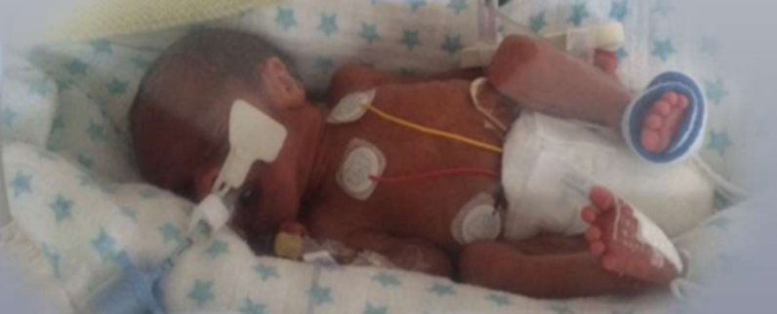
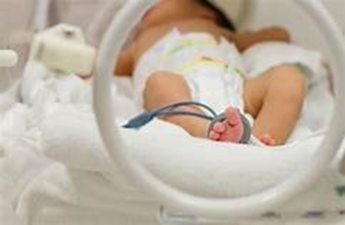
IMPACTS
Babies born to smokers weigh 200g less than those born to non-smokers and are at 40% higher risk of being preterm
Lung development is incomplete. Many babies need significant medical intervention and protracted respiratory support. These infants are vulnerable to infection.
SHS exposure in home environment increases rates of SIDS, respiratory conditions, and other infections in NICU babies.
Children of smokers are 4 times more likely to go on to be smokers themselves.
Notes:
Babies born to smokers weigh on average 200g less than those born to non-smokers (1), and are at 40% higher risk of being born preterm. The relative risk of admission to NICU for infants of smokers is increased by at least 20% compared to infants of non-smoking mothers. Mothers of infants requiring admission to NICU are more likely to be smokers.
We undertook a review of routinely collected patient data at NNUH, and this, together with our PPI work suggests that this is likely under reporting smoking prevalence. Of 32 parents approached during a 4-month period, approximately a third were smokers and a third were ex-smokers. Mothers were often not asked about their smoking status at delivery at all, despite these figures being used for reporting purposes. Fathers are not included within these figures, although we know that for women who quit smoking during pregnancy, having a smoking partner is a major predictor of postpartum relapse and contributes towards second-hand smoke exposure.
As aware, children of smokers.. In the short-term such as increased infection rates and asthma, and long-term for diseases such as cancer. There also 4 times…
Lab… and can also be a cause of infection and respiratory issues. THS refers to smoking particles that remain on smokers’ skin, clothes and furniture after they’ve finished smoking.

Slide 7
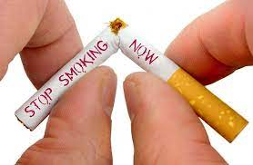
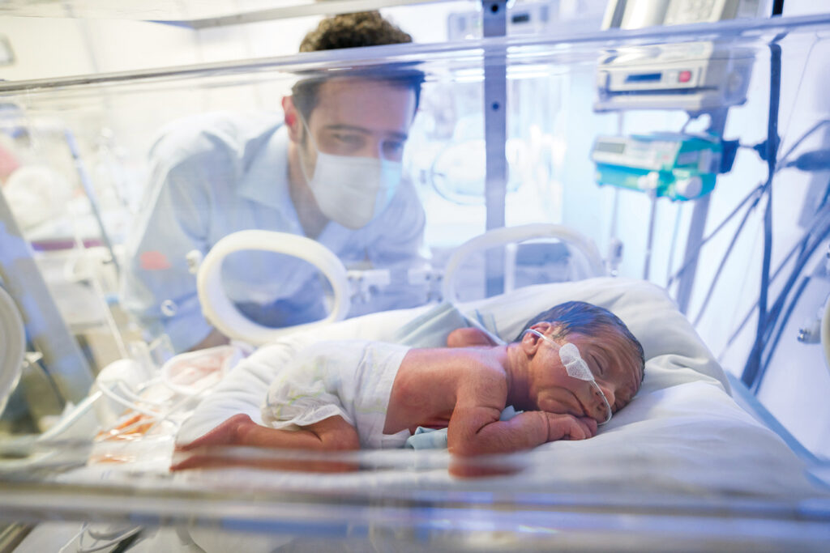
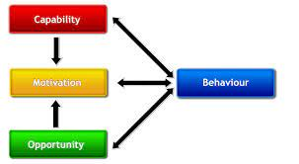
WHY DON’T PARENTS JUST STOP?
Notes:
DIFFICULTIES WITH CESSATION - for many smokers it may take 30 or more quit attempts before being successful (Chaiton et al, 2016)
STRESS AND RELAPSE The preterm birth of an infant and the subsequent time spent in the NICU are extremely stressful for mothers and fathers (Åhlund et al, 2009). Stress is a leading predictor of postpartum relapse (Orton et al, 2018)
CAPABILITY, OPPORTUNITY, MOTIVATION (deficits in) motivation – for self and don’t know helaht impacts on baby

Slide 8
WHAT MIGHT HELP?
Stopping smoking, or remaining abstinent, is one of the few things that parents can do to significantly improve the longer-term recovery and health of their offspring.
NHS Long-term plan, NICE guidance, Kahn review
NICU admission may represent a ‘teachable moment’ for smoking cessation but there is no UK intervention.
NRT & Behavioural advice (Northrup, 2020, feasibility trial)
NRT and incentives (Stott et al, 2020)
“ More robust interventions that include maternal and partner/household smoking cessation are likely needed”
Notes:
…All parents, without exception, in our PPI work said that they would be amenable to receiving smoking cessation or relapse prevention support, and would especially welcome advice on maintaining a smoke-free home
The National Institute for Health and Care Excellence (NICE) guidance recommends smoking cessation referral and support for all people, including patients, carers and visitors, in secondary care settings, and postpartum. NHS long term plan emphasise prevention and suggest that smoking cessation support should be available at every point of contact with the NHS.
Given the concurrent expressed desire for support from both parents and professionals, and guidance, and the fact that NICU admission may represent a teachable moment, there was a clear need for developing an intervention to offer support.

Slide 9

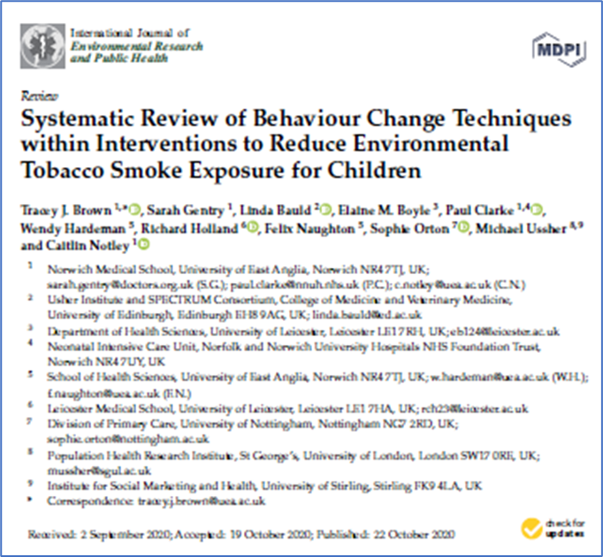
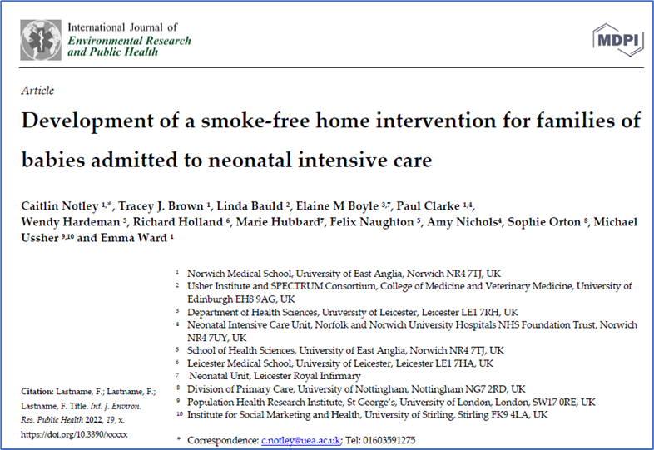
LOVE MY LUNGS DEVELOPMENT
1
Systematic review of interventions to reduce environmental smoke exposure for children
2
42 interviews with NICU parents
Focus groups with 23 NICU HCPs
3
Person centred interviews with 10 NICU parents focusing on intervention components
Notes:
Aim of NESCI was to define and develop a prototype intervention. We followed MRC guidance for developing complex interventions
Systematic review of paediatric setting interventions to identify determinants and techniques for reducing environmental tobacco smoke exposure. Not talk too much about that, but the review suggested that approaches using counselling and self-help were most effective.
We conducted focus groups with HCP and interviews with parents whilst their baby was on the unit including parents who were smoke or were recent ex-smokers and importantly fathers. Interviews and FGs asked what support might be needed, in what form, delivered by who, and for what time duration.
Refine a prototype intervention through further interviews with NICU parents who were smokers.

Slide 10

WHAT MIGHT HELP?
Top 10 messages from intervention development work
Intervention should be theory driven targeting BCTs most likely to effect change
Intervention needs to target Mums, Dads, and wider family
Parents want to be asked about smoking, most want to quit and need support
Support should be immediate, during the NICU admission
Parents want to know the hard facts about the impact of tobacco on their baby
Information on third hand smoke, from baby perspective
Digital, easy to access materials
NRT and / or e cigarettes
HCPs bespoke training enabling discussions with parents about smoking in a way that does not compromise the relationship
Brief intervention and support offer to avoid stigma and shame
Notes:
… now we are going to hear from NICU parents about their experiences and what might have helped

