Slide 1

NHS England and Improvement’s contribution to the prevention agenda and closing remarks
Professor Jacqueline Dunkley-Bent OBE
Chief Midwifery Officer for England
12th May 2021 ASH and the SiP Challenge Group Webinar

Slide 2
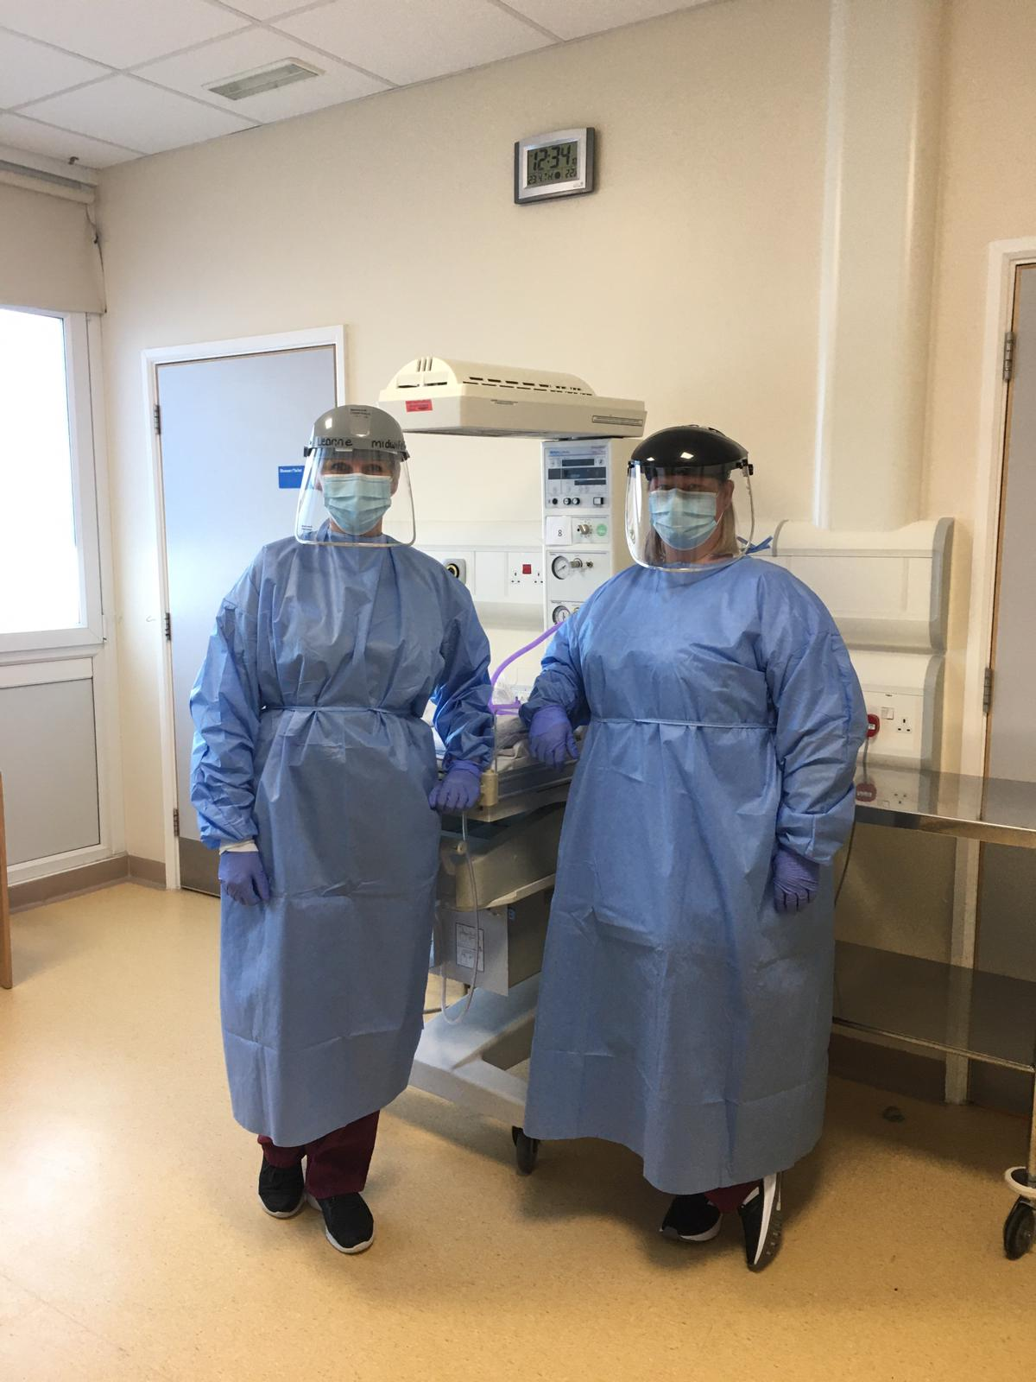
Recognition of the impact of Covid-19
Workforce challenges
CO monitoring ‘pause and restart’
Service reconfigurations
Restrictions on support partners
Thank you

Slide 3
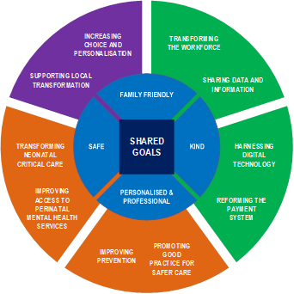
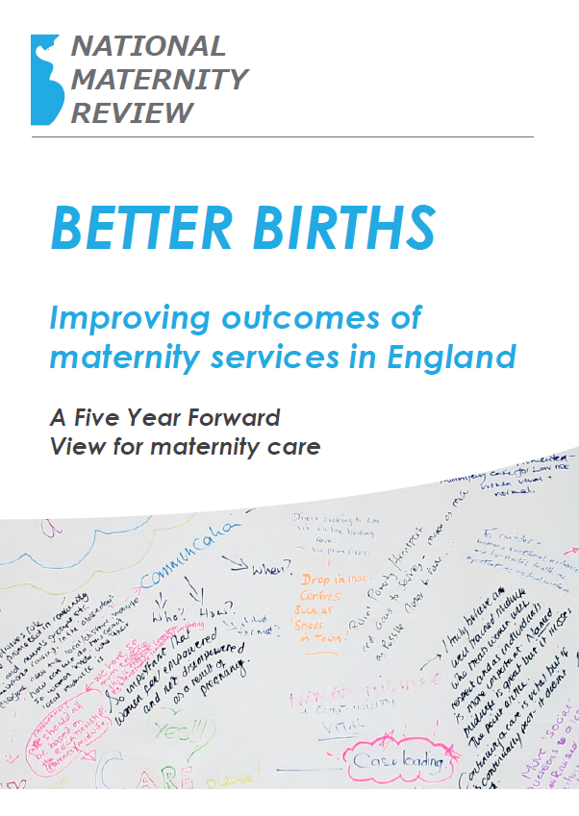
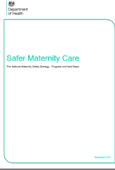
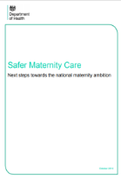
Maternity Transformation Programme at a glance
Overseen by the Maternity Transformation Programme Board
10 workstreams, multiple deliverables, owned across organisations
28 Recommendations from Better Births
2016 – Safer Maternity Care Action Plan – 11 actions
7 Regions assuring the delivery of 11 key ‘system asks’ through 44 Local Maternity Systems
2017 – Progress and next steps – 9 actions
Delivery challenged and supported by the Stakeholder Council

Slide 4
Maternity transformation - what are we trying to achieve?
The programme’s twin, mutually-reinforcing aims are to improve the safety of maternity care and improve outcomes, and to improve the personalisation of care so as to empower women to get their new or extended family off to the best start.
Safety Aim
Our aim is to make measurable improvements in safety outcomes for women, their babies and families. We are doing this by bringing together a range of organisations contributing to maternity and neonatal safety in order to deliver the recommendations set out in Better Births and to deliver the government’s strategy to halve the 2010 rates of stillbirths, neonatal and maternal deaths and intrapartum brain injuries in babies by 2025, with a 20% reduction by 2020. This means:
reducing the rate of stillbirths from 5.1 per 1,000 births in 2010 to 4.1 in 2020 and 2.5 in 2025.
reducing the rate of neonatal deaths from 2.9 per 1,000 births in 2010 to 2.3 in 2020 and 1.5 in 2025.
reducing the rate of brain injury from 4.9 per 1,000 births in 2012 to 4.1 in 2020 and 2.5 in 2025.
reducing the rate of maternal deaths from 10.6 per 100,000 maternities in 2010 to 8.5 in 2020 and 5.3 in 2025.
reducing the rate of pre-term births by 25% from a 2015 baseline of 8% to 6% by 2025.
reducing the prevalence of smoking in pregnancy from 10.5% to 6% or less by 2022.
Personalisation Aim
The Better Births vision is personalised care, centred on the woman, her baby and her family, based around their needs and their decisions, where they have genuine choice, informed by unbiased information. Alongside this there is a ambition for most women to have continuity of carer, to ensure safe care based on a relationship of mutual trust and respect in line with the woman’s decisions
Enabled by:
All pregnant women have a personalised care plan by March 2021
All women can make choices about their maternity care during pregnancy, birth and postnatally
Most women (>51%) receive continuity of the person caring for them during pregnancy, birth and postnatally by 2021, with 35% of women booked onto a continuity of carer pathway in March 2020, and 20% in March 2019
More women can give birth in midwifery settings (at home and in midwifery units)
All women receive improved postnatal care, in line with an improvement plan agreed by commissioners and providers
All women can access their electronic maternity personal health records by 2024.
Health Inequalities
The programme’s twin aims are underpinned by a commitment to reducing health inequalities. We will not meet our twin aims if we do not tackle the underlying causes of health inequalities. Stark health inequalities persist - MBRRACE-UK - Maternal mortality: Black women x 5, Asian women x 2, most deprived x 3, Stillbirth rate is increasing for Black babies - 121% ↑, Neonatal mortality: Black babies 50% ↑, Asian 66%↑, deprived areas x 2

Slide 5
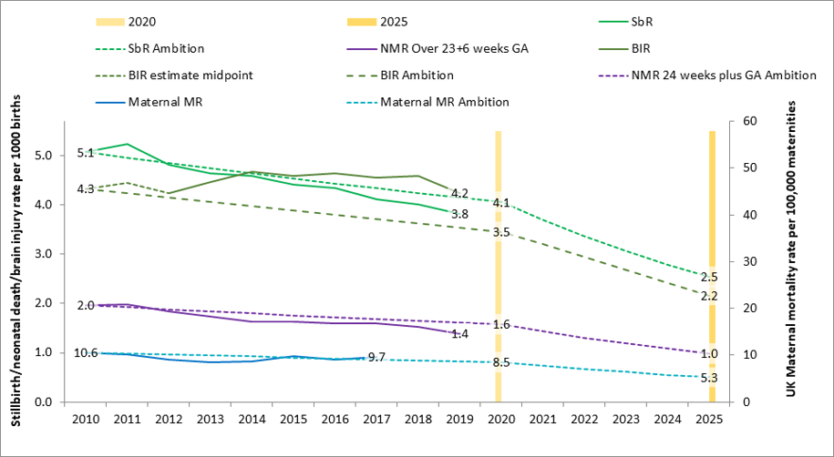
Progress towards Safety Ambition

Slide 6
Progress Continuity of Carer
Relationship-based care saves babies’ lives: Baby loss reduces by 16%; women 19% less likely to lose their baby before 24 weeks; reduces preterm birth by 24% (Sandall et al 2016)
Midwives report increased job satisfaction due to the better relationships with the women they care for and the higher standard of care they feel able to deliver (2019 survey of 432 staff across 8 LMS)
Many services were able to maintain their continuity of carer teams during the pandemic; new teams continue to be launched across the country
In November, there were:
  347 continuity of carer teams in place where each midwife provides all 3 elements of midwifery care
  214 teams placed in areas of deprivation
  165 teams placed where many women from Black, Asian or Mixed ethnic groups live
  2,322 midwives providing continuity of carer to 94,458 women

Slide 7
NHS Long Term Plan
NHS will accelerate action
to achieve 50% reductions
in stillbirth, maternal
mortality, neonatal
mortality and serious brain
injury by 2025
National Maternity Ambition
To reduce the rate of stillbirths,
neonatal and maternal deaths,
and brain injuries occurring
during or soon after birth by
50% by 2030; and 20% by 2020

Slide 8
Maternity transformation programme priorities
use data and insight to identify opportunities for improvement, particularly in relation to unwarranted variation and to address health inequalities
ensure all provider trusts investigate and learn from incidents, and share this learning
reduce by 50% the rate of stillbirths, maternal and neonatal deaths and acquired brain injuries by 2025
Support the regional commissioning of Maternal Medicine Networks, as required
Implement Saving Babies’ Lives Care Bundle (v2)
Improve local perinatal mental health pathways and provision
Implement continuity of carer, in line with programme ambitions

Slide 9

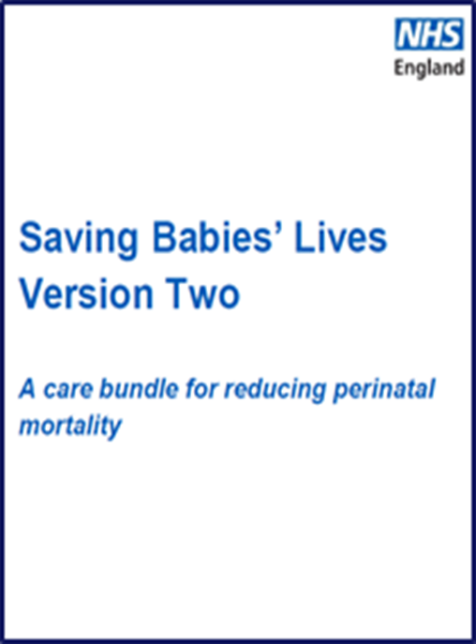
Long Term Plan
Key achievements
Next steps
•

Slide 10
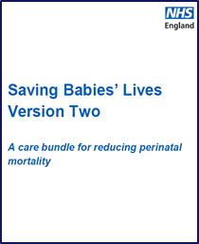
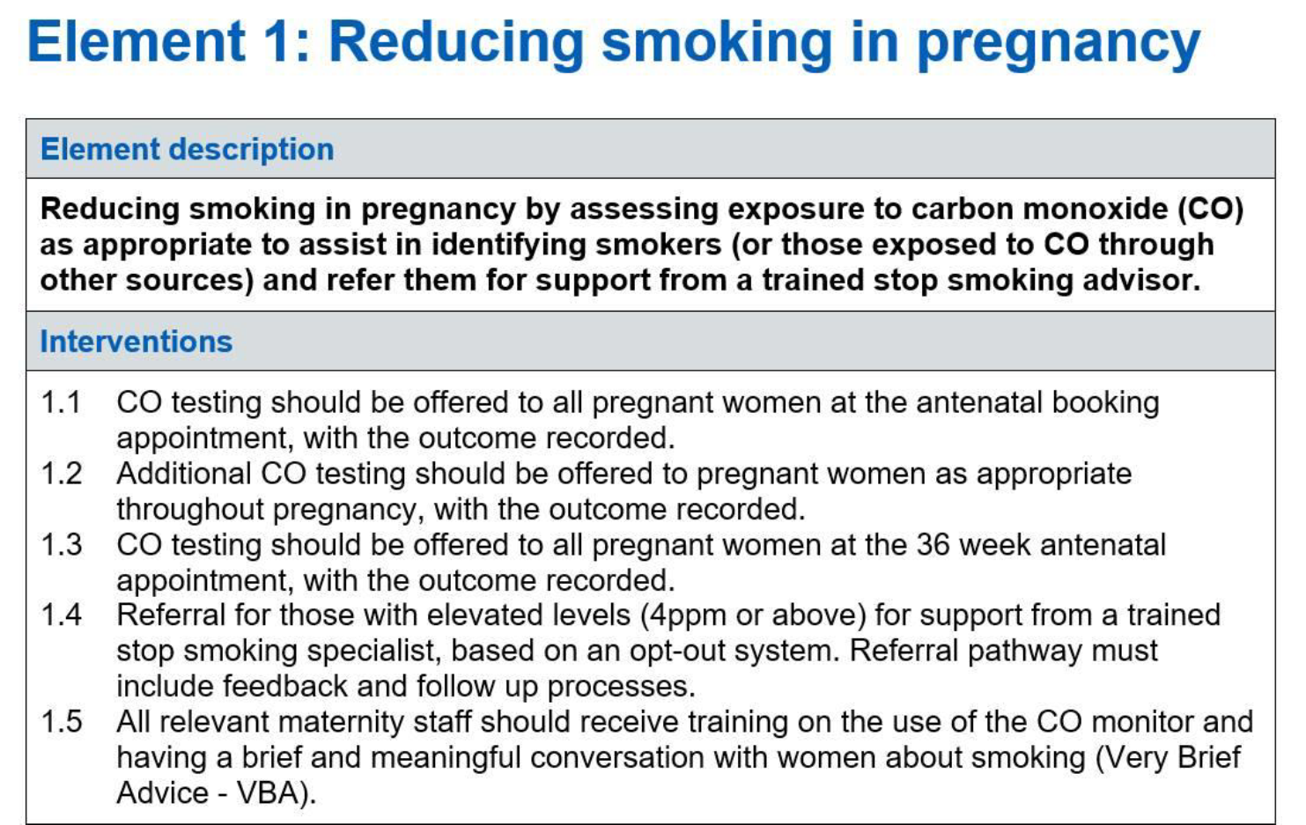
Saving Babies’ Lives Care Bundle Version 2 – CO monitoring pause and restart

Slide 11

Closing Remarks and ‘call to action’

