Slide 1



Hilary Wareing Director iPiP
Smoking in Pregnancy and Beyond
A Public Health Nursing Approach

Slide 2

Smoking is the single most important modifiable risk factor in pregnancy

Slide 3
Smoking in pregnancy
Reference: PHE (2015) Reducing infant mortality in London: An evidence based resource
Picture credits: Dr Marilena Korkodilos

Slide 5
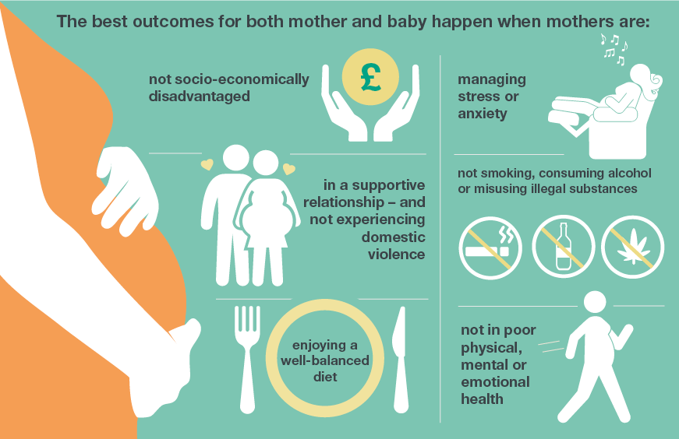


Prevention pathway: preconception to 6-8 weeks
Promote contraceptive choices
Improve preconception health and care
Improve postnatal care and transition to health visiting / early years
Promote healthy behaviours and reduce risk factors
Screening and immunisations
5
Fit For and During Pregnancy
Notes:
Improvement in prevention throughout the pregnancy pathway is necessary for an improvement in choice as it will mean not only an increase in the amount of choice available in a particular locality, but an increase in the proportion of those able to access a range of options through an improvement in their overall health and wellbeing. We think about preconception – 6/8 weeks but actually extended up to age two to further develop support offered. We have a range of programmes from routine screening through to promoting healthy behaviours such as cutting out smoking and drinking
Safety in the delivery room is also impacted by the health of the women under the care of maternity services.
PHE is providing support to local maternity systems to promote a whole systems, holistic approach to prevention both to build healthy places to have and raise families, and through supporting women and their partners.
Provide early, universal access to information and support for health issues such as smoking, obesity and poor mental health
Embed opportunistic enquiry on need for contraception and preconception care
Improve access to immunisations recommended in pregnancy
Upskill workforce to give public health advice, offer or refer to interventions

Slide 6
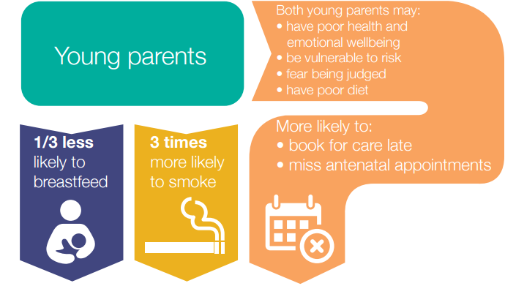
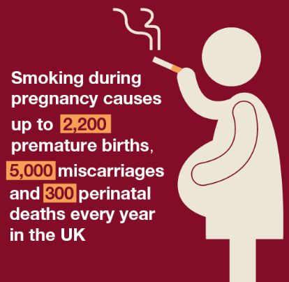
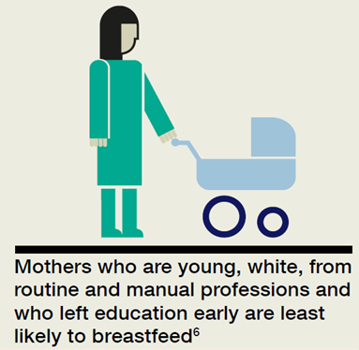
Reducing inequality
Smoking is the main modifiable risk factor in pregnancy
Geographical variation: 2% - 26.6% SATOD
FNP RCT: 56% smoking in late pregnancy
3 times as likely to have poor mental health
Up to 20% of women develop a mental health problem during pregnancy or within a year of giving birth – this can have significant and long-term consequences
Pregnancies in areas of highest social deprivation 50% more likely to end in stillbirth or neonatal death
5
Notes:
A reduction in health inequalities and improvement in prevention is vital for delivering on the ambitions of every woman fit for pregnancy and every woman fit in pregnancy.
SiP: Smoking is the main modifiable risk factor in pregnancy
70,000 babies born to mothers who smoke
PMH: One of the strongest predictors of wellbeing in the early years is the mental health and wellbeing of the mother or caregiver
- up to 20% of women experience a mental health problem during pregnancy or within a year of giving birth
With the continued development of the maternity services data set this is helping us to look at risk factors and ineqaulities

Slide 7
Smoking at Time of Delivery: trend over time

Slide 8
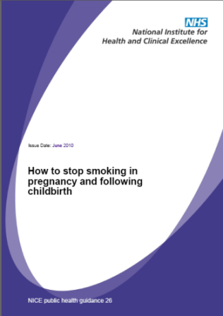
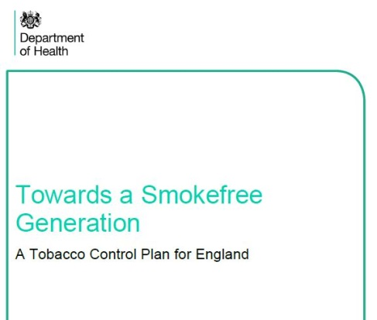

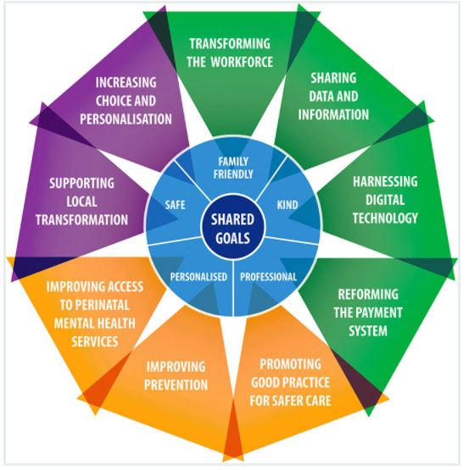
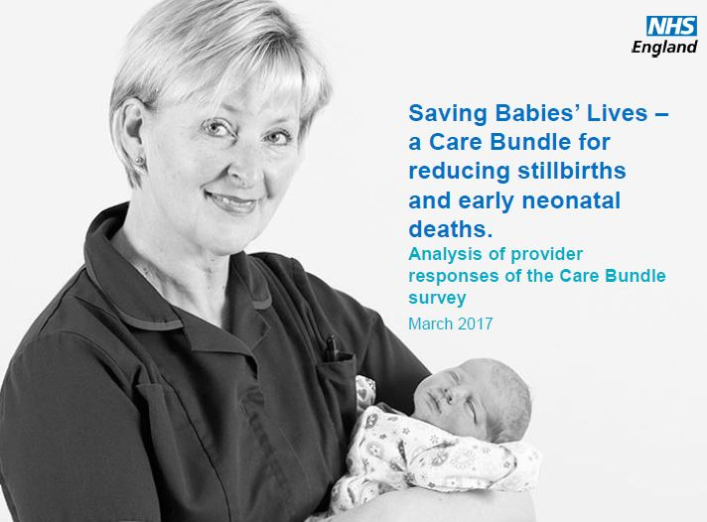

System-wide action
NICE Guidance (PH26) 8 Recommendations requiring action across the healthcare system. Including:
Identifying & referral (CO screening, opt-out)
Contacting referrals & delivering support
Meeting needs of disadvantaged pregnant smoker
Training to deliver interventions
Tobacco Control Plan, July 2017
New ambition to reducing smoking in pregnancy to 6% or less by 2022.
Care Bundle
Element 1: Smoking Cessation
Local prevention planning:
- Sustainability and Transformation Plans
Prevention at Scale
Local Maternity Systems
Maternity Transformation Programme:
Improving Prevention (work stream interdependencies)
Smoking in Pregnancy Challenge Group

Slide 9

Smoke free NHS
CO monitoring
Advice & support
Antenatal & SATOD data
Commissioning stop smoking services
Promoting smoke free active communities
Smoke free fitness
Engaging YP
Smokefree Pregnancy Townscape
CO monitoring Advice
Engaging whole families to be smoke free
(importance of Dads and grandmothers)
Education science PHSE, sport
Smoke free homes
(New baby passive smoking)
Smoke free pregnancy advice
Smoke free premises
Occupational health
Media campaigns

Slide 10
What women want?
Women expect to be asked and screened | “It’s about attitude not the profession, I don’t care if they are nurses, doctors or midwives, they just need to tell me the facts and understand me”
To have a conversation (expectation), done in the right way at the right time | “Being shown all the graphic images makes it real. Being spoken to like they understand and not just talking at you” “ Being direct and honest”
Relate it to them, their experience, their needs, their fears | “Relate it to a person, emotions make it so much more real “it can happen to me” “Don’t just say its not good for the baby and leave it at that. It just doesn’t seem important”
Not just a one off conversations | “It feels like they are just asking ‘cos they have to” “do you smoke? yes”-Want to quit?, No-The end”
Style and content- language is key to | The way you speak to someone is vital – don’t tell me ‘I must not smoke”, but “ Let’s see what stops you from stopping smoking and see how we can help you to give
Involve people around them | “She made a separate appointment for my husband and discussed the risks of second hand smoking to the baby… this made it seem so important, that I certainly wasn’t going to take any risks”

Slide 11
What Health Visitors told us
Over 90% of health visitors reported recording smoking status of pregnant women and new mothers
80% received no handover information on women's smoking status or quit status
consider smoking as one of many conversations they are expected to have in limited time and contact
report they offer VBA “ask, advise and signpost” generally to the GP or SSS if woman wants support to stop
report second hand smoke conversation seems more acceptable
feel that smoking isn’t always seen as the most important issue
95% of Health Visitors reported not using CO monitoring with pregnant women or new mothers
93% of Health Visitors wanted more training on smoking in pregnancy and new mothers

Slide 12
.
Barriers and enablers
Barriers
Enablers
Lack of time and resources
Tick box to meet targets
Feeling that its not their role
Lack of training and knowledge
Unclear pathways for support
Professional view of the subject to whether they broach the conversation
Concern about the trust and relationship
Normalisation of behaviours, conditions and practice
If the mum asks them
If they have knowledge of pregnancy (eg previously a MW)
Knowing smoking status on referral
Being able to offer CO testing
Leadership, so role seen as the ‘norm’ and ‘routine’

Slide 13
What do we need?
Knowledge and confidence to have a challenging conversation
Face to face training to build knowledge and change practice
CO monitors (important tool but not essential)
Relationships with and confidence in other services
Improved communications/information flow s between organisations
Materials specifically for health visiting
This being a priority within commissioning and provider organisations

Slide 14
Training
Design:
The key messages were:
training should be offered as part of a whole systems approach
the focus should be on very brief advice that uses time effectively
the need to increase professional knowledge of and confidence in the support available to support women to quit smoking
the need to enhance confidence to use a CO monitor as part of a brief intervention
to enhance confidence to have the conversation
to build on existing skills

Slide 15
Aims and Objectives
The overall aim of the training is:
to enable practice nurses and health visitors to identify those women
who are smoking in pregnancy and early after birth, raise concern
about the impact and refer to specialist support to quit smoking.
The objectives are to support participants to:
understand the impact of smoking on foetal and child health
be confident in assessing women’s CO levels and identifying those who smoke
recognise the opportunities within their practice to undertake CO testing and deliver very brief advice
be confident to support a pregnant woman / new mother to take action
be aware of support available and how to access this

Slide 16
Evaluation of Local Pilot Sites
Post training participants reported what had been most beneficial:
“Top tips for awkward questions.”
“Role play for something so emotional”
“Learning about the effects of smoking and second-hand
smoking”
“Real life situations and how to manage them.”
“Practice scenarios.”
Use of CO monitors and results.”
“How to have a difficult conversation.”
“Language to use for best effect.”

Slide 17
Evaluation of Local Pilot Sites
Pledges made by participants included:
“Be clear and consistent with messages.”
“To use the CO monitor and make referrals.”
“I will start screening at the first post natal visit.”
“I am going to monitor everyone at new visits. ”
“I will have a conversation about smoking at my visits.”

Slide 18
Training the Trainer - Pilot
Overall Aim
To enable participants to be confident to deliver very brief advice training to public health nurses.
Objectives
To support participants to:
understand the impact of smoking on foetal and child health
understand the national context regarding smoking in pregnancy and beyond
have an understanding of how the training was developed
recognise the opportunities, within health visiting and practice nursing, to deliver very brief advice
be confident to deliver training utilising the resources provided

Slide 19
What Next?
Knowledge and confidence to have a challenging conversation
Face to face training to build knowledge and change practice
CO monitors (important tool but not essential)
Relationships with and confidence in other services
Improved communications/information flow s between organisations
Materials specifically for health visiting
This being a priority within commissioning and provider organisations
Knowledge and confidence to have a challenging conversation
CO monitors (important tool but not essential
Relationships with and confidence in other services
Improved communications/information flows between organisations

Slide 20
Thank you
Any questions?

