Slide 1


Can e-cigarettes help people experiencing homelessness to stop smoking when provided by staff at support centres?
Lynne Dawkins​
Professor of Nicotine & Tobacco Research​
dawkinl3@lsbu.ac.uk
​
This project is funded by the National Institute for Health and Care Research, Public Health Research Programme (NIHR 132158). The views expressed are those of the author(s) and not necessarily those of the NIHR or the Department of Health and Social Care.
Lynne Dawkins has acted as a consultant for Johnson & Johnson around nicotine containing products for smoking cessation

Slide 2

Background
Few smoking cessation trials focusing on homelessness
Quit success rates are low
None focusing on e-cigarettes (EC)
There is interest in quitting smoking, using EC and willingness to take part in research
BUT intervention needs to be delivered ‘in-house’ and by trusted individuals
PPI

Slide 3
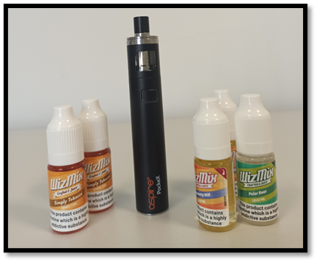
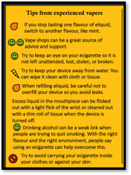
What was our intervention?
E-Cigarette (EC)
1 re-fillable Aspire PockeX EC
Up to 4-weeks supply of e-liquid
  Blueberry, mint or tobacco
  12mg/mL or 18mg/mL nicotine concentration
  Given out weekly by staff
Tips and tricks leaflet

Slide 4

What was our control group?
Usual care (UC)
Leaflet with quit advice, adapted from ‘NHS Choices’
Details & signposting to the local SSS

Slide 5



How was it delivered?
We trained:
220 staff across 32 centres
To deliver EC or UC

Slide 6

This is a ‘cluster’ trial
32 centres in England, Scotland and Wales randomly allocated to:
EC UC
Target sample:
N=480 adults accessing homeless support centres

Slide 7
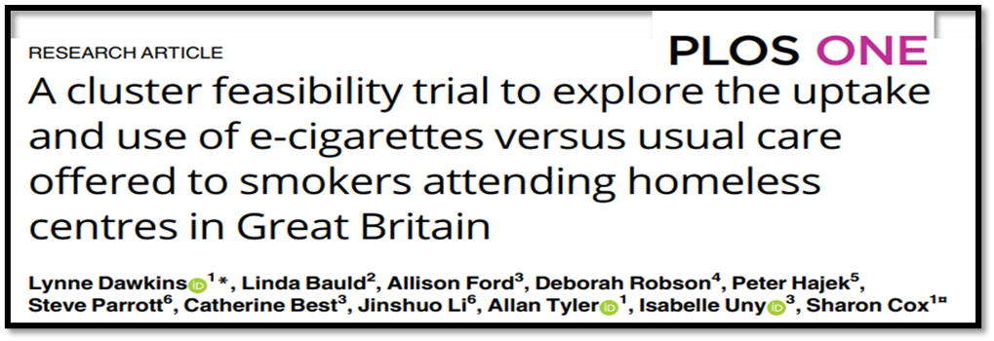
Is a large trial feasible?
In a 4-centre feasibility study we found:
Half of all eligible people asked, took part
82% still had the EC at 12 weeks & 63% at 24 weeks
59% were followed up at 24 weeks
24 week quit rates:
EC: 6.3% (3/48)
UC: 0% (0/32)

Slide 8
We wanted to find out:
The proportion in the EC and UC group who:
  Quit smoking completely through to 24-weeks (sustained abstinence)
  Stopped smoking for at least 7 days
  Reduced the number of cigarettes smoked by 50% or more
Any changes in risky smoking practices over time and between groups
The cost of the intervention
How the intervention was delivered; what were the mechanisms of any change in smoking behaviour; and contextual factors

Slide 9








Trial Timeline
EOI gained prior to centre allocation
Process evaluation:
Researcher observations, field notes, checklists
Centres randomised to EC or UC
2
Centre staff training
3
Participant recruitment
4
Follow-up assessment 12 weeks
8
Follow-up assessment 24 weeks
9
Centres recruited
1
Follow-up assessment 4 weeks
7
Completion of baseline assessment
5
Intervention delivery (staff)
6
Process evaluation:
Staff interviews
Process evaluation:
Participant interviews

Slide 10
Participant Flow
710 patients assessed for eligibility
55 ineligible; 178 not interested in participating
477 enrolled
1 centre withdrew prior to training and was replaced
32 centres and 477 participants randomised
16 centres and 239 participants allocated to the EC arm
16 centres and 238 participants allocated to the UC arm
Lost to follow-up (n=1)
1 withdrew consent
n=191 at 4 weeks
n=157 at 4 weeks
Lost to follow-up (n=1)
1 died
n=156 at 12 weeks
n=126 at 12 weeks
n=162 at 24 weeks
n=111 at 24 weeks
238 participants included in intention-to-treat analysis
236 participants included in intention-to-treat analysis

Slide 11



  Centre recruitment
  Participant recruitment
32
477
Translation
  Follow up rates
  4 weeks: 74%
  12 weeks: 60%
  24 weeks: 58%
12

Slide 12









Participant Characteristics
44 years
63% physical illness
15 cigs per day
CO = 16ppm
FTCD = 5.3
61% mental illness
83% male
65% drank alcohol
83% white
89% on benefits
50% illicit drugs

Slide 13


Findings: 24-week sustained abstinence (CO validated)
EC
2.1%
UC
0.8%
No significant difference between groups: aRR = 2.44; 95%CI: 0.51-11.7

Slide 14
% 7-day CO-validated quits at each follow up
7-day quit rates remain low but consistently higher in the EC group
Significant difference between groups: aRR = 2.96; 95%CI: 1.05-8.32

Slide 15
% reporting at least 50% reduction in smoking at each follow up
Smoking reduction was consistently higher in EC group
4-week: aRR=2.46; 95%CI:1.75-3.46
12-week: aRR=2.31; 95%CI:1.62-3.30
24-week: aRR=2.06; 95%CI:1.45-2.94

Slide 16
Risky Smoking Practices
Sharing cigarettes, smoking discarded cigarettes, asking strangers for cigarettes
20 – 50% reported ‘any’ engagement in these at beginning of the study
Most common - sharing cigarettes ‘going twos’

Slide 17
Risky Smoking Practices
(Y axes = % reporting any)

Slide 18

Costs (per participant)
 | EC £ (SE) | UC £ (SE)
Costs to deliver
Treatment costs | £92 (£0) | £50 ( £0)
Smoking cessation costs | £110 (£4) | £87 (£8)
Costs per quit (CO validated 24- weeks sustained abstinence) | £5,260 (£2,286) | £10,310 (£7,208)
Total cost (incl, primary, secondary care etc.) | £3,859 (£441) | £2,716 (£386)

Slide 19
Conclusions
Even in a sample not motivated to quit, short-term quitting and reduction in smoking is possible…
…particularly in people using an EC
But sustained abstinence is difficult to achieve…
…and rates were lower than expected reducing power to detect an effect
Cost per quit was high
It is possible to engage with homeless centres & people attending these services
There is interest in addressing smoking and using an EC
Additional support is needed to support long-term quitting

Slide 20

















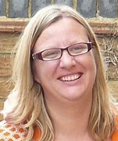







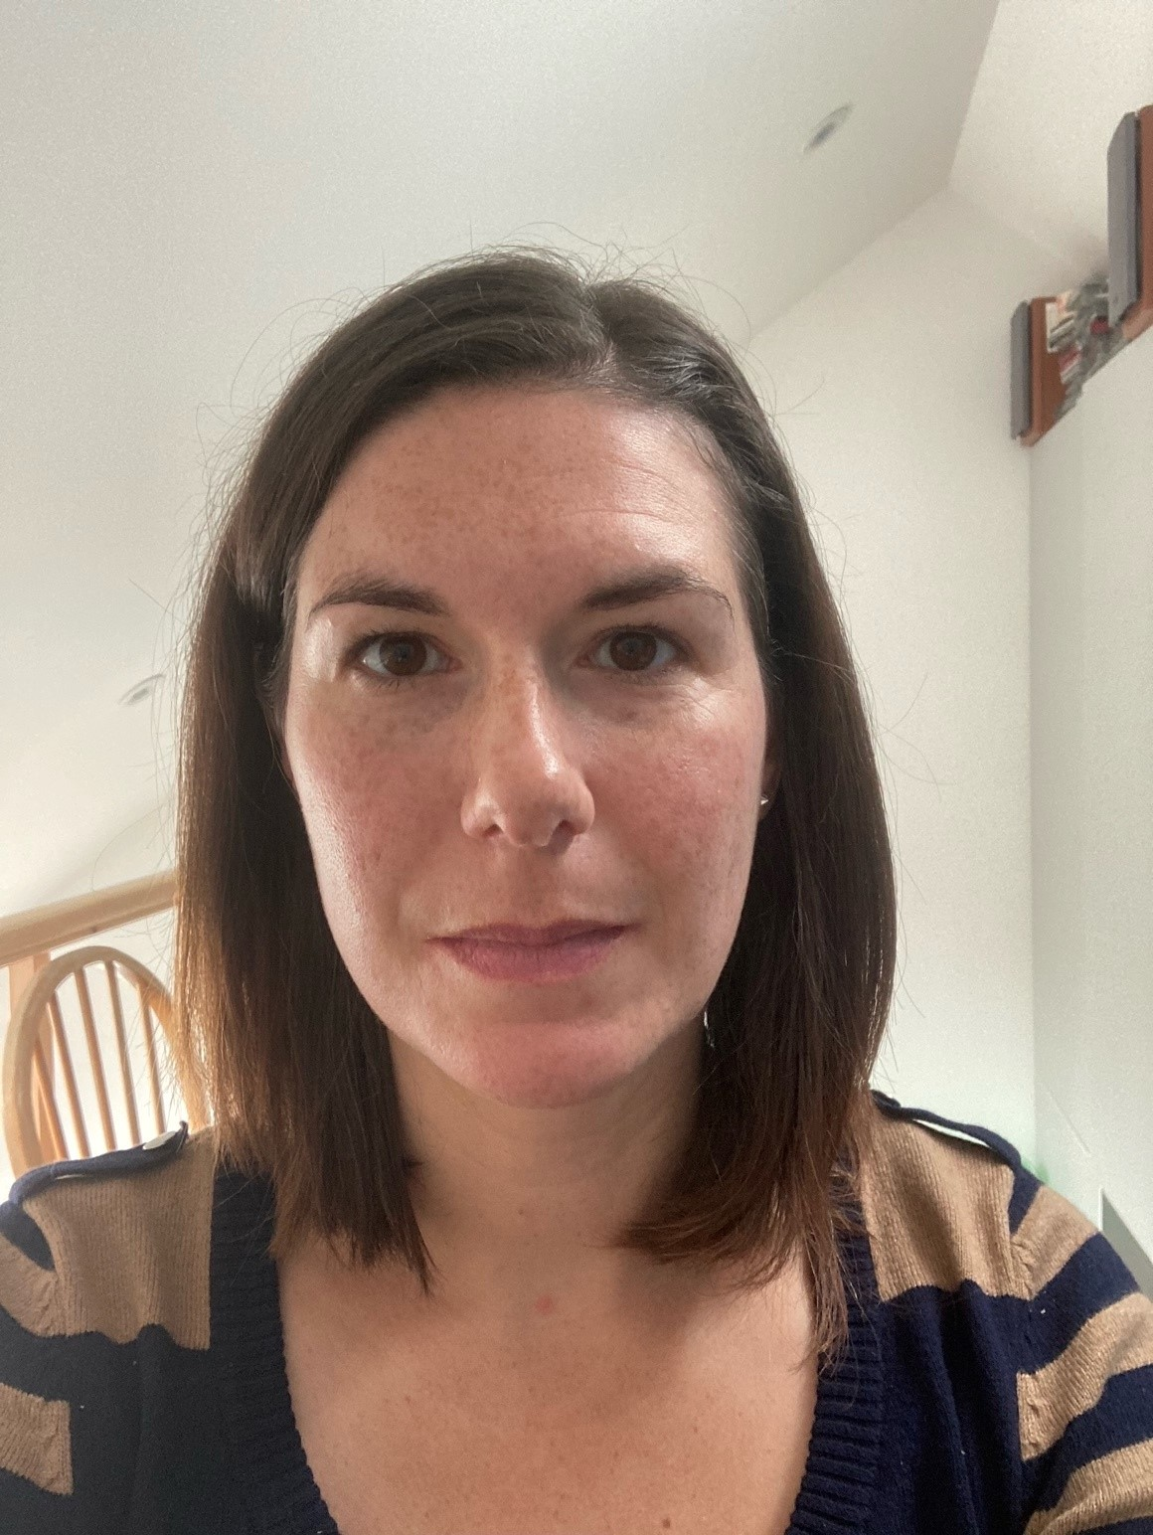




Acknowledgements
SCeTCH Team:
Prof. Lynne Dawkins, LSBU
Dr Sharon Cox, UCL
Dr Kirstie Soar, LSBU
Dr Allison Ford, Stirling
Prof Caitlin Notley, UEA
Dr Rachel Brown, Cardiff
Dr Allan Tyler, LSBU
Dr Emma Ward, UEA
Anna Varley, UEA
Jessica Lennon, Cardiff
Amy Edwards, Cardiff
Charlotte Mair, LSBU
Janine Brierley, LSBU
Bethany Gardner, LSBU
Lauren McMillan, Stirling
Laura Reid, Stirling
Dr Debbie Robson, KCL
Dr Francesca Pesola, QMUL
Dr Steve Parrott, York
Dr Jinshuo Li, York
Prof Linda Bauld, Edinburgh
Prof Peter Hayek, QMUL
Some of the 32 services:
The ARC
Maidstone Day Centre
Lodging House Mission
Purfleet Trust
Logos House Lifehouse
CATH Day Centre
London City Mission
In Hope, Providence Row
Seaview, NewDay
This study is funded by the National Institute for Health Research Public Health (project reference: 132158). The views expressed are those of the author(s) and not necessarily those of the NIHR or the Department of Health and Social Care

