Slide 1
Smokefree NHS
Treating Tobacco Dependency Taskforce
Dr Ruth Sharrock
Clinical Lead for Tobacco, NENC ICB

Slide 2
Taskforce Engagement prior to Long Term Implementation
Tobacco identified as a key regional priority by Population Health and Prevention Board – established 2017
‘a dedicated regional steering group to drive forward the ambition of the TCP for a Smokefree 2030’
Building on established relationship between tobacco commissioners LAs, DPHs, NHS
Co-ordinated by SF NHS Strategic Manager – Joanna Feeney (January 2019), coinciding with LTP publication
Overseen by PHPB Program Manager
Engaged a network of Smokefree leads from FTs (variety of clinical backgrounds), shared modelling tools, comms, resources
Promotion of Smokefree pledge – signed by all FTs in NE and by ICB - an initial commitment to embedding policy
Data collection template with ‘gold standard indicators’ to record compliance with NICE guidelines – system readied for NHS mandated data collection, developed with NECS
Despite these strong foundations significant limitations persisted – data capture, pharmacotherapy access, onward referrals low (70% recorded as declined, QEH Dashboard 2021), varied access to community commissioned SSS
Gap analysis through CLeaR ‘deep dive’ Assessments

Slide 3
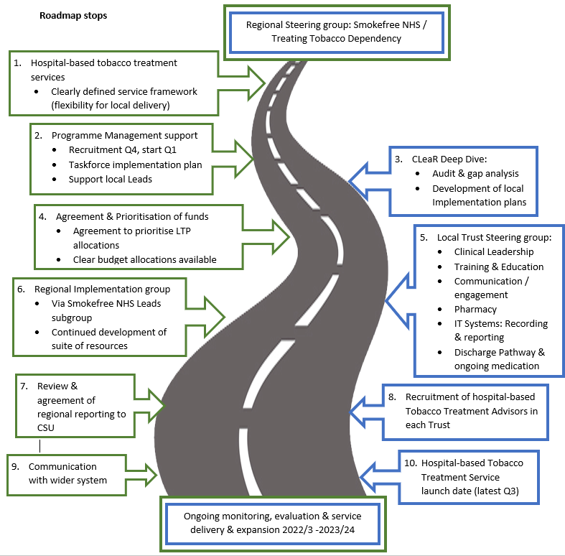
LTP Implementation
SF NHS Strategic manager post – post extended by PHPB to oversee LTP implementation
Building on established communication routes through SF Leads subgroup
Data support via NECS allowed feedback to NHSE in readiness for mandated data set
Clinical and DPH leadership embedded to provide cross system support and guidance
Recognition of regional opportunity to go ‘Further and Faster’ – implementation at scale.
Clinical Leadership brings patient narrative and networking opportunites

Slide 4
Implementation at Scale – Further, faster, sooner
Proposal and business case developed and presented to
  AOs for evolving ICS structure
  Provider Collaborative
  Alternative would have been fair share allocation versus prioritisation work to minimise impact on health inequalities – both impacting on reach and effect
Successful: awarded costs for at scale implementation

Slide 5
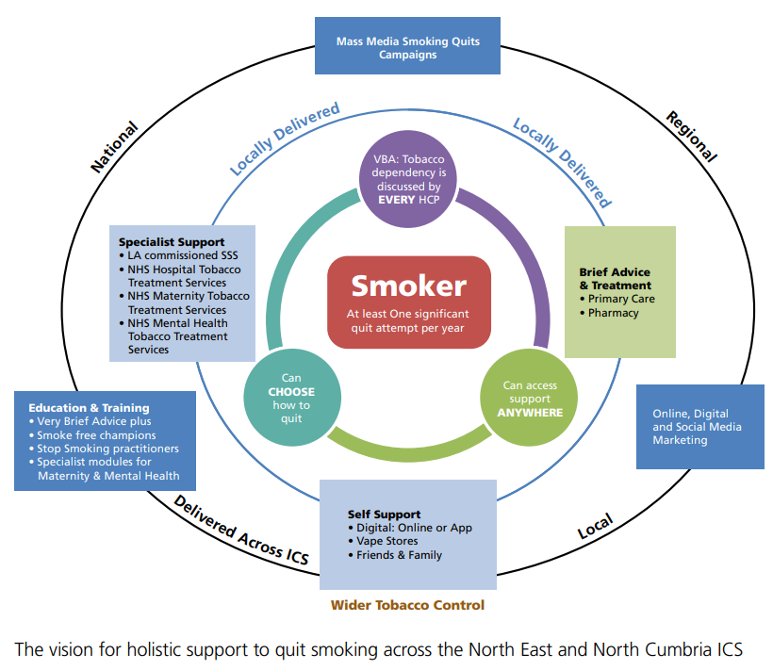
A Vision for Holistic Support

Slide 6
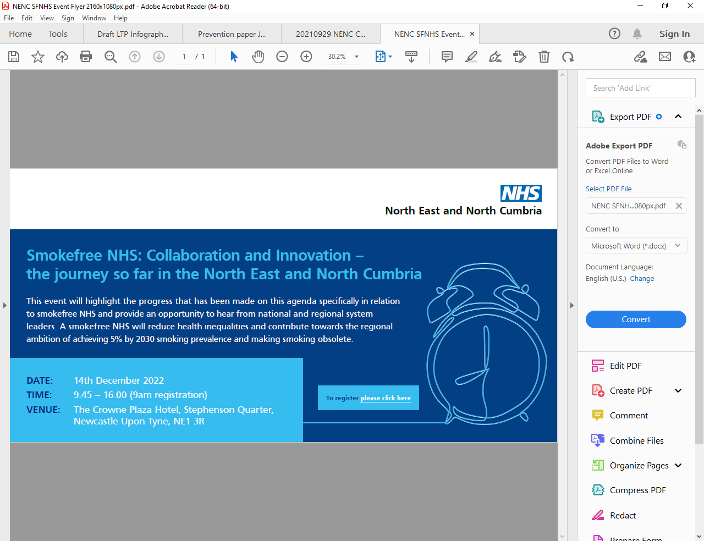
LTP Roll Out
Comprehensive package of support to trusts
Shared resource to support recruitment, job descriptions, comms, patient facing materials
Commissioned regional training provision
Regional Implementation Tracker
With funding flow comes requirement to provide governance
SLA developed
Tracking of metrics by trust
Readiness for national reporting
Escalation plan for support for non delivery
Common challenges – shared barriers – relationship building key
Clinical Leadership role

Slide 7
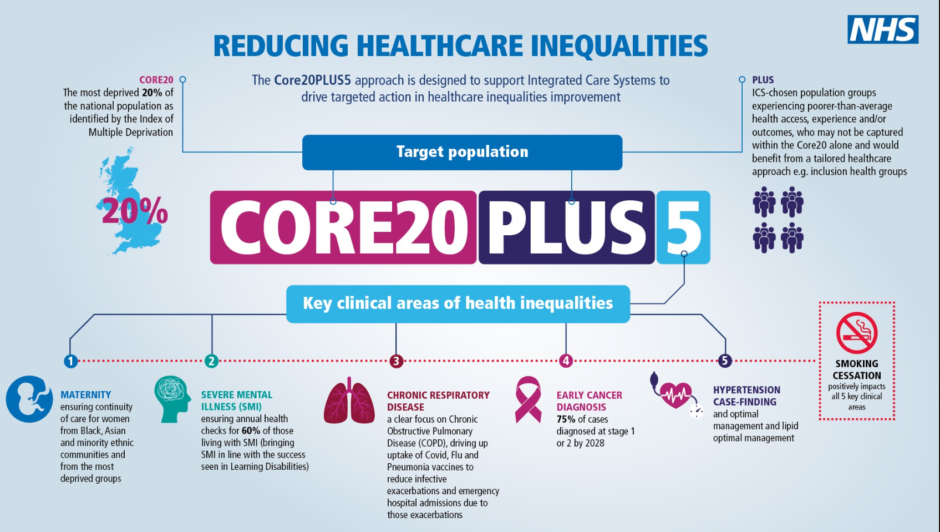
TTD Taskforce current and future vision
Complex cross system challenges – need to work towards embedded collaborative working and Regional Approaches/ Standards
Huge opportunities in the Health Inequalities agenda – Tobacco is the leading driver
New workstreams already in progress
  STDO
  SMI

Slide 8
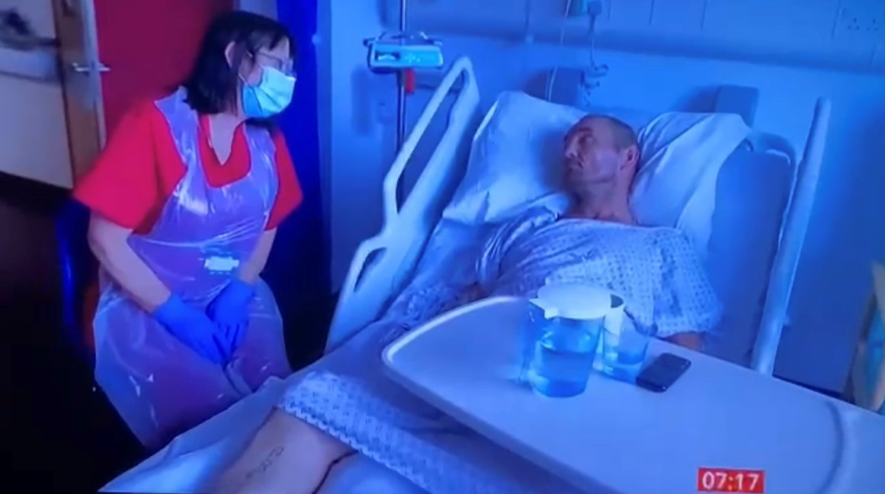
Key Messages – Enablers/Barriers
Engagement – LA and pharmacies at all levels
Clinical Leadership both across regional patch but to gain support in trusts and problem solve – Smokfree working groups in FTs
Data
Workforce – broaden recruitment – staff engagement
Long term vision and investment – need to build sustainable services
Research opportunities
Patient Narrative

