Slide 1
ELFT Tobacco Dependency Treatment Service
East London NHS Foundation Trust
Tobacco Dependency Service
Ogechi Anokwuru
Trust and Forensic Lead for Tobacco Dependency
o.anokwuru1@nhs.net

Slide 2

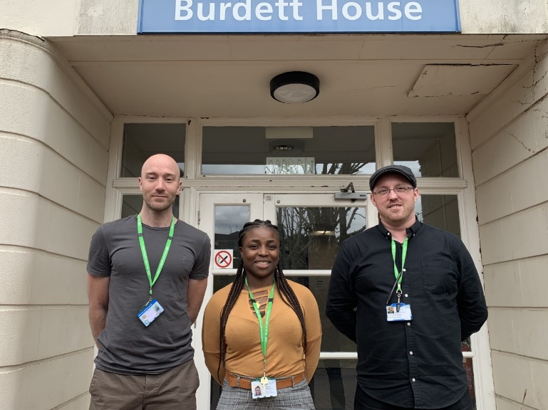
Our service
- ELFT TDS journey began in 2019, and expanded in summer 2022.
- 3 advisors covering the Trust to 10 advisors.
- These areas are: Bedford and Luton, City and Hackney, Newham, Tower Hamlets, Forensics and community services.
- We have assessed over 1688 patients

Slide 3
Pathway: prescriber model
ELFT does not use Homely Remedy protocol
NRT prescribed by doctors and Dr independent prescibers (e.g. nurses)
NRT dosage reviewed by ward pharmacist and Dr with advice from Tobacco Dependency team

Slide 4
Inpatient Service Pathway.
New admission
Very Brief Advice offered to all new admissions
-
Recorded outcome on lifestyle form.
All smokers should be offered NRT within 30 minutes of admission.
NRT should be administered within 2 hours of admission (relies on prescriber)
Ward staff to send referral to smoking Cessation Team.
Smoking Cessation Advisor
Smoking cessation advisor to attend the ward to completes full Assessment,.
Set a reduction date or quit date or support with temporary abstinent whichever is more appropriate for the patient.
Review NRT offered in admission or offer a new NRT of patient’s choice or depending on the individuals tobacco dependency.
Advise the doctor to Prescribe NRT as regular medication rather than PRN , to ensure regular use and to be included as part of TTA when discharge.
Patients keen on using vapes are encouraged to purchase their own vapes
Inpatient Follow up/ Review
Smoking Cessation advisor will review service user on a weekly basis until discharge in the community
–
**If a service user has quit or reduce smoking, the doctor will need to review the service user’s psychotropic medication dosage **
Service user will also be informed and offered ongoing support in the community.
12 weeks post discharge follow up
Once a service user is discharge from the ward with 2 weeks TTA of NRT.
A phone call is made to the service user to arrange ongoing support In the community.
Service user will be reviewed for 6 weeks in the community, either by f2f or telephone support, depending on the service user's choice.
Further support
After discharge follow up in the community, the service user will then be transferred to the local authority if they require further support
In some directorates there are ELFT community smoking clinics, where the service user can be referred to for further support instead of the local authority .
Referrals to be sent to Elft.stopsmoking@nhs.net

Slide 5
Timeliness of patients receiving NRT
Estimated 100% offered and estimated 50% receive NRT within 24 hours
  No concrete data on this currently
  Planning to run audit to monitor this

Slide 6
Barriers & enablers
Barriers
Understaffing: impact on NRT provision
High staff turnover: training schedule didn’t take this into account
Lack of staff confidence even after receiving training
Staff may perceive smoking as way to reduce violence and aggression on wards, and stabilise patient’s mental state
  Culture of turning blind eye to smoking
  High level of smoking amongst staff
Enablers
Longer inpatient stay: greater opportunity to intervene & follow up
Great control over patient choices when patients are sectioned

Slide 7
Making change happen: focus on culture change at ELFT
Updated smokefree policy
Training
  Bi-monthly training for staff
  Mentoring: champions on ward/drop-in sessions/competency check
Engaged staff in shaping change work
Staff offer

Slide 8
NRT uptake
Results: choices of quit aid
25% of patients have chosen to use combination NRT alone
74% of patients are vaping and using NRT

Slide 9
Results: wider impact
Violence and aggression across the Trust has reduced by 67% over last 2 quarters
  due to smoking cessation interventions
Staff quit rates
  Over 30 staff have quit since 2021
Delivered training to 371 staff in last year
  Total of over 6,000 staff members in Trust

Slide 10
Future recommendations
Future
Working with stakeholders: Swap to stop scheme

Slide 11
Thank you

Slide 12
Working & learning together
We are on the same team to end the harms of tobacco
We all want the best for patients & people in our lives who smoke
There is a great deal of misinformation around
  can be hard to navigate
  ASH provides evidence-based information & a forum for discussion
Guidance for disagreeing well
  Ask questions, with a genuine aim to deepen your understanding of the views and perspective of others.
  Summarise their perspective to check you have understood correctly
  Be gentle as well as clear when you provide information
  Be open to new information

Slide 13
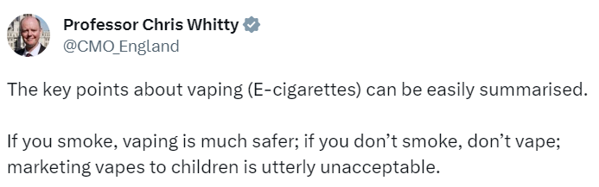
Where you can find information on vaping
Public Health Minister has announced a new ‘swap to stop’ scheme that will involve distributing vapes
Link to our resources on vaping in the chat
  Including evidence around common areas of misinformation/misunderstanding

