Slide 1




The Rotherham NHS Foundation Trust
Tobacco Treatment Services
Mike Smith
Healthy Hospitals Programme Manager
michaelsmith4@nhs.net

Slide 2
The Rotherham NHS Foundation Trust
Tobacco Treatment Services
Impact Statement
We will provide enhanced Tobacco Treatment Services to aid the reduction of local smoking prevalence and associated health care burden
ICB Target
45% of all smokers with LOS>1 are prescribed NRT within 24 hours of admission
Jan 2023 Position
11% of all smokers with LOS>1 prescribed NRT within 24 hours of admission

Slide 3
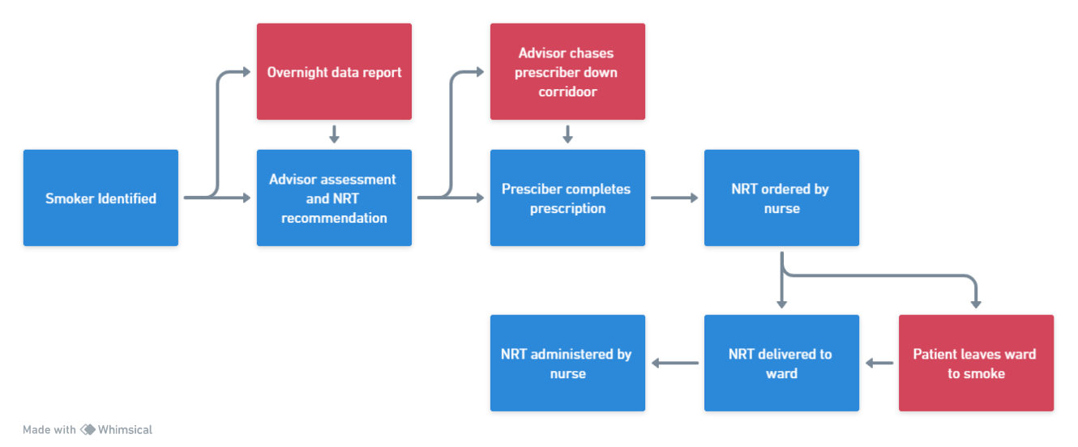
Process Mapping
Current State

Slide 4
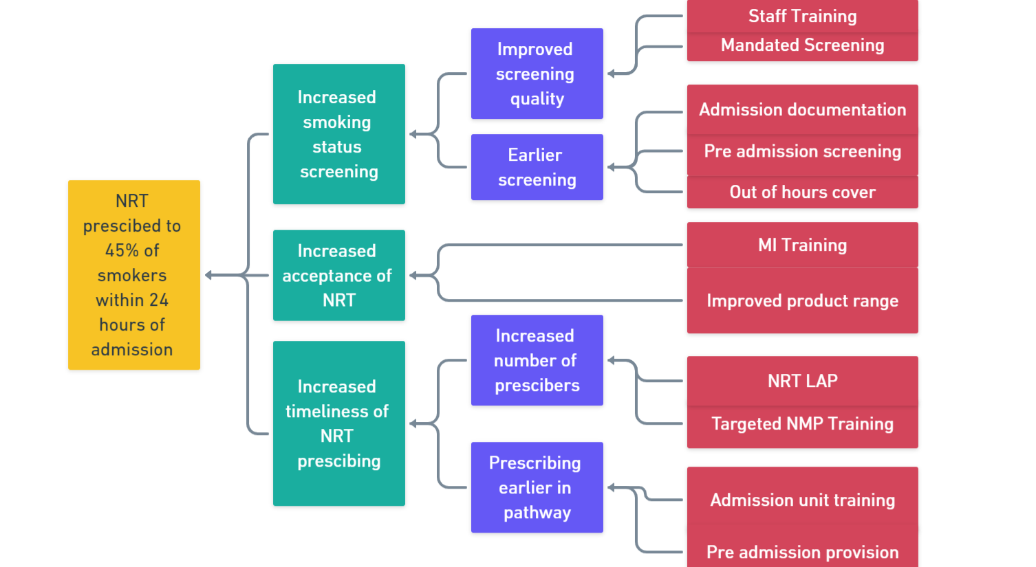
Driver Diagram
NRT Prescribing

Slide 5
Nicotine Replacement Therapy
Locally Agreed Protocol
What – NRT added directly to the medication chart by non-prescribers
Who – Nurses/Midwives and NCSCT Practitioners
Where – Acute inpatient setting excluding HDU/CCU
Why – Quicker provisions, decrease prescriber burden, improved care
When – Admission/assessment excluding post cardiac event

Slide 6
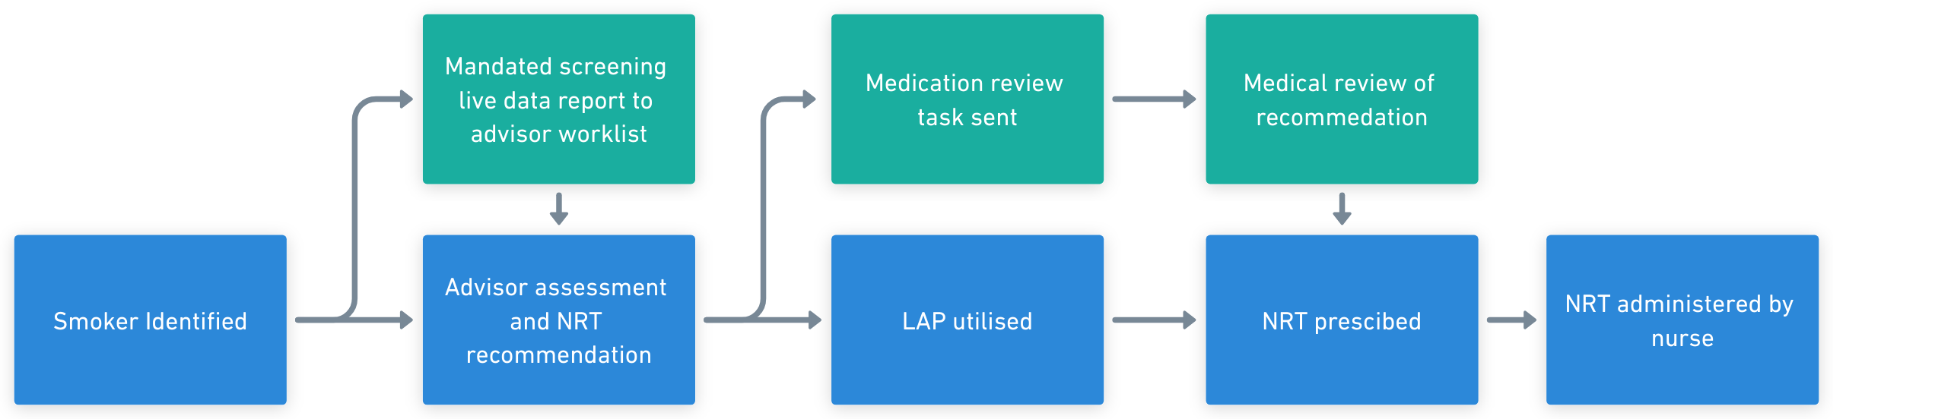
Process Mapping
Future State

Slide 7
Tobacco Treatment Pathway
Key Milestones
Instant Referral System March
NRT LAP – 24 hour provision April
NRT LAP – Ongoing provision and take home medications June
Baseline NRT Stock on wards May
“Control your Cravings” campaign July

Slide 8
Quantitative Outcomes
% of all smokers with LOS>1 prescribed NRT
LAP
Soft Launch
LAP Extended
Instant RF
Ward Stock
Comms Campaign

Slide 9
Quantitative Outcomes
% of all smokers by service activity
Instant RF
Staffing Reduction

Slide 10
Qualitative Feedback
Staff and Patients
“It massively helps us, happy to help with the trickier ones” - Medic
“A much easier process for all of us and clearly helps patients” - Nurse
“Way quicker than I got them (NRT products) last time” - Patient
“I can add real value by using this, much prefer it this way” - Advisor

Slide 11
The Rotherham NHS Foundation Trust
Next Steps
Advisor Role Review
Updated Advisor job description, desktop review +/- job matching panel
Increase LAP Users
Targeted LAP promotion and training to nurses in A&E and Admission Units
Enhance Data Insights
To inform targeted training and support by area and pathway

