Slide 1
Working Towards a Smokefree NHS Workforce
A regional pilot supporting NHS staff to quit smoking
Caitlin Barry
Project Manager for NENC Staff Tobacco Dependency Offer
Gateshead Health NHS FT (on behalf on NENC ICS)
Notes:
The case study would consist of a 10-minute slot covering:
Rationale behind the vape offer
What the offer consists of
How you made the case internally
Overcoming any barriers
Outcomes and learning

Slide 2

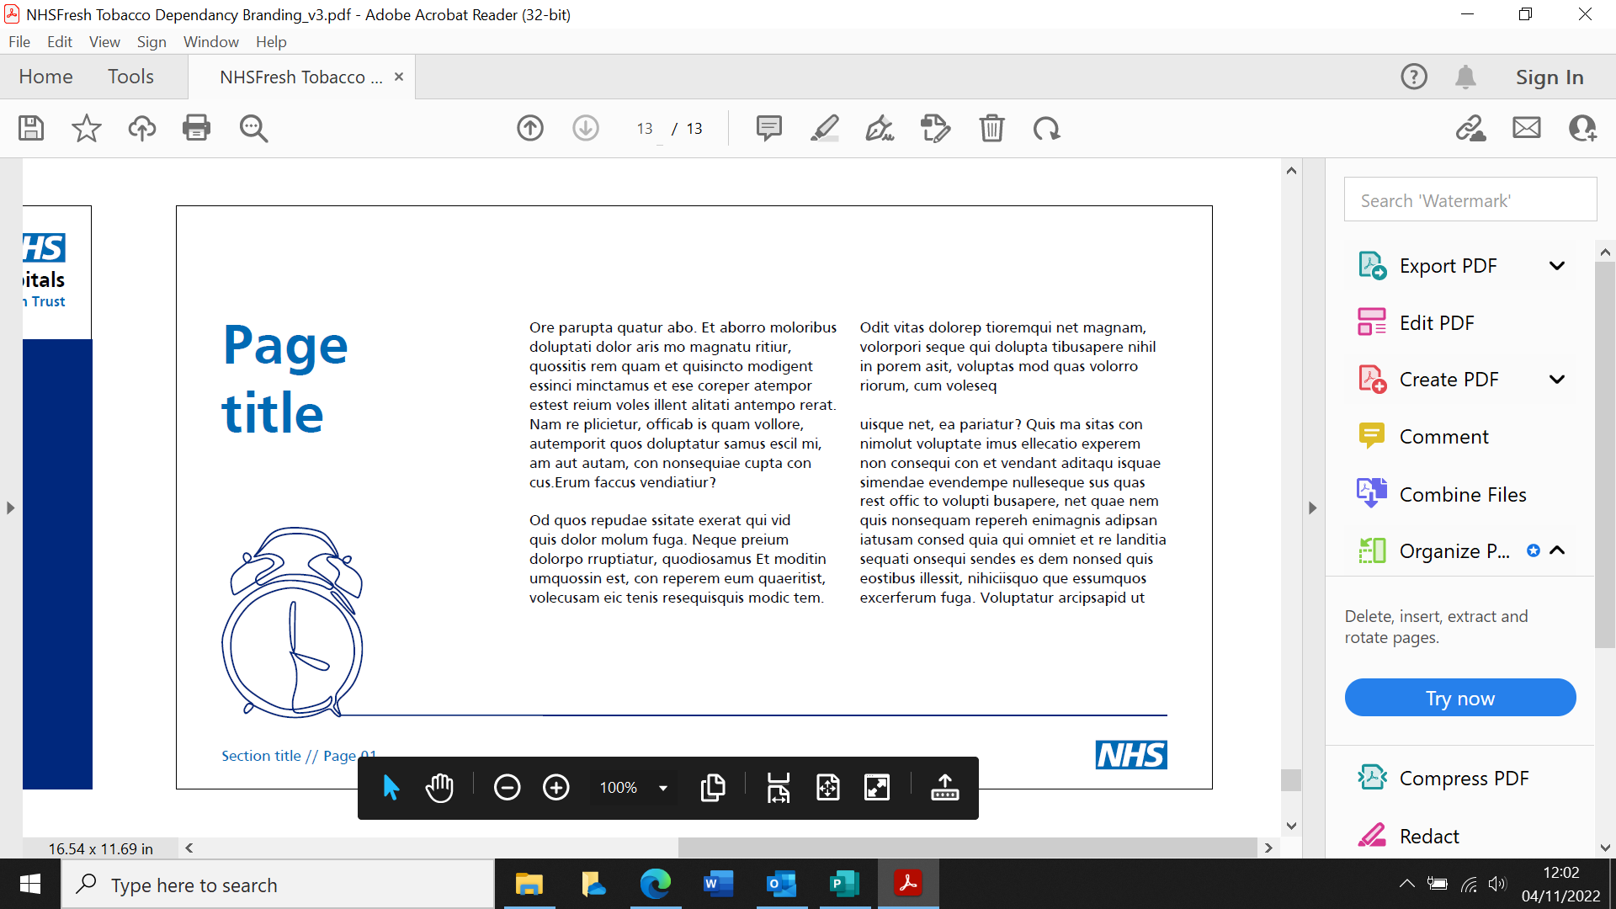
North East and North Cumbria ICS
Over 85,000 NHS Foundation Trust Staff
11 NHS Foundation Trusts
(8 acute* and maternity*, 2 mental health* and 1 ambulance service)
*undertaking region-wide implementation of Long Term Plan
13 Local Authorities
14.8% Smoking Prevalence in North East
Notes:
Region-wide embedding of LTP -

Slide 3

Making The Case
RCP: The total staff smoking cost imposed on NHS as an employee and healthcare provider by staff smoking is thus estimated at £206 million per annum.
NICE NG209: Encourage employers to provide advice, guidance and support to help employees who want to stop smoking.
NICE NG209: Give clear, consistent and up-to-date information about nicotine-containing e‑cigarettes to adults who are interested in using them to stop smoking (for example, see the NCSCT e-cigarette guide and Public Health England's information on e-cigarettes and vaping). [2021]
NENC: Region wide implementation of the NHS LTP
Anecdotal barriers to accessing support:
‘As if stopping smoking wasn’t hard enough you had the stress of spending all your spare time trying to sort out how and where you were going to get the tablets from. It was easier to walk to the corner shop and buy cigarettes.’
(NHS Staff Member talking about a previous quit attempt)

Slide 4
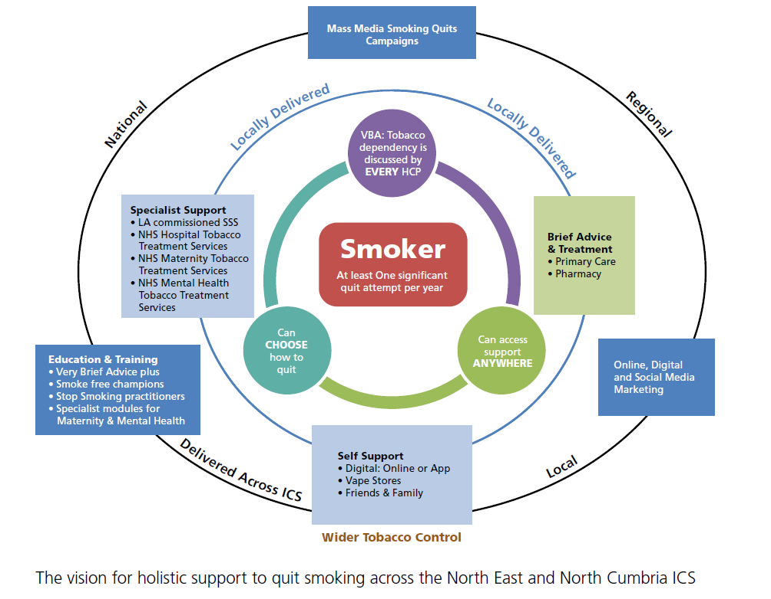

Overcoming Barriers
Region-wide implementation of the LTP TDTS
LA Tobacco Commissioners Forum
Clinical Leadership
Taskforce vaping position statement (2019,2023)
Regional conferences and webinars on vaping
ADPH NE Vaping position statement (2022)
Smokefree NHS Strategic Manager
Clinical Delivery Manager (Tobacco)
Smokefree NHS / TTD Taskforce
National guidance and growing evidence base
Mental Health Trusts offering vapes as first line treatment
Funded places at e-cigarette summit

Slide 5
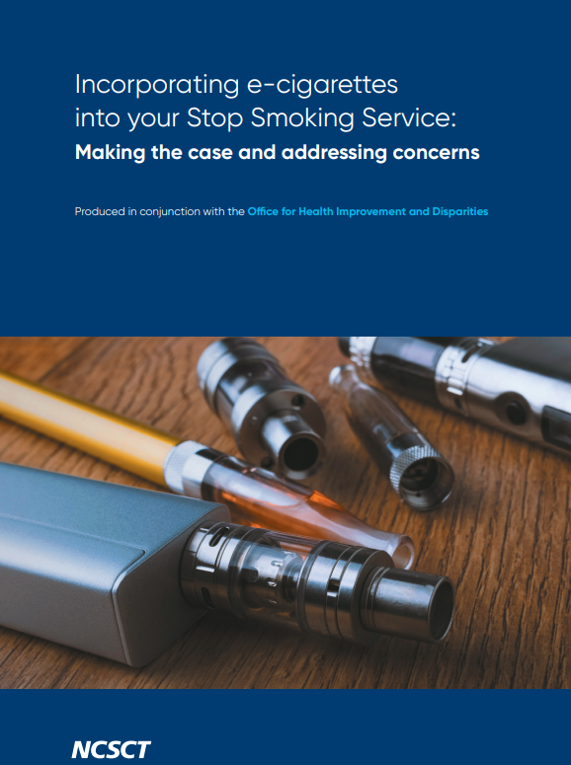
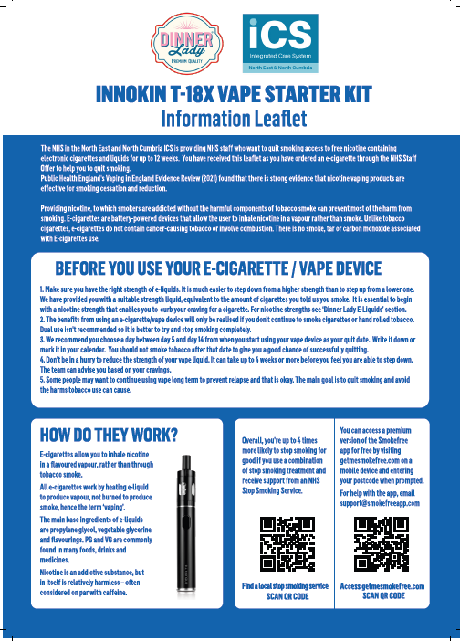
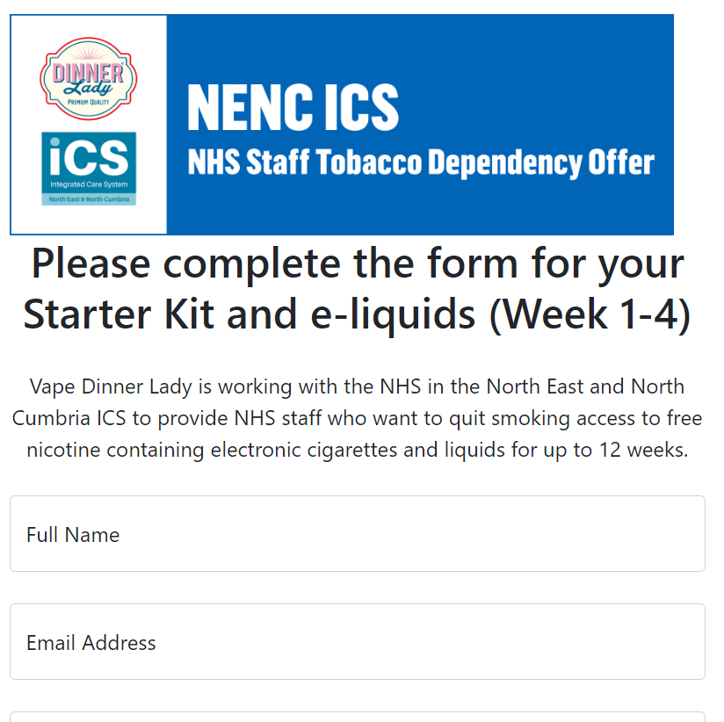
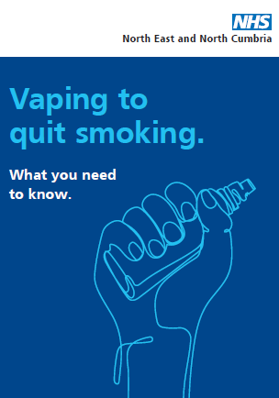
Overcoming Barriers & Learning
Barrier | Overcoming the Barrier
Misinformation/misunderstanding the use of vapes as a smoking cessation aid | Utilisation of vaping position statement, NICE guidance and evidence reviews to inform the service user Creation of information resources for service users, with links to NCSCT, local stop smoking services, Fresh Quit website etc.
Supply and provision of vapes | Working closely with Trust procurement team to support the process of procurement. Calculate cost and product based on 12 week supply, rather than individual product supply. Note: new supply portal now active (wasn’t available at the time)
Delivery and storage of vapes (additional barrier includes regional footprint – 13 LA areas) | Direct supply from vape supplier (Vape Dinnerlady) to service user’s home address via online ordering platform – reduction in handling and administration versus storing and posting vapes in-house Note: important to consider service impact and if this option works for your service user group.
Finding the right product | Refillable vs Disposable Available flavours (most popular menthol and raspberry – 10% order tobacco flavour)
**Coming Soon

Slide 6


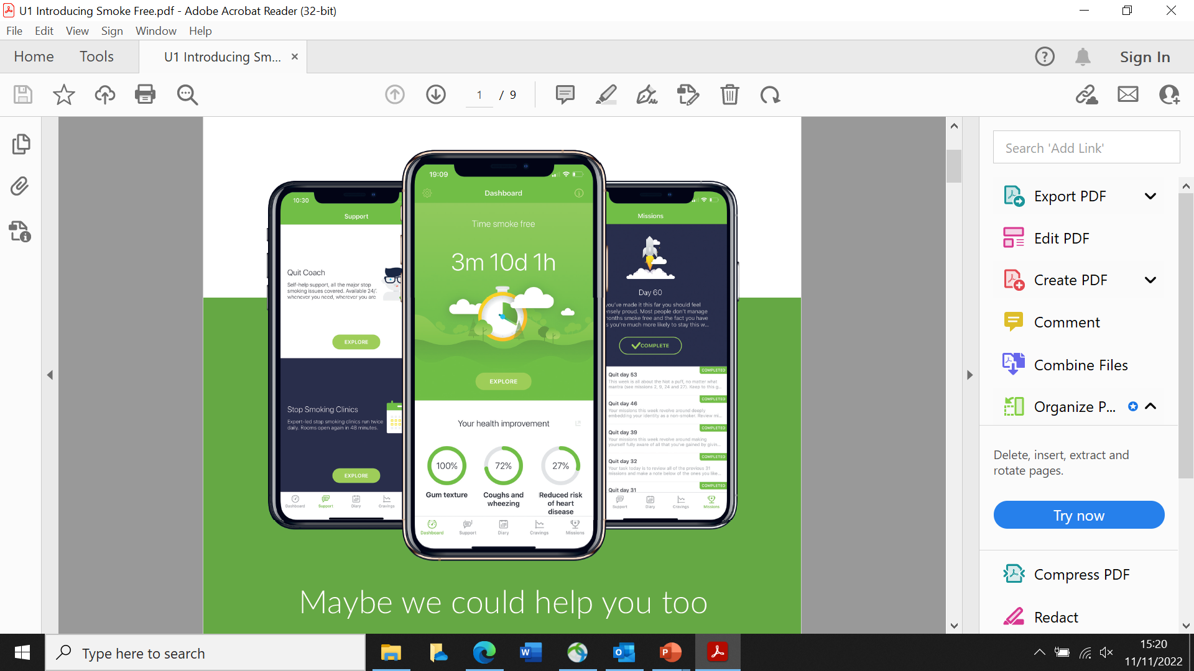

NENC Staff Tobacco Dependency Offer
Embedded into existing Local Authority provision, the offer includes:
Eligible Staff
All staff working in Foundation Trusts across NENC (including those working for subsidiary companies on FT sites)
Free Nicotine Replacement Therapy
Introduction of regional vape offer – free vape supplies for 12 weeks
Behavioural Support
Free Premium Access to Smokefree App
Note: Existing provision uplifted for NHS staff.
Indicates changes from standard provision

Slide 7












Outcomes (includes data for FY 2022/23)
647 staff accessed offer regionally
13.6% of staff
accessing the offer report working in routine and manual roles
44 NHS staff accessing the Smokefree App
(premium version available for free from NENC ICS, behavioural support only)
52.3% of staff accessing the offer were from IMD 1 and 2 (most deprived)
50.6%
quit rate
*self reported at 28 days
75% of NHS staff opted to use a vape as part of their quit attempt
**Over 1,000 NHS staff were supported to make a quit attempt between launch in December 2021 and April 2022, but due to changes in data reporting requirements, a full data breakdown is not included. Average quit rate was 48%, with 80% of service users utilising the regional vape offer

Slide 8
Learning
Learning
Free cessation aids act as a motivating factor for accessing support – 75% utilising vape
Word of mouth is key in engaging R&M workers – TDTS advisors, sharing among colleagues and sharing of case studies
Collaboration is key – working with LA partners to embed vape offer increases capacity for support and ensures staff can access trained advisors within their locality
Forward Planning
Offer funded until end of September 2023
Commence service user evaluation in collaboration with the Applied Research Collaboration (ARC) NENC in Q1 23/24

Slide 9
Working Towards a Smokefree NHS Workforce
Caitlin Barry - Project Manager
caitlin.barry1@nhs.net
Follow NENC Treating Tobacco Dependency Taskforce on twitter: @SmokefreeNHS_NE

