Slide 1
Smokefree Pregnancy: The Maternity Transformation Programme and the NHS Long Term Plan
Misha Moore
National Speciality Advisor for Obstetrics (Public Health)
NHS England and NHS Improvement

Slide 2
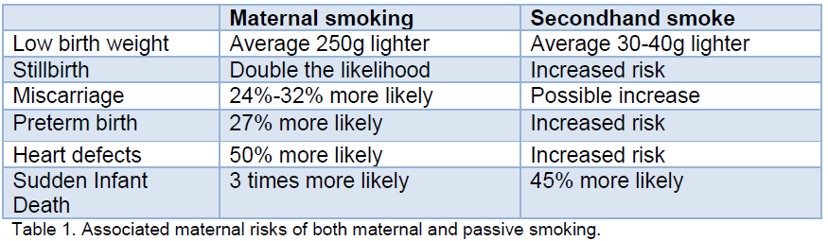
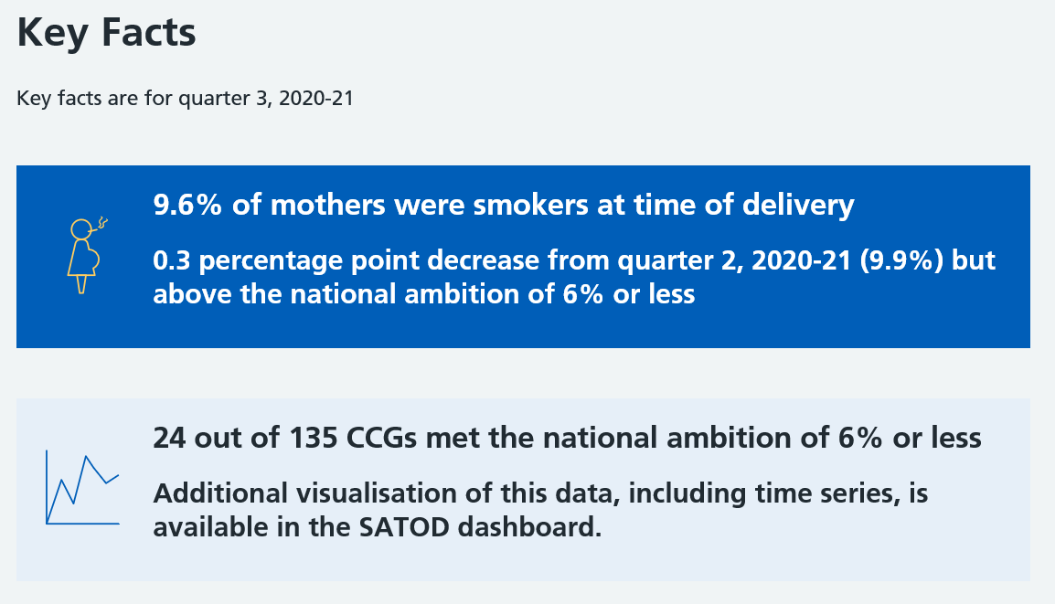
Smoking in Pregnancy

Slide 3

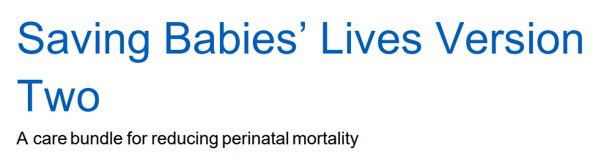

Slide 4
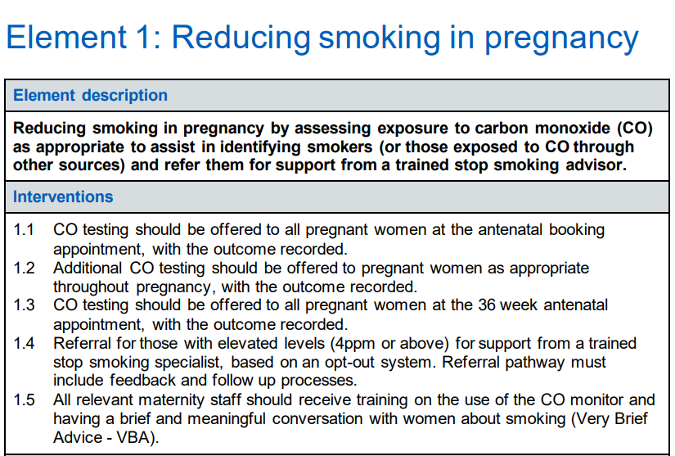

Slide 5
NHS Long Term Plan
Prevention is a core component.
Sets out the NHS’s contribution to tackling tobacco dependence and delivering a smokefree generation
Designed to:
build on good work already happening, including SBLCBV2
work in synergy with current Stop Smoking Services
focus on both physical and mental health services
have a level of national direction, but local development and delivery.

Slide 6

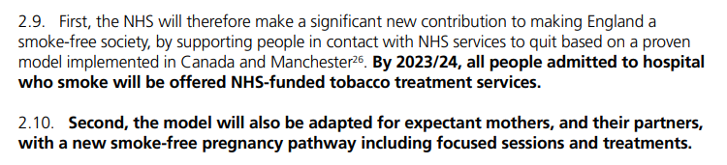

Slide 7
2021/22 and beyond
Intention to deliver the full scope of the commitments laid out in the LTP, recognising the current uncertainty which will impact pre-COVID-19 plans.
Phased rollout across all ICSs until the end of 2023/24
From 2021/22 all systems (STP/ICS) will receive LTP transformation allocations.
Single allocation to ICS to cover all elements of the LTP tobacco commitments (maternity, inpatients mental health)
Allocations should increase over time allowing greater coverage of service, but in the short term systems will need to prioritise services.

Slide 8
Intervention
Recommended model based on NICE guidance and learning from the Greater Manchester Smokefree Pregnancy model:
identifying smokers
offering, on an opt-out basis, bespoke specialist behavioural advice, combined nicotine replacement therapy and intensive face-to-face follow-up.
Intensive:
1:1 (approx. 40 min) meeting with a tobacco dependence adviser at antenatal booking, or very soon after.
NRT at first contact.
Weekly face-to-face appointments for at least four weeks
Six further face-to-face appointments throughout pregnancy

Slide 9
Considerations
Unique opportunity to change and develop current pathway
Recommended Smokefree Pregnancy Model
In-house
Target early intervention
  Flexibility in delivery, with the ability to:
  use different staff groups
  commission across organisational boundaries including local authorities
  expand, intensify or accelerate delivery using local resources.
  Ensure sustainable element of the maternity pathway

Slide 10
What can be done now?
.
Regions and LMNS can influence to ensure that maternity is a core component of plans and is prioritised according to need.
We will continue to support the three Smokefree Pregnancy early implementer sites and share learning for future sites.
You do not have to wait for the LTP funding. There is good practice already within the system - you could get a head start.

Slide 11
Questions and/or ideas…
Join our Future NHS platform at https://future.nhs.uk/NHSpp/grouphome
Paul Cilia La Corte Bea Petrovica Misha Moore
p.cilialccorte@nhs.net bea.petrovica@nhs.net misha.moore@nhs.net
https://www.longtermplan.nhs.uk/areas-of-work/prevention/treating-and-preventing-ill-health/

