Slide 1
Becoming smoke free
in a MH and LD Trust
Michelle Higgins & Amanda Bailey
September 2021

Slide 2
Content
Background to our policy review
Preparation for smoke free
E-cigarette product choice
Implementation into the organisation and care settings
Progress so far and where next

Slide 3

Leeds and York Partnership NHS FT (LYPFT)
Mental health and learning disability Trust
Community and inpatient units across Leeds and York
Specialist services (inc. national)
Services across Yorks & Humber region

Slide 4
Background
2016 – first attempt at smoke free
No dedicated focussed support – responsibility and oversight was added to existing roles
Prospect of stopping/abstaining as inpatients very daunting – a lot of objection
Staff commented on lack of ongoing support and felt not listened to when concerns were expressed
Clandestine smoking prevalent on Trust sites
Resulted in a pause on smoke free status – reinstatement of smoking shelters etc.
Fire safety concerns

Slide 5
How to do it differently
Smoke free lead appointed in 2018 (specialist experience in field)
Reviewed staff feedback from 2016 attempt
Planned evidence based review of smoke free and nicotine management policy; key change was planning the implementation of e-cigarettes
Collaborated with fire safety officer – joint agenda
Presented proposals to the Board with costings and supporting evidence
Sought support from regional partners, Public Health tobacco control colleagues as well as experts within our own Trust
Collaborative approach to change involving staff and service users

Slide 6

Obstacles
Cultural shift
Perceptions about alternatives to traditional NRT despite evidence
Personal objections
Safety concerns
Leased property v owned

Slide 7
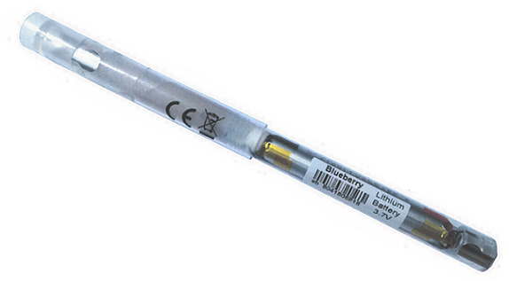
Inclusion of e-cigarettes
Chosen due to design – tamper evident with battery visible
3 flavours
  blueberry
  tobacco
  menthol
Free of charge to inpatients subject to risk assessment
Supplier used in secure environments
Collection and recycling included in cost
No link to tobacco industry

Slide 8
Implementation
Sept 2019: 12 week pilot on one Trust site incorporating a variety of services with ongoing evaluation
Weekly steering group involving ward staff, estates & facilities, fire safety officer, pharmacy, clinical effectiveness
Staff and service user focus groups
Surveys/questionnaires/suggestion boxes
End of pilot evaluation inc. costings, feedback and options appraisal

Slide 9

Life Savers
Fire safety notice
Trust Board
Cost of smoking related damage to estate
Smoking related incidents
Narrative of managing addiction
Pandemic
Use of evidence
Healthy Living Advisors

Slide 10
Progress & next steps
2 years on from implementation
Planned for roll out across sites during early 2020 subject to landlord approval
Pandemic accelerated plan – overnight rollout in 1st lockdown
E-cigarettes widely used among smokers to support quitting and abstinence
More support needed for staff across Trust
Plan to roll out support to community service users – join up with local stop smoking services
Continue to review policy in line with evidence

