Slide 1
CQC Guidance on Smokefree policies in mental health inpatient services
Mary Yates
Mental Health Nurse
National Tobacco Dependence Trainer ​
16th April ‘24

Slide 2


Overview
O
• Why this guidance is needed
• The importance of smokefree
• Take aways from this guidance
• How to implement this guidance

Slide 3
Tobacco dependence is uniquely dangerous.
It is a leading cause of physical, mental and social problems.
Traditionally it has been seen as a ‘lifestyle choice’, ‘bad habit’ or ‘personal freedom’​.
We now have a new standard of care in NHS. We must see tobacco dependence as a preventable, chronic, relapsing disease, that requires access to evidence based treatments, provided in smoke free health care services.
There is a new ambition to be completely smokefree by 2030.

Slide 4
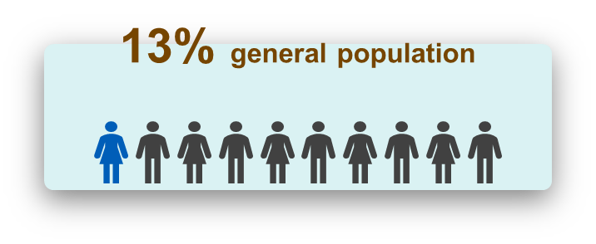
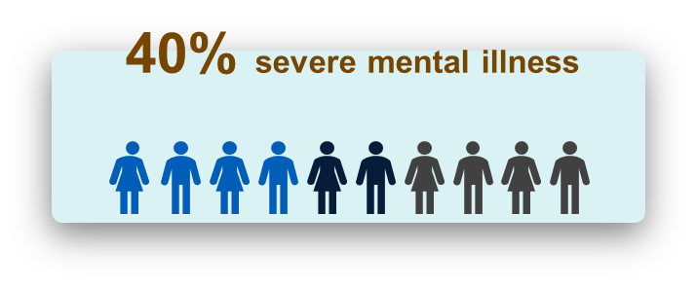
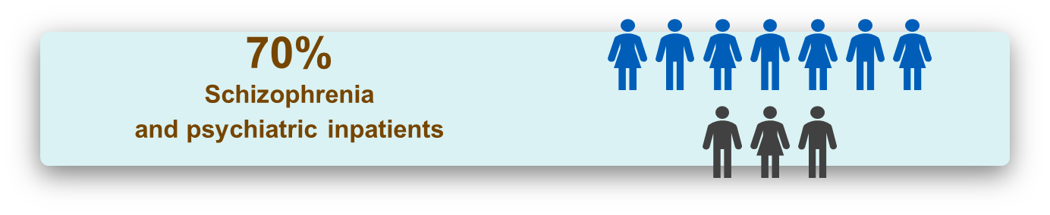
Big inequalities in smoking rates
23% start smoking on admission

Slide 5
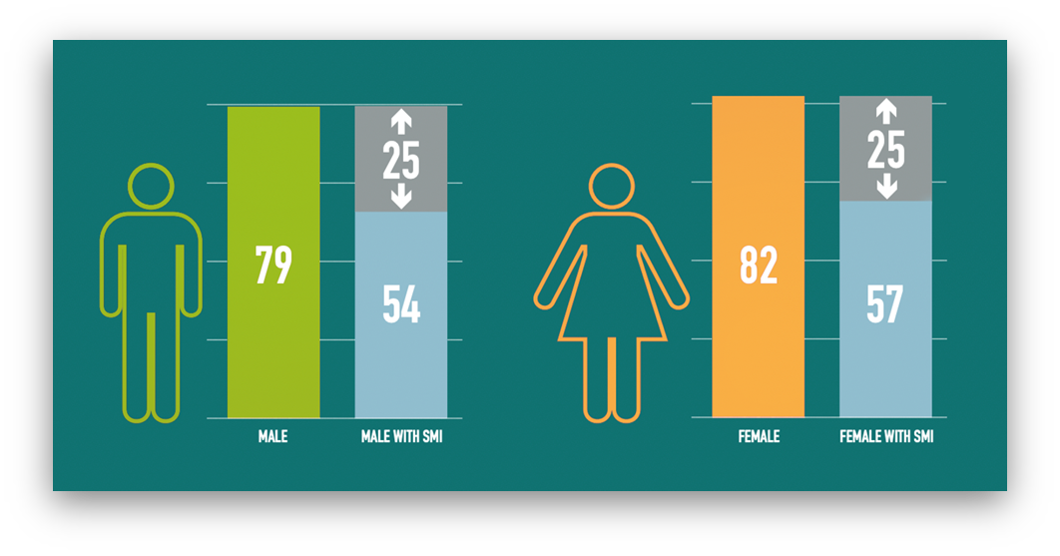
People with mental illness suffer disproportionately and die young because of smoking-related illness
People with serious mental illness die up to 25years earlier than people without a mental illness;
smoking is the single biggest reason for this.
Increased risk of heart disease and stroke​
2–3 times more likely to have diabetes ​
Increased risk of respiratory disease, asthma, ​
bronchitis, emphysema​ and COPD
More cancer (15 types) and worse cancer survival rates ​
Increased risk of osteoporosis ​and fractures​
Increased risk of tooth decay, gum disease, ​tooth loss
ASH. The Stolen Years: The Mental Health And Smoking Action Report. 2016

Slide 6

Smoking contributes to poor mental health
Higher rates of depression, anxiety, panic attacks and stress
More severe symptoms of psychosis
Longer time in hospital
More frequent admissions
Higher doses of some medications (50% increase for clozapine)
risk of Psychosis / Bipolar Disorder/ Depression / Dementia
risk of earlier age of onset for Schizophrenia and Depression
Exploitation and Stigma
Poverty

Slide 7
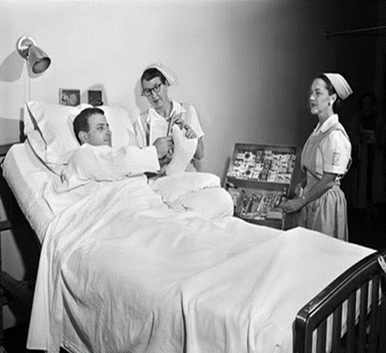
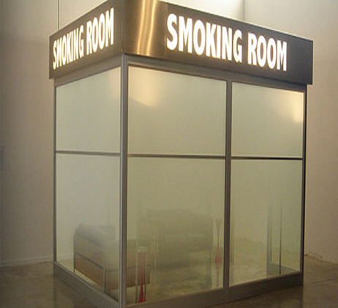
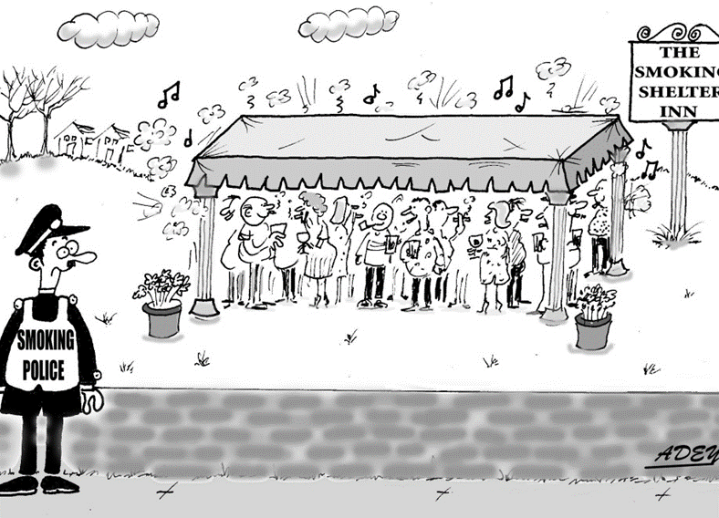
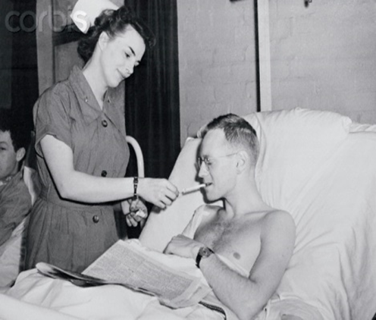
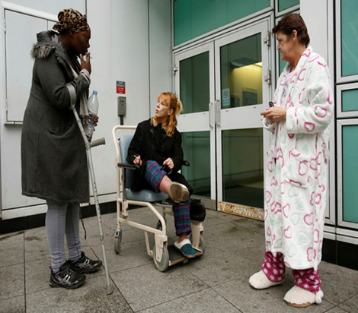
Helping patients to develop preventable disease and die young
2.23 hours per day / per ward facilitating smoking; Robson et al (2016) Time to Smoke, NTR

Slide 8
In the past CQC inspectors have;
criticised hospitals/trusts where efforts were being made to help people stop smoking, by referring to this as a restrictive practice
instructed services to install storage facilities for smoking materials
given outstanding ratings to MH Trusts who help patients to smoke, by storing tobacco materials and escorting for ‘smoke breaks’
This undermines efforts to achieve a completely smoke free environment and ultimately close the inequality gap.

Slide 9
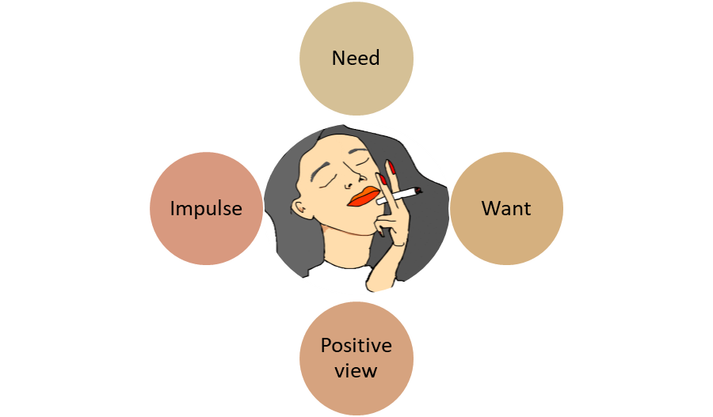


Understanding why people smoke, helps us support them to stop
Vapes / NRT/ Nicotine analogues
Prompt, Plentiful, Practice, Prolonged
Remove cues to smoke
Storage, breaks, routine
Educate re benefits
Accessible information
Educate re harms
Regular CO testing

Slide 10
A shared promise
We will never again refer to tobacco dependence as a ‘lifestyle choice’, ‘bad habit’ or ‘personal freedom’​.
It is a powerful addiction and chronic relapsing but treatable clinical condition.

Slide 11
CQC is in a unique position to monitor the quality of care provided to people who smoke (and to non-smokers).
This new guidance is important to help improve the standards of care in this domain of practice.
CQC has provided clarity regards storage of tobacco, such that services will not be criticized if they have a policy which supports confiscation and destruction of tobacco materials, in the context of good communication systems.
This is similar to the way we ban plastic bags to reduce suffocation risk. It is also in line with the long established practice to confiscate and destroy alcohol, which is also harmful to health, although not as damaging as tobacco!

Slide 12
The fact that a service is smokefree should not be raised as a concern about ‘blanket restrictions’.’
Blanket bans on e-cigarettes that have no cogent justification could, however, be raised as blanket restrictions.
However, blanket bans on e-cigarettes (vapes) should be observed in CAMHS services.
Where services have implemented smokefree policies without tobacco dependence training for staff, access to TTD (i.e. stop smoking aids (medicines, nicotine replacement therapies and vapes), and routine carbon monoxide testing, this should be discussed under the ‘effective’ key question.
Appropriate medicine reviews and monitoring should be completed to ensure that medicines doses are altered when necessary as a person’s smoking status changes. This should be reviewed under the ‘safe’ key question.
9002497 Brief guide:BG025 Smokefree policies in mental health inpatient services, October 2023 V1 Review date: October 2024

Slide 13


Summary
Tobacco dependence is a leading cause of preventable (physical and mental) suffering and premature death
Admission to hospital, is an opportunity to identify smokers and offer support to stop. Access to vapes, NRT (2 products), nicotine analogue medication + behavioural support improves the chance of successfully stopping. When provided in a smoke free environment, it is easier for the patient to succeed
CQC have a vital role to monitor services, and ensure these life-saving treatments are provided to improve patient’s experience and chance of recovery

