Slide 1
The case for regional collaboration on tobacco control in [insert ICS area]
[Name and organisation] Email: []

Slide 2
Overview
Background
Smoking in [ICS]
Tobacco control in [ICS]
Modelling progress towards smokefree 2030
Why Integrated Care System (ICS) level action matters
What should be delivered at the ICS level?

Slide 3
Smoking in [ICS region]

Slide 4
Smoking drives health inequalities in [ICS]
There are at least [x use supporting spreadsheet] adults who smoke in [region]
This represents a [x% use supporting spreadsheet] prevalence – [the same as/higher than/lower than] the national average
There are inequalities in the region:
  [insert geographical inequalities]
  [x% use supporting spreadsheet] of people in routine and manual occupations in [ICS] smoke
APS 2021; 2021 population estimates; OHID, tobacco control profiles, 2023; ASH, Economic and Inequalities Dashboard, 2022;

Slide 5
Smoking drives health inequalities in [ICS]
Smoking is responsible for half of the difference in life expectancy between the least and most deprived.
Nationally, smoking rates are more than 3 times higher in the most deprived decile compared to the least deprived
There are at least [x - use supporting spreadsheet] hospital admissions due to smoking in [ICS] each year
Smoking causes around [x - use supporting spreadsheet] deaths in [ICS] per year
OHID, tobacco control profiles, 2023; ASH, Economic and Inequalities Dashboard, 2022
ONS, Deprivation and the impact on smoking prevalence, England and Wales: 2017 to 2021. 2023.

Slide 6
Smoking increases social care needs
Smokers are 2.5 times more likely to need social care and on average need care 10 years earlier than non-smokers.
Due to smoking [ICS] there are:
  More than [x – use supporting spreadsheet] people receiving funded residential/ domiciliary care
  [x – use supporting spreadsheet] people receiving informal care from family and friends
  An estimated [x – use supporting spreadsheet] people with unmet social care needs
ASH, Economic and Inequalities Dashboard, 2022

Slide 7
Smoking undermines prosperity
The average smoker spends around £2,500 a year on smoking, the same as the average energy bill
In [wider region], [x – use supporting spreadsheet %] of households containing smokers live in poverty once spend on smoking is taken into account
That’s [x – use supporting spreadsheet] households in [ICS] comprising:
  [x] Working age adults
  [x] Children
  [x] Pensioners
In [region/system] there are around [use supporting spreadsheet] people out of work due to smoking
ASH, Economic and Inequalities Dashboard, 2022

Slide 8
Costs of smoking in [region]
Smoking costs [region] [£xm use supporting spreadsheet] per year
Smokers spend at least an additional [£xm use supporting spreadsheet] on tobacco
 | NHS | SOCIAL CARE | LOST EARNINGS/ EMPLOYMENT | TOTAL COST
TOTAL | £xm | £xm | £xm | £xm
Local authority 1 | £xm | £xm | £xm | £xm
Local authority 2 | £xm | £xm | £xm | £xm
Local authority 3 | £xm | £xm | £xm | £xm
Local authority 4 | £xm | £xm | £xm | £xm
Local authority 5 | £xm | £xm | £xm | £xm
Local authority 6 | £xm | £xm | £xm | £xm
ASH, Ready Reckoner, 2022

Slide 9
Benefits of reducing smoking
An effective, coordinated tobacco control strategy for [ICS] could:
  save hundreds of lives each year
  reduce inequalities
  reduce burden on the NHS
  improve quality of life
  protect children from harm
  lift households out of poverty
  increase local productivity and economic prosperity
  decrease criminality
ASH, The End of Smoking, 2022

Slide 10
Tobacco control in [ICS]

Slide 11
Current TC activities in [ICS]
Local authorities:
  Around [x] quits in local Stop Smoking Services
  [x] FTE allocated Public Health time for tobacco control
  Approx. [£xk] spent on tobacco control outside of services
  [Other…]
ICB:
  [LTP implementation…]
  [Other ]

Slide 12
Progress towards a smokefree 2030

Slide 13

Hazel Cheeseman, ASH
Sarah Jackson, UCL
5% adult smoking by 2030
Modelling the decline

Slide 14
Projected smoking prevalence
Linear trend:
Projected prevalence based on current trajectory in England (linear trends since 2020)
-0.450/year (SE 0.202), p=0.269
Smokefree 2030 target (5% smoking prevalence) will be missed by ~9 years
Points represent raw (observed) annual prevalence
Lines represent modelled prevalence
Target missed by ~9 years
Smokefree 2030 target
Notes:
If we look at the trend for England since the start of the pandemic – which we have the most robust data on given the larger sample size - we can see that the decline in prevalence has slowed down. If this trend continues, the 5% target will be missed by almost a decade.

Slide 15
Quitting smoking
Only 37% of smokers per year make a serious attempt to quit. Around a quarter of these are successful.
Therefore only 9% of smokers successfully quit each year.
Of these successful quitters:
  2% quit through stop smoking services
  4% get some professional advice and use medication
  15% use nicotine replacement therapy they bought at a pharmacy
  40% succeed on their own without any help
  39% use an e-cigarette

Slide 16

Activity that can drive progress
Area of activity | How it will impact on smoking rates
 | Improve quit success | Increase quit attempts | Prevent relapse | Prevent uptake
Invest in quit support
Increase access to evidence-based aids
Communications strategy
Enforce regulations
Expand Very Brief Advice (VBA)
De-normalise smoking
Advocating for national policy
Notes:
These are actions identified by ASH which can reduce prevalence of smoking

Slide 17
Why does ICS level action matter?

Slide 18
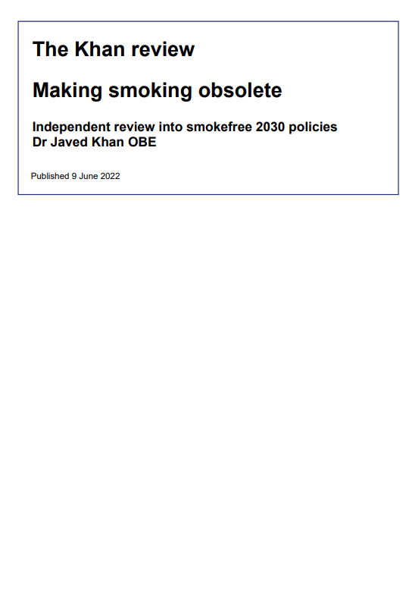
Why does ICS action matter?
There is a national ambition to get England to less than 5% smoking prevalence by 2030
Reducing smoking requires interlocking actions that target demand and supply at many different levels.
Doing these things together will drive change at pace and scale
Policy action needed to reduce smoking was set out in independent Khan Review but only partially adopted into national policy
Recommendations in the Khan Review can be delivered through a collective approach at Integrated Care Board (ICB) level
ICBs working in partnership with local authorities to develop system-wide tobacco control programmes was endorsed by the government in their announcement on achieving a smokefree 2030
Javed Khan, Making Smoking Obsolete, 2022;
Neil O’Brien, achieving a smokefree 2030: cutting smoking and stopping kids vaping, 2023

Slide 19
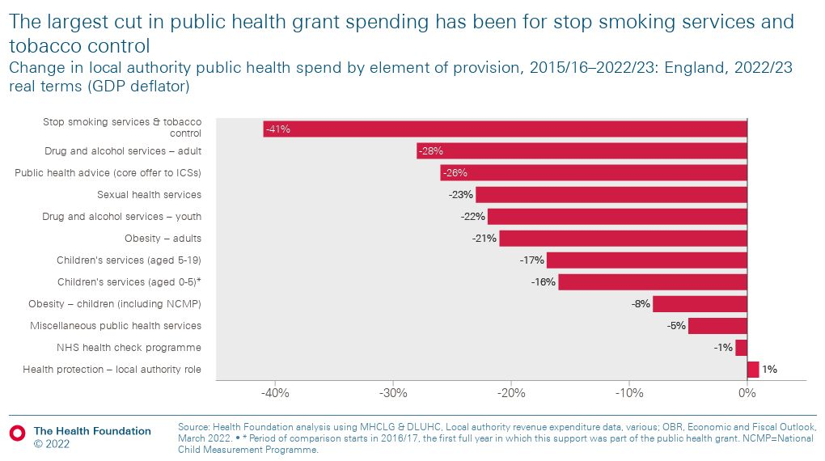
Public health funding has been eroded
Smoking cessation and tobacco control services are not protected Public Health functions
As a result they have seen biggest declines in local spend as local authority public health budgets have shrunk
This is despite having strong evidence-base and big impact
More funding is unlikely so new solutions need to be found
The Health Foundation, Public Health Grant: what is it and why greater investment is needed, 2023

Slide 20
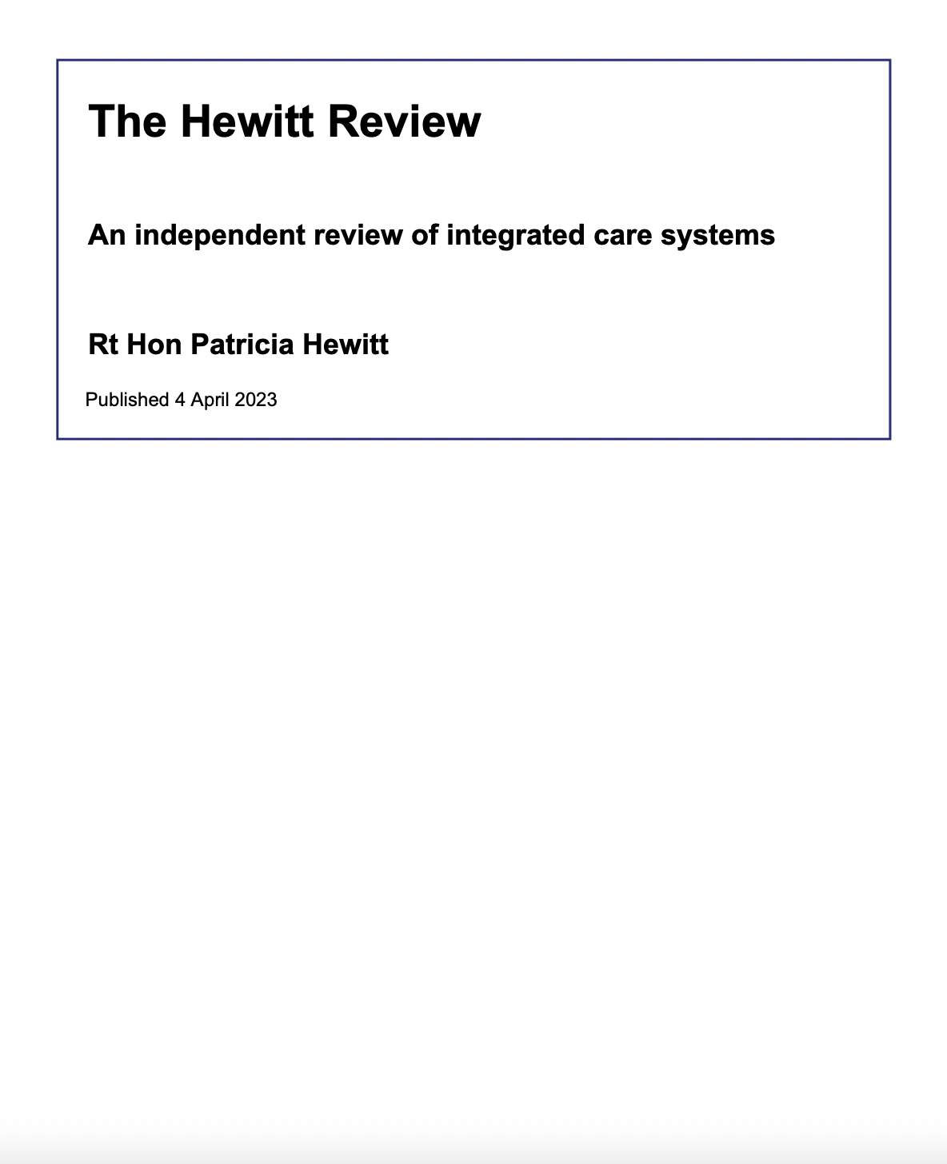
Tobacco control is necessary to meet key aims of ICSs
The independent Hewitt review encourages ICSs to shift their focus to prevention
Reducing smoking will help ICSs achieve all 4 of their main aims of:
  Improving outcomes in population health and healthcare
  Tacking inequalities in outcomes, experience and access
  Enhancing productivity and value for money
  Helping the NHS support broader social and economic development
Tackling smoking will also be essential in improving all of the disease areas identified for the major conditions strategy
Rt Hon Patricia Hewitt, An independent review of integrated care systems, 2023;
Steve Barclay, Government Action on Major Conditions and Diseases, 2023

Slide 21
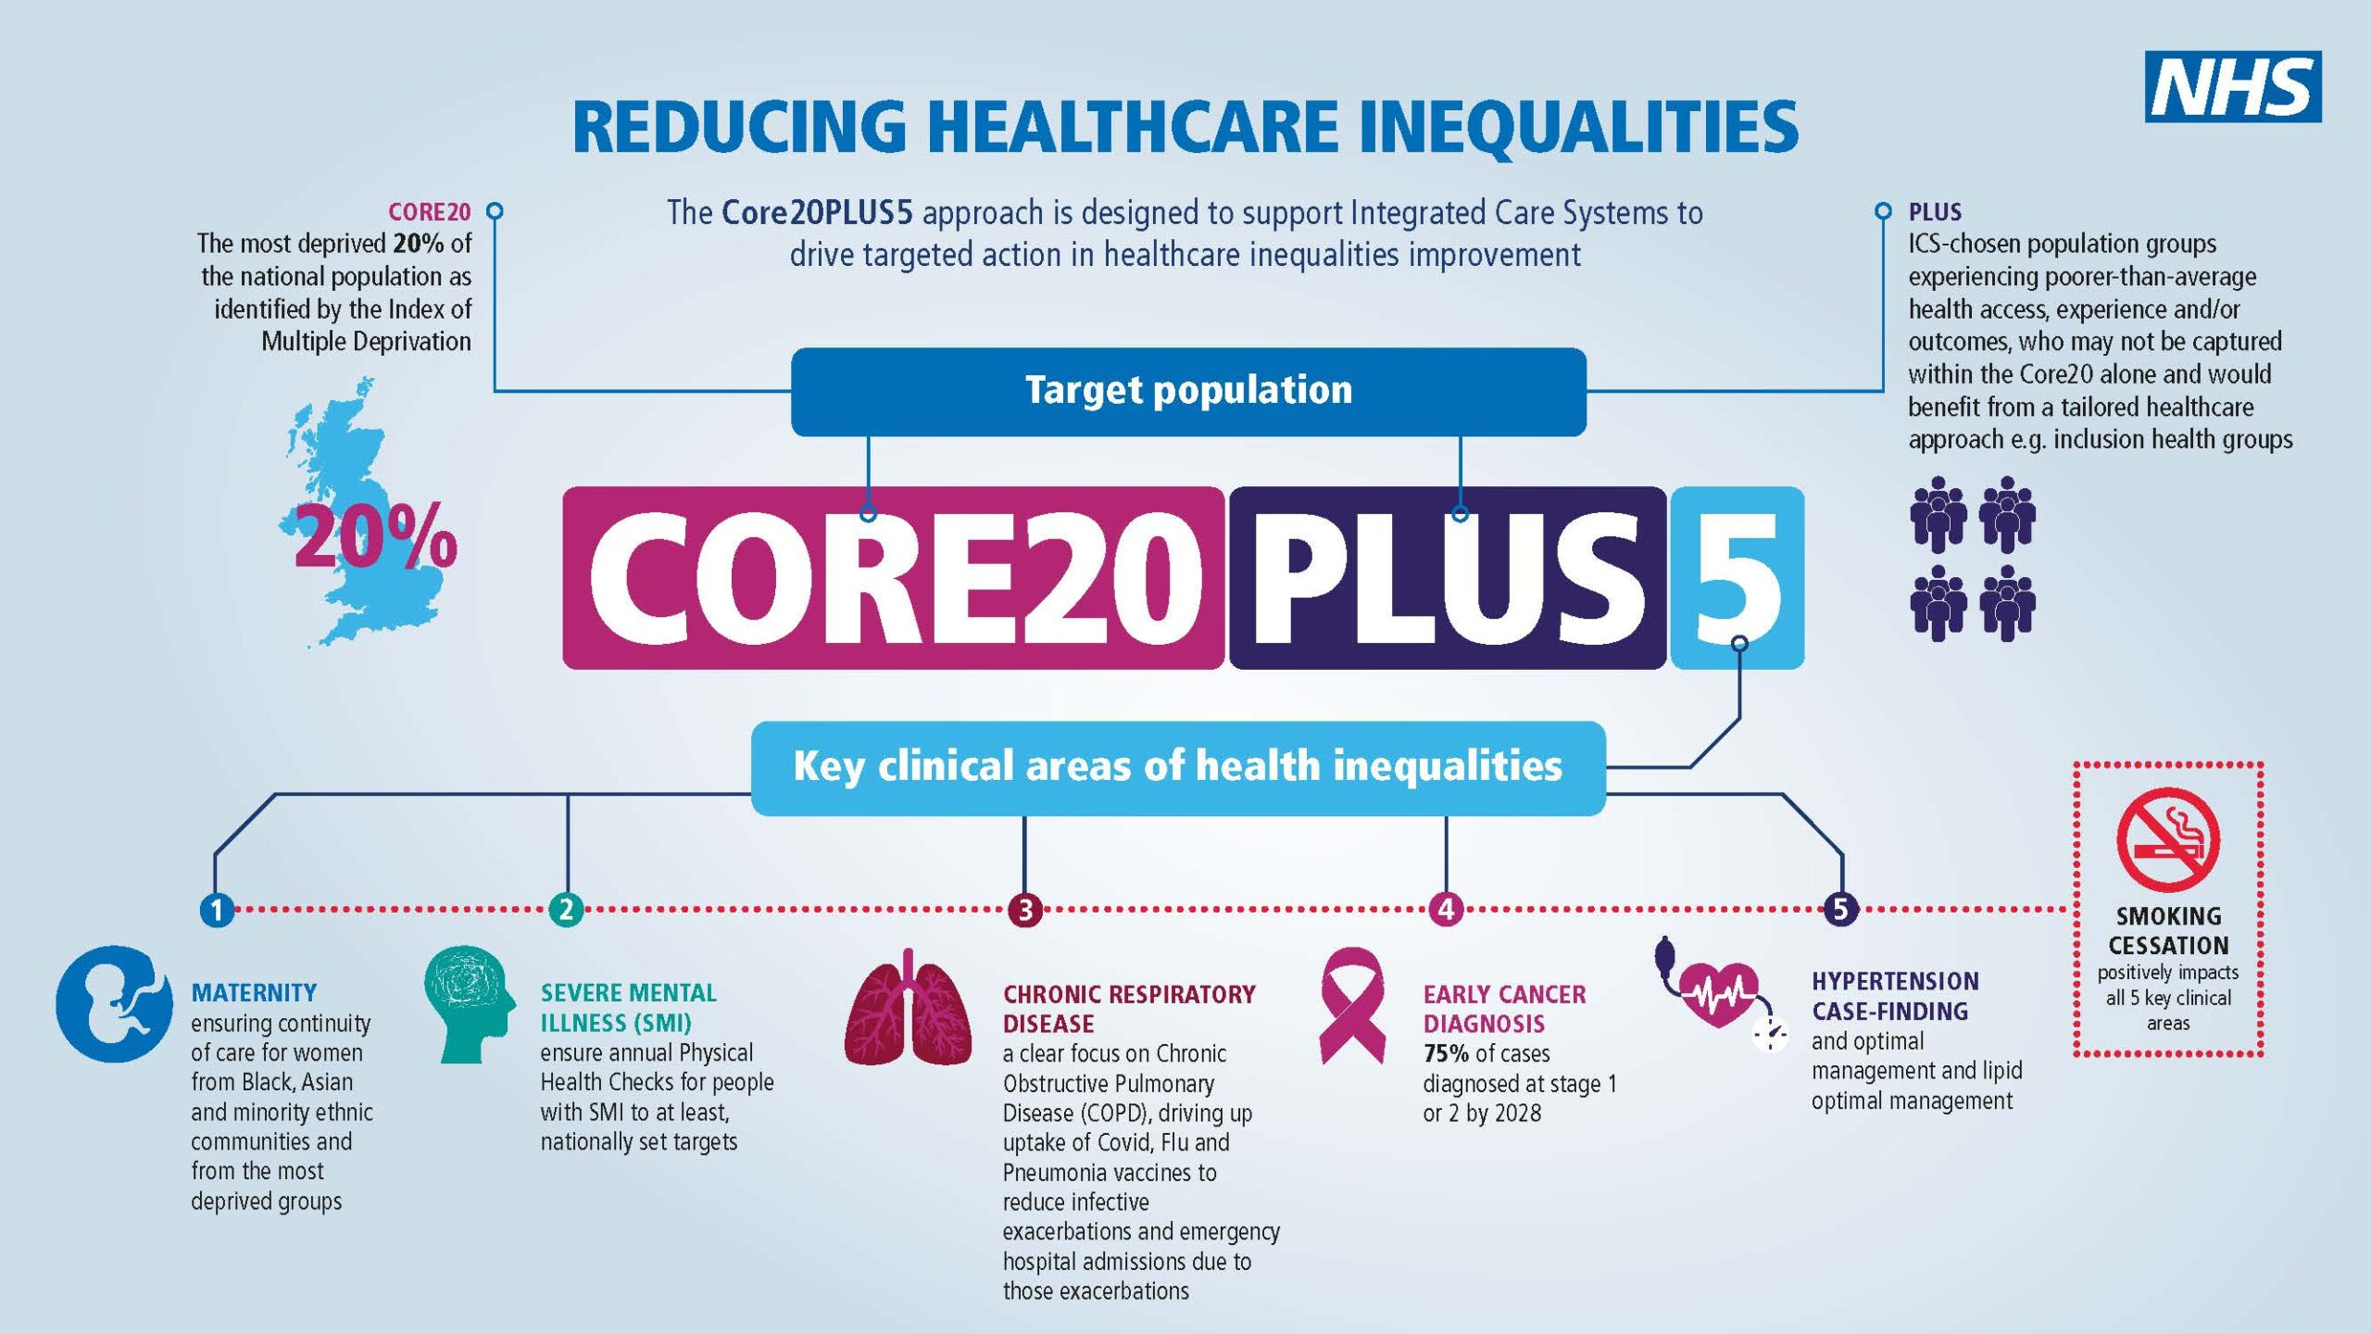
Tackling Health Inequalities using the Core20PLUS5 approach
Smoking worsens all Core20PLUS5 conditions and is a major cause of health inequalities in all Core20PLUS5 populations
https://www.england.nhs.uk/about/equality/equality-hub/national-healthcare-inequalities-improvement-programme/core20plus5/

Slide 22
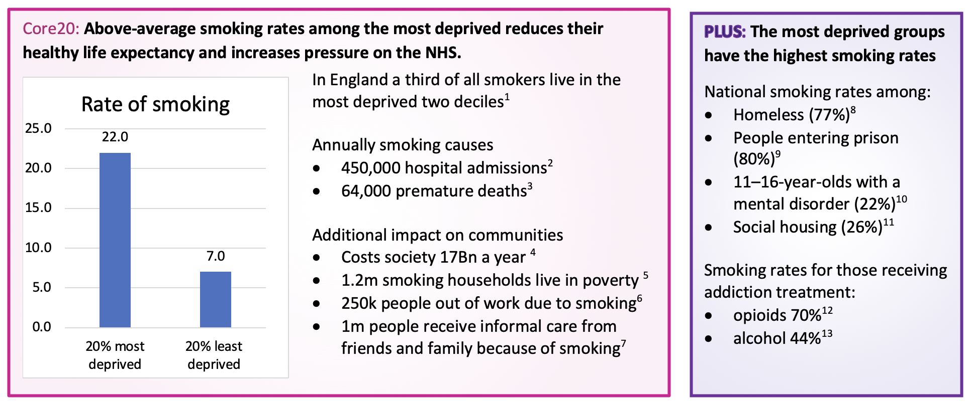
Smoking and the Core20PLUS populations
Notes:
[1] ONS. Deprivation and the impact on smoking. 2023
[2] Smoking Attributable hospital admissions (2019/20). Admissions data from Hospital Episode Statistics (HES); Office for National Statistics (ONS) - mid-year population estimates; Smoking prevalence data from Annual Population Survey; and . and relative risks from the Royal College of Physician's Report 'Hiding in Plain Sight'. Data - OHID
[3] Smoking attributable mortality (new method). 2017 – 19 Directly standardised rate - per 100,000 Local Tobacco Control Profiles - Data - OHID
[4] ASH Ready Reckoner for ICS 2022
[5] H Reed (2021), Estimates of poverty in the UK adjusted for expenditure on tobacco – 2021 update.
[6] H Reed (2020), The impact of smoking history on employment prospects, earnings and productivity: an analysis using UK panel data.
[7] H Reed (2021), The costs of smoking to the social care system and related costs for older people in England: 2021 revision.
[8] Homeless Link. The Unhealthy State of Homelessness. 2014.
[9] O’Moore E. Successfully delivering smokefree prisons across England and Wales. July 2018.
[10] Marcheselli F, Brodie E, Si N, Pearce N, McManus S, Sadler K, et al. Mental Health of Children and Young People in England, 2017 . NHS Digital; 2018.
[11] Local Tobacco Profiles – Data – OHID:
[12] Smoking prevalence in adults (18+) admitted to treatment for substance misuse (NDTMS) - all opiates. 2019/20 Local Tobacco Control Profiles - Data - OHID
[13] Smoking prevalence in adults (18+) admitted to treatment for substance misuse (NDTMS) - alcohol. 2019/20 Local Tobacco Control Profiles - Data - OHID

Slide 23
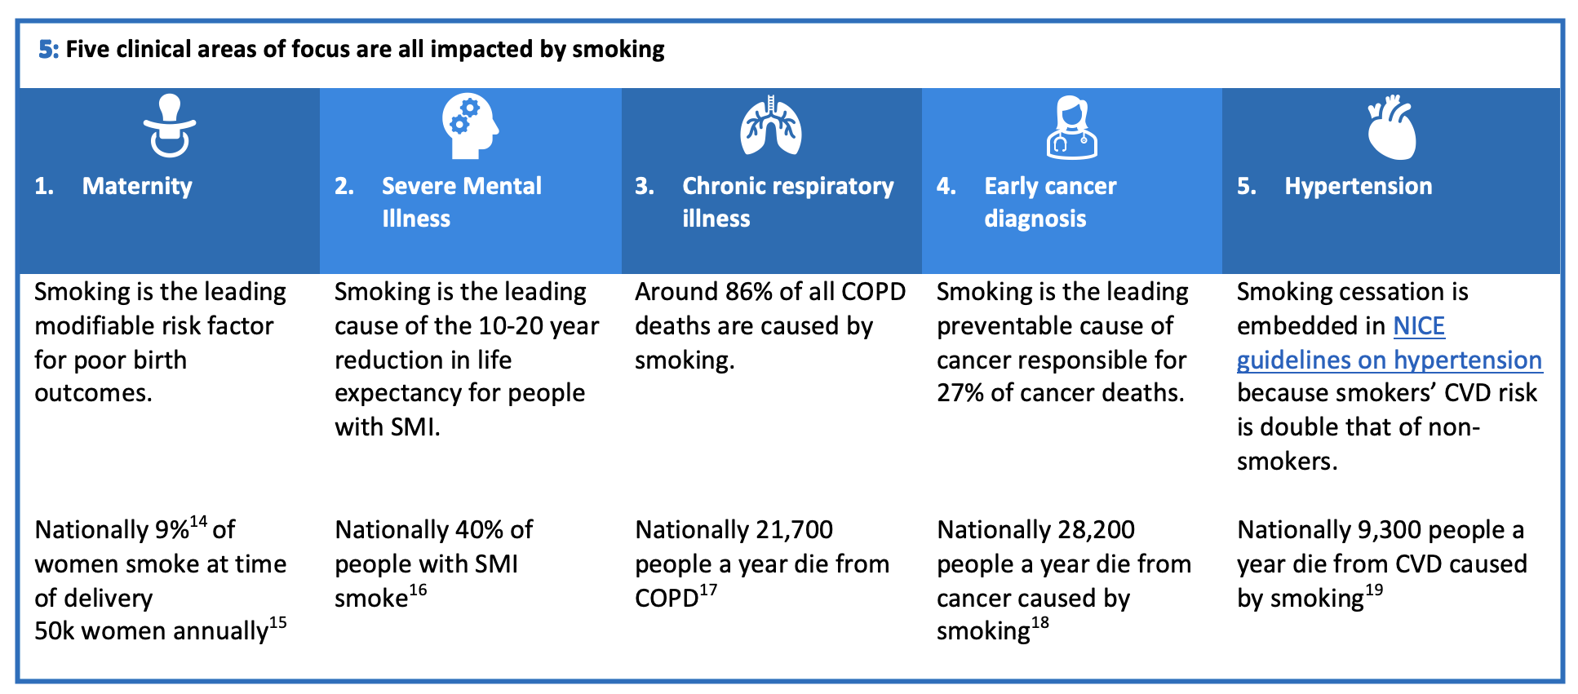
Smoking and the 5 clinical areas of focus
Notes:
[14] Smoking status at time of delivery. (2021) Calculated by PHE from the NHS Digital return on Smoking Status At Time of delivery (SATOD) Local Tobacco Control Profiles - Data - OHID
[15] Smoking status at time of delivery. (2021) Calculated by PHE from the NHS Digital return on Smoking Status At Time of delivery (SATOD) Local Tobacco Control Profiles - Data - OHID
[16] Smoking prevalence in adults (18+) with serious mental illness (SMI) (2016) Local Tobacco Control Profiles - Data - OHID
[17] Mortality rate from chronic obstructive pulmonary disease (3 year range) 2017 – 19 Directly standardised rate - per 100,000 Local Tobacco Control Profiles - Data - OHID
[18] Smoking attributable deaths from Cancer (new method). 2017 – 19 Directly standardised rate - per 100,000 Local Tobacco Control Profiles - Data - OHID
[19] Smoking attributable deaths from heart disease (new method). 2017 – 19 Directly standardised rate - per 100,000 Local Tobacco Control Profiles - Data - OHID

Slide 24
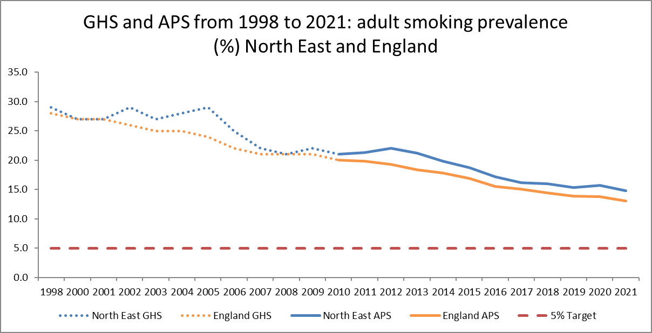
Regional action speeds progress
Adult Smoking Prevalence: 2005 to 2021
The North East have had a regional programme since 2005
They initially saw the fastest rates of decline in smoking of any region
Have since kept pace despite high levels of deprivation
Programme begins
The North East region has shown a steady rate of decline in smoking prevalence from 2005 onwards (2005 – 29.0%, 2021 - 14.8%, a 45.4% drop in actual smokers)

Slide 25
An effective ICB programme can:
Achieve economies of scale through investment in activity less effective/ not possible at local level
Adds to local action to grow the level of impact across the system
Concentrates expertise to provide hub to support local policy development
Take a targeted approach to accelerate reductions in Core20PLUS5 populations
Collectivise risk – co-ordinating activity across organisations that might face barriers to being taken forward individually

Slide 26
What should be delivered at an ICS level?

Slide 27
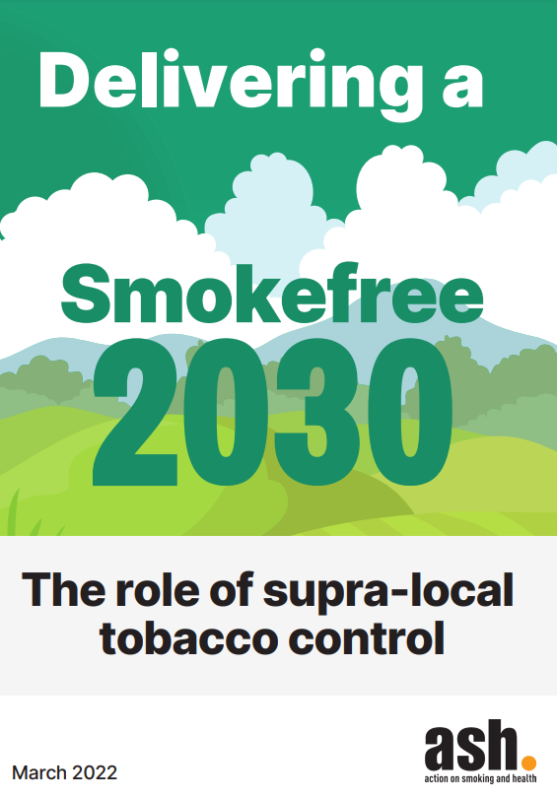
What should be delivered at ICS level?
ASH 2022 report found nationally there was agreement that the following functions worked well at regional/ supra-local level:
  action on illicit tobacco
  communications campaigns
  making the case for tobacco control
  policy and intervention development
  supporting local implementation.
However, programme success was also determined by other characteristics such as:
  expertise in tobacco control
  the ability and mandate to lead
  effective relationships
  distinctive programme of work

Slide 28
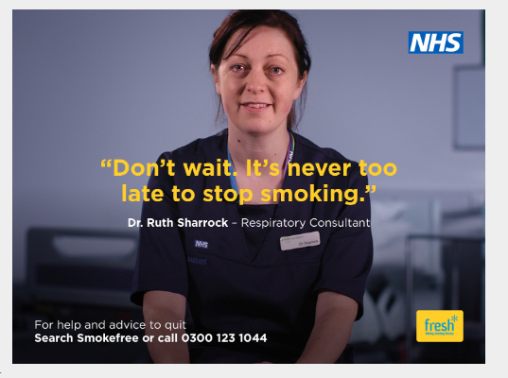


What this looks like elsewhere
London Tobacco Alliance – newly established limited LA funding
Greater Manchester –Making Smoking History programme. Established following devolution
Fresh/ Balance in the North East – substantial programme over many years. Now jointly funded by LA and ICB

Slide 29
What might this mean in practice?
Co-ordination across ICB
Supported network across NHS, Local Authority (LA) public health, LA other functions, police, fire, HMRC etc. Shared priorities Action at place co-ordinated and amplified across system
Effective delivery
Agreed set of functions to be delivered across ICS (with scope for wider partnership across region) Functions will deliver economies of scale Amplification locally but not replicated
Inspire change
Give leaders a voice to champion action across system Champion action needed nationally Empower local communities through engagement with smokers

Slide 30
Summary
The challenges [ICS] faces around inequalities, premature death and health-related worklessness are in large part driven by smoking
Not currently on track to meet 2030 target
This programme provides an opportunity for action at scale
Activity needs to stimulate quit attempts, support quit success AND prevent uptake
Needs a multi-strand strategy with emphasis on at scale actions
Action should build on learning from other successful programmes
Any strategy should be based in evidence

Slide 31
Benefits of reducing smoking
An effective, coordinated tobacco control strategy for [ICS] could:
  save hundreds of lives each year
  reduce inequalities
  reduce burden on the NHS
  improve quality of life
  protect children from harm
  lift households out of poverty
  increase local productivity and economic prosperity
  decrease criminality
ASH, The End of Smoking, 2022

