Slide 1

Update on Champix and alternatives
Lion Shahab, PhD
University College London
@LionShahab

Slide 2
Brief overview
Champix
Generic alternatives
Cytisine & cytisinicline

Slide 3
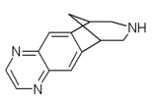
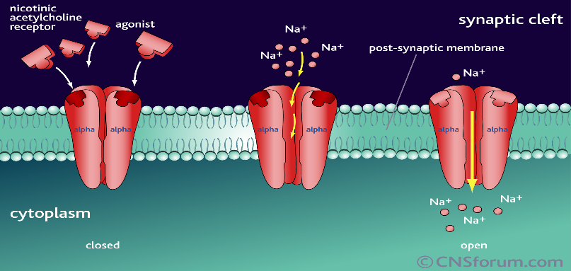
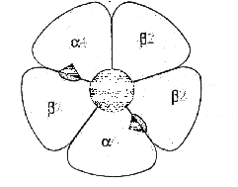
Varenicline – what is it?
Champix
Varenicline tartrate (Chantix/Champix®) was specifically designed to help smokers stop by Pfizer
  Structurally based on cytisine, a natural toxin with nicotine-like action
  Start one week before quit date: 0.5 mg (1 tablet) daily for 3 days, then 1 mg (2 tablets) for 4 days; after quit date 1 mg twice daily for 11 weeks
Selective partial agonist of nACh receptors (α4β2)
Binding site
http://www.cnsforum.com/content/pictures/imagebank/hirespng/rcpt_sys_nic_ag1.png
http://biology.ridley.on.ca/human_genome_project/hgi99/nicotineaddiction.htm

Slide 4
Champix
Varenicline – how does it work?
100%
Maximum effect
Full agonist
Blocks reward
Effect
Partial agonist
50%
Reduces Craving
0%
Dose, exposure
Has a good side-effects profile compared with other smoking cessation medication (e.g., bupropion) – most common is nausea
More effective against lapses (recruits failures back into abstinence)

Slide 5
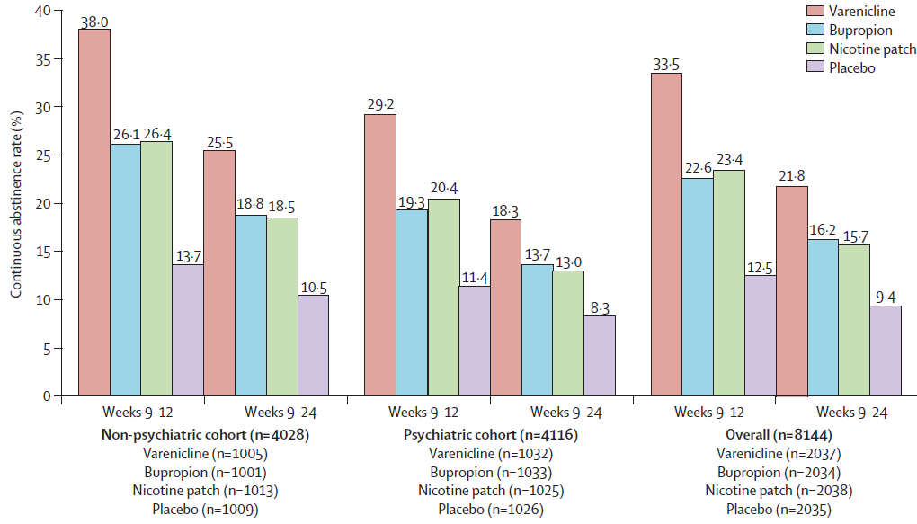
Champix
Varenicline – effectiveness & who uses it
Highly effective treatment
Anthenelli et al (2016). Lancet, 387: 2507-20
Jackson et al (2019). Addiction, 114: 787-797
Notes:
Largest ever smoking cessation trial to establish effectiveness in psychiatric population (because of concerns about neuropsychiatric effects)

Slide 6
Champix
Varenicline – effectiveness & who uses it
Highly effective treatment
Most popular prescription medication among SSS attendees: ~60% or ~110,000 smokers in 2019/20 (NHS, 2021)
But most smokers do not use any aids (~50%) and the most popular aids are not prescription medication
https://smokinginengland.info/graphs/top-line-findings

Slide 7
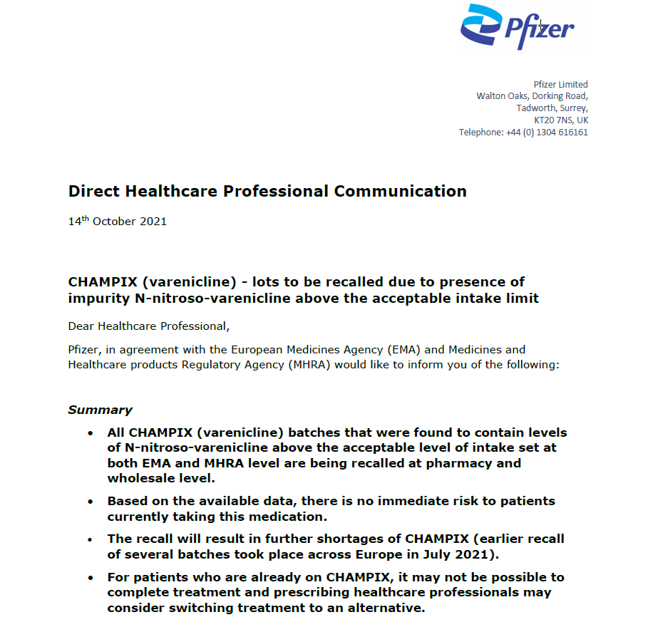
Champix
Varenicline – withdrawal from market
From July 2021, Pfizer began to recall Champix in Europe
This resulted in immediate drop off in prescription of Champix
7,535 fewer smokers stopped at 6 months or 3,768 fewer long-term ex-smokers ~ 1,696 avoidable smoking-related deaths/year
https://openprescribing.net/chemical/0410020D0/
Notes:
Absolute risk difference is 6.85% ~ 110,000 = 7,535 fewer smokers stopped at 6 months (50% long-term relapse rate) ~ 3,768 fewer long-term ex-smokers (90% reduction in 50% excess mortality if they had stopped at median age for treated smokers) ~ 1,696 avoidable deaths/year

Slide 8
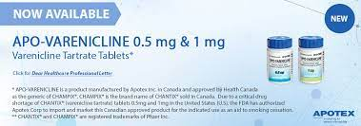
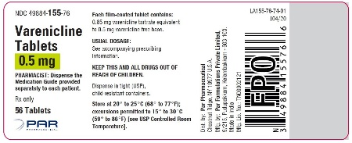
Generic alternatives
Apo-Varenicline and Par Varenicline
Come in doses of 0.5mg and 1mg
Produced by Apotex Corp. / ENDO
Apo-Varenicline Available in Canada
  Approved by FDA in USA August 2021 for temporary import from Canada
Par varenicline approved as generic version for distribution in USA by FDA in August 2021
Neither currently available in UK/EU market!
  Exclusive license lapsed in 2020 in USA but only in September 2021 in UK/EU
The introduction of generics/loss of exclusivity makes it less likely that Pfizer will return to market with Champix

Slide 9
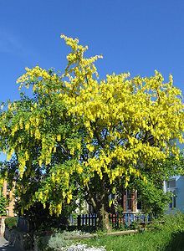
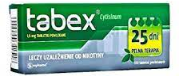
Cytisine/Cytisinicline
What is it and how does it work?
Plant-based alkaloid that acts as a partial nAChR agonist (similar to varenicline) found in C laburnum (Golden Rain/Chain)
  Partial agonist action maintains dopamine release: withdrawal ↓
  Higher affinity for nAChR than nicotine: rewarding effects of smoking↓
Has been used in Eastern Europe for smoking cessation treatment since 1980s
Because most of the scientific literature on it was published in non-English literature, was largely forgotten about
Early review by Etter (2006) showed that it nearly doubled abstinence rates compared with placebo (but poor quality)
  Treatment: 1.5mg tablets in downward titration from 6/day to 1/day over 25 days

Slide 10
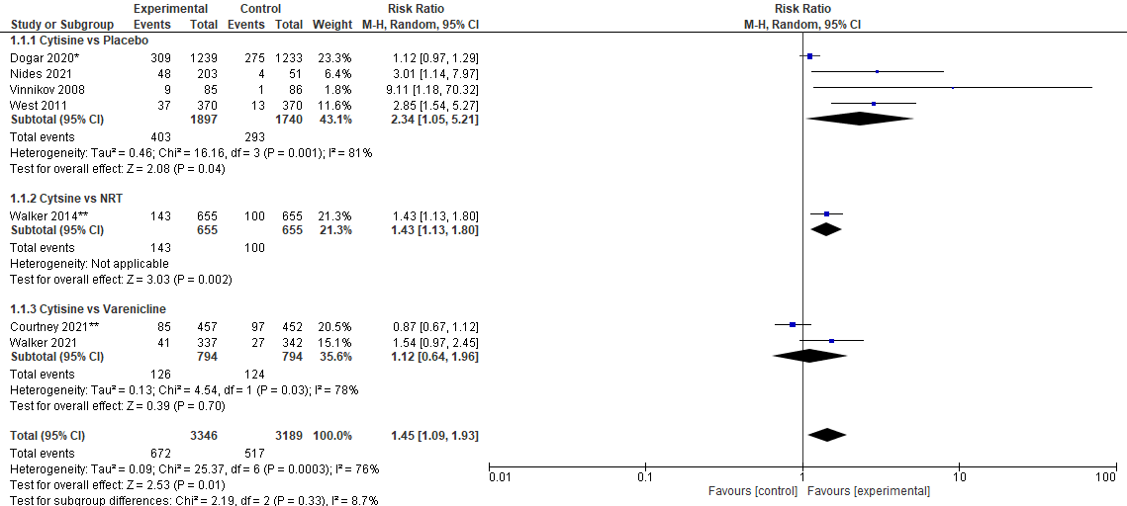
Cytisine/Cytisinicline
Effectiveness
Seven high-quality RCTs are currently in the literature, generally finding superior efficacy
Notes:
Dogar Tuberculosis population – highly motivated?

Slide 11
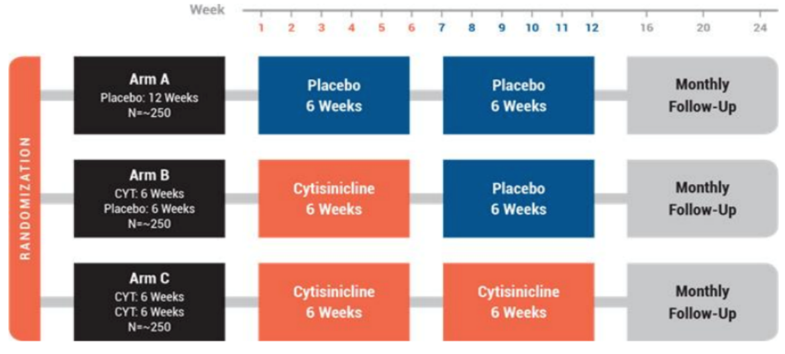
Cytisine/Cytisinicline
Effectiveness
Seven high-quality RCTs are currently in the literature, generally finding superior efficacy
Generally has a better side effects profile than varenicline, particularly for abnormal dreams and nausea (likely due to lower 5-HT_{3A} affinity)
  Walker et al 2021: IRR 0.56 (95%CI 0.49-0.65)
  Courtney et al 2021: IRR 0.88 (95%CI 0.81-0.95)
Health Technology Assessment involving 21 varenicline and 2 cytisine trials concluded that cytisine “is estimated to be both more clinically effective and cost-effective than varenicline” (Leaviss et al, 2014)
Current Phase 3 trial (ORCA) by Achieve Life Science underway using novel dosing schedule (3mg TID, over 25 days)
  Based on acceptability and favourable outcomes of Phase 2b trial (Nides et al, 2021)

Slide 12
Conclusions
Champix is a highly effective, if underused, smoking cessation treatment
It has been withdrawn from market due to impurities
  Unavailability of Champix will have contributed to avoidable smoking-related deaths in UK
Champix is unlikely to return due to expired exclusive patent
  Probable that generics will become available in the near future in UK
Cytisine, in addition to generic varenicline, may fill the gap
  Has similar effectiveness but better side effects profile than Champix
  Status as natural health product may increase popularity and attract new smokers into quitting process
  Given ongoing trials, likely to be launched soon

