Slide 1
Smoking cessation Patient Group Directions (PGDs)
Kieran Reynolds
Medicines Use and Safety – NHS Specialist Pharmacy Service (SPS)

Slide 2
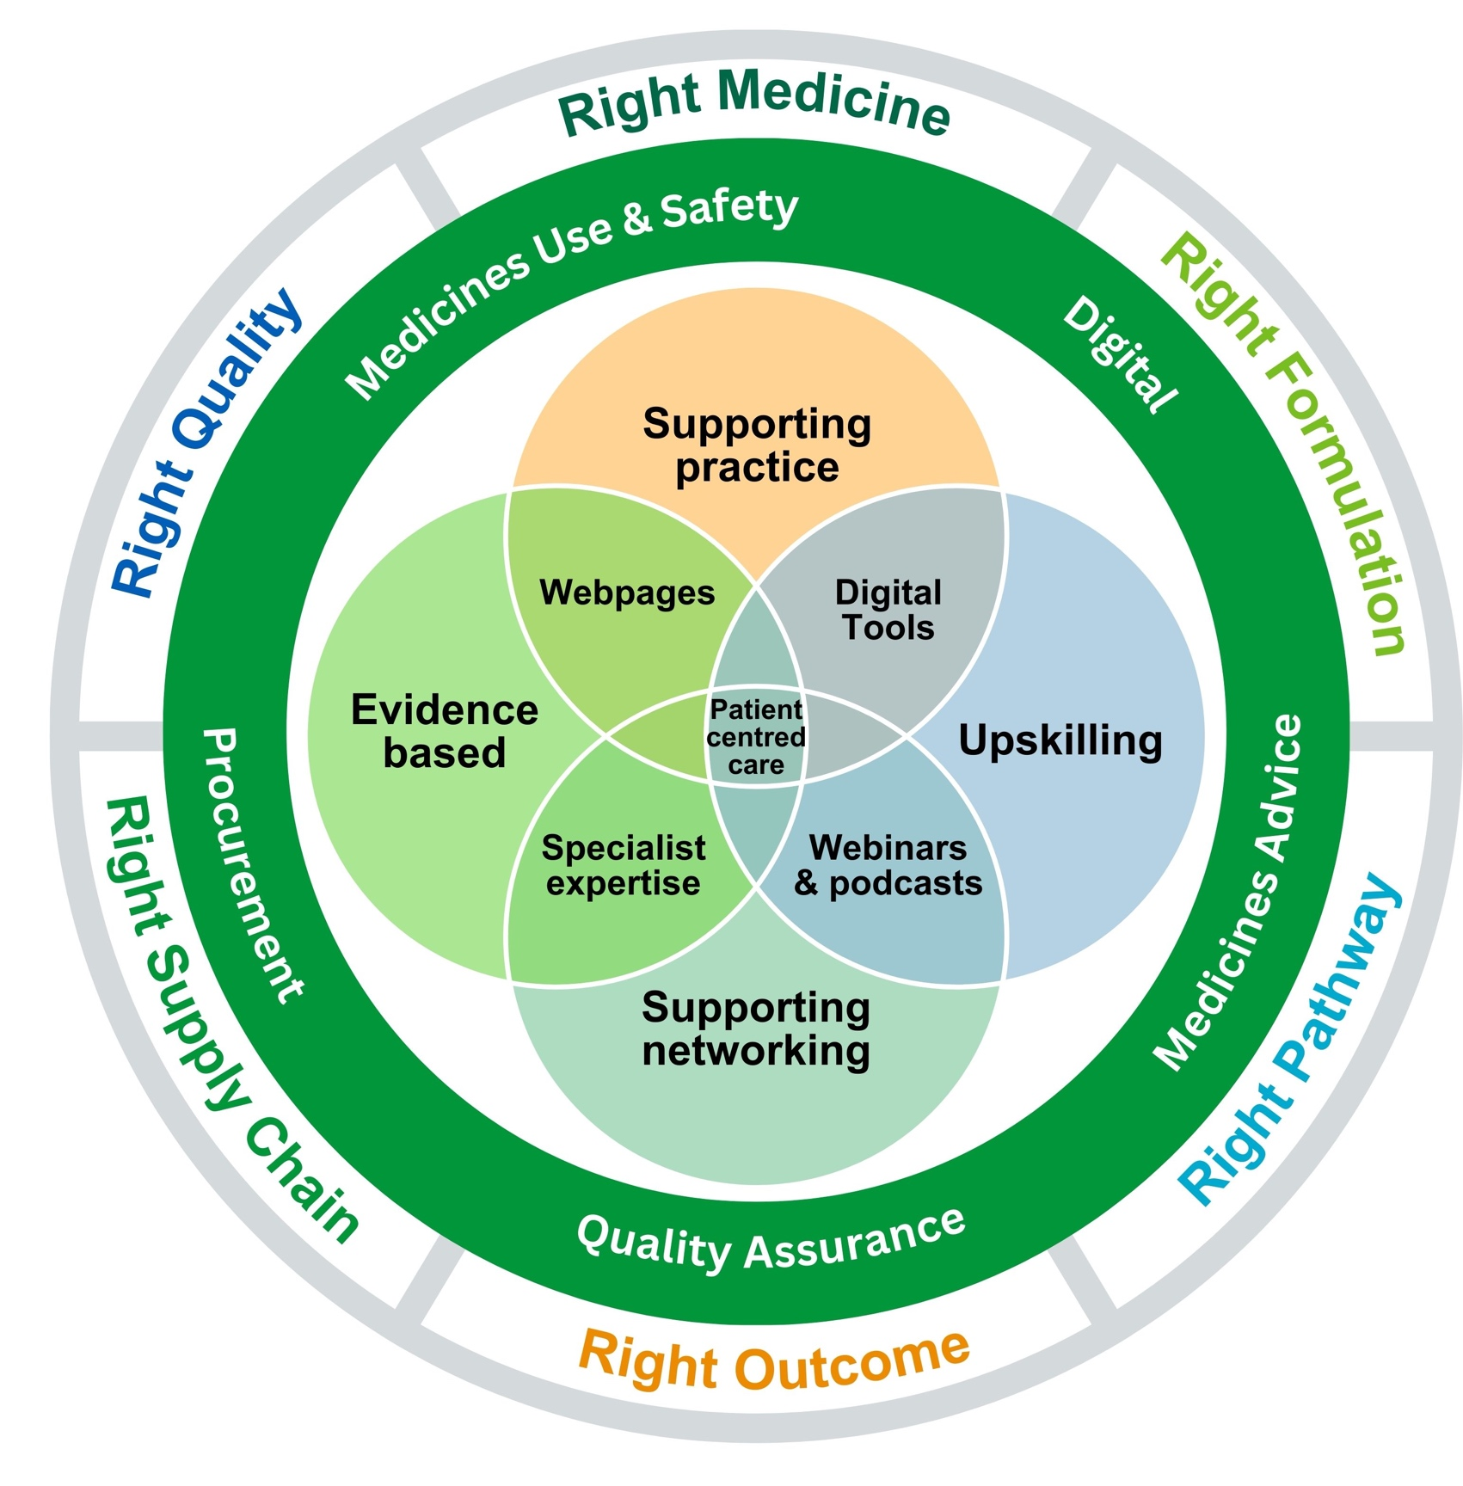
Who are SPS?
Commissioned by NHS England
Span all 7 NHS England regions
Working together to “do once and share”
Lord Carter review recommended standardising the development and distribution of PGDs (& medicines policies, and other essential organisational governance documents).
Reduce duplication and help release local resource that can be redeployed

Slide 3
What is a PGD?
A written instruction which enables the supply and/or administration of medicines in the absence of a Patient Specific Direction (PSD), prescription or a legal exemption in Schedule 17 or 223 of the Human Medicines Regulations 2012.
Can only be used by the registered health professionals listed in schedule 16, part 4 of the HMR 2012.
Not a prescription
NICE MPG2: PGDs must only be used where there is no other suitable legal mechanism for supply/administration.

Slide 4
What is a PGD?
The PGD user working under a PGD is doing it autonomously – they are responsible for assessing that the individual meets the criteria set out in the PGD as no deviations from the PGD are permitted
Clinical judgement cannot be used to supply/administer a medicine outside the criteria stated in the PGD
Healthcare professionals must only work under a PGD when they are listed in the legislation, are fully trained and competent to do so and have been individually authorised to work under the PGD.
No delegation of responsibility is permitted under a PGD – all activity including consent, clinical assessment, supply/administration and record keeping must be undertaken by the same registered healthcare professional.
Notes:
As we know legislation changed on 26 June and pharmacy technicians are now included in the list of registered professionals able to work under a PGD.
First point defines what a PGD is, I won’t read it for you but
The supply/administration can be for an individual known or not known to the service i.e. can be an appointment or a walk in.
PGDs are or course subject to legal controls , we appreciate PGDs may be an area many pharmacy technicians are not familiar with so today we want to give you an overview and encourage you all to find out more so that you are aware of the legislation and know that you are safely working within it.

Slide 5



An analogy
Prescribing: an all you can eat buffet
PGD: set menu
No changes, no substitutions
Notes:
A colleague used to refer to prescribing as an all you can eat buffet and a PGD as a restricted set-lunch menu

Slide 6
Smoking cessation PGDs
SPS have developed 2 PGD templates:
  Varenicline (published October 2024)
  Cytisinicline (cytisine)
    NICE guidance; expected publication date Feb 2025
    PGD template will be published after this guidance is released
Developed with the support of NHSE and specialist stakeholders working within clinical practice (doctors, pharmacists, nurses).
These PGDs are an option for NHS/LA services to use in smoking cessation services
These PGDs will hopefully facilitate:
  Assessment and treatment initiation on the same day
  Shorter and simpler treatment pathway
  Enabling non-prescriber led services

Slide 7
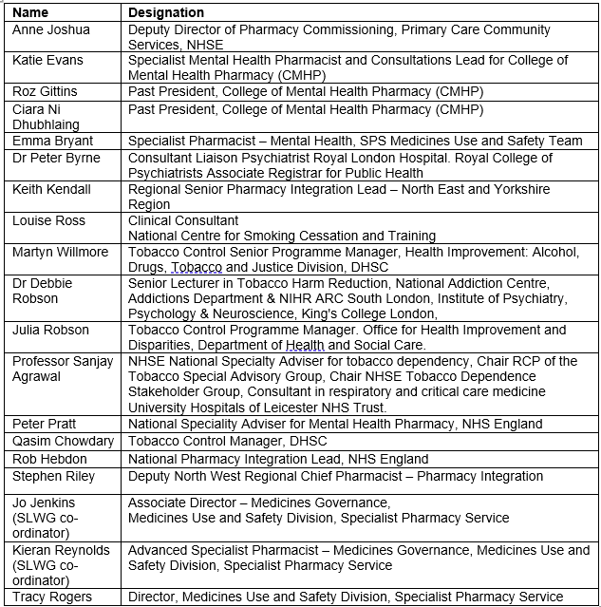
Smoking cessation
PGD SLWG

Slide 8
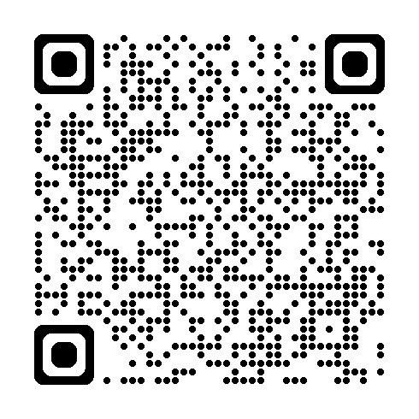
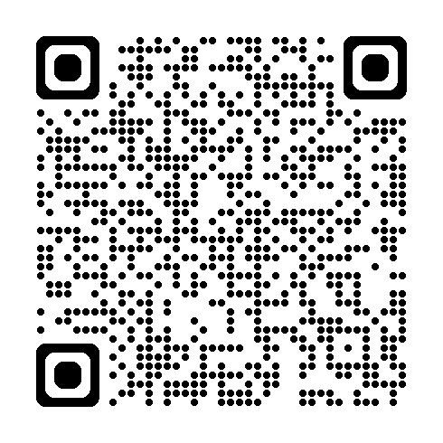
Next steps
Local sign-off
The PGDs must be (reviewed and then) signed by:
a senior doctor
a senior pharmacist
any other professional group representatives involved in their use
The PGDs must then be authorised by an appropriate authorising body (e.g. NHS Trust, NHS Foundation Trust, LA) in line with The Human Medicines Regulations 2012 (regulation 229):
Note: where an NHS or LA is commissioning provision from an independent provider (including charities) the commissioner is the legal authorising body.
The identity of the authorising signatory will be determined by the organisations’
governance structure.

Slide 9
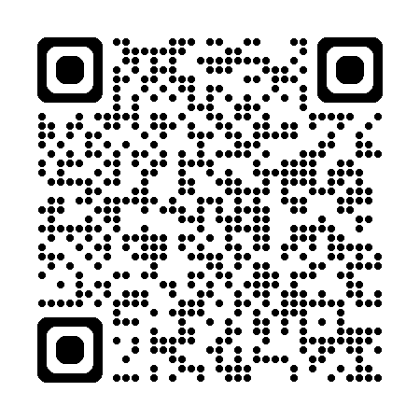
Next steps
2. Local governance
PGDs must also be reviewed through the organisation’s PGD governance system (i.e. DTC, Meds Management governance oversight group) once clinically signed, prior to obtaining authorising signature. Liaise with your local pharmacy team to determine who is responsible for this.
3. Training
Ensure the relevant training is completed so that practitioners can be assessed
for competency to use the PGDs.
This can be provided locally or via national resources.

Slide 10
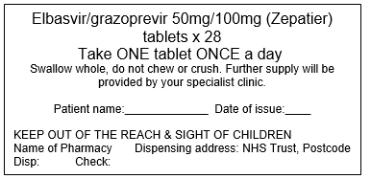
Next steps
4. Supply of medicines
Supply of medicines under a PGD requires medicines to be over-labelled with the dosage instructions and address of the service, as well as space for the individual’s name and date of supply.
Liaise with your local pharmacy department/specialist pharmacy team re: acquiring and managing over-labelled stock of medicines.

Slide 11
Smoking cessation PGDs – summary
An option for services to use
Require local sign-off before can be used
May require supply of over-labelled medicines
May work for some services, may not work for others

Slide 12

Contact us

