Slide 1
Incentives: adding value to
Smokefree Pregnancies
Jane Coyne
Treating Tobacco Dependency Programme Lead
GMHSCP
16.03.22

Slide 2

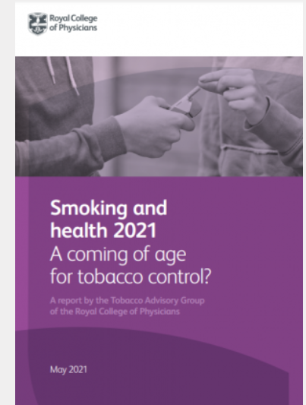
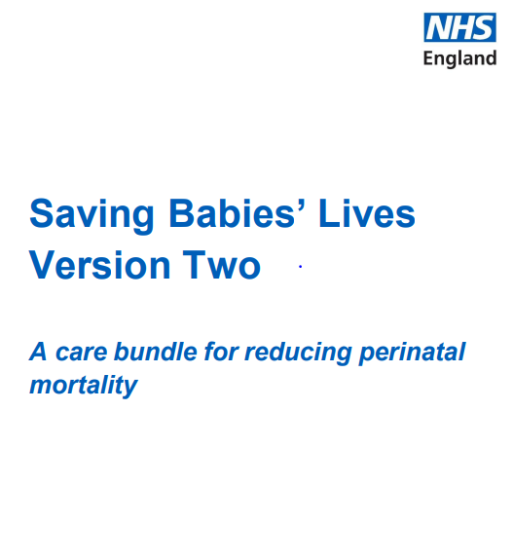
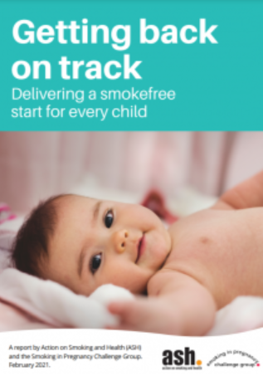
Why treat tobacco dependence in the NHS: business case
Incentives: adding value to
Smokefree Pregnancies
headlines
  The NHS Saving Babies Lives Care Bundle (SBLCB) was born out of a response by the Strategic Clinical Networks to England’s poor stillbirth rate of 4.2 stillbirths per 1,000 total births and the NHS’s commitment to a reduce maternal mortality, neonatal mortality and serious brain injury and a reduction in preterm births rates by 2025, the death of a baby has significant psychological, social and economic consequences for parents and their families which may persist for many years. The majority of stillbirths still occur in the antenatal period and occur in otherwise healthy babies, and the reason often cannot be explained. The risk of stillbirth is 52% higher in pregnant women who smoke
Notes:
Office for National statistics (ONS) 2018. Births in England and wales, 2017. London: Office for National Statistics
Campbell-Jackson, L., & Horsch, A. (2014). The Psychological Impact of Stillbirth on Women: A Systematic Review. Illness, Crisis & Loss, 22(3), 237–256. https://doi.org/10.2190/IL.22.3.d
Takawira et al (2015) Maternal smoking and the risk of stillbirth: systematic review and metanalysis The hub - Home

Slide 3
NICE and Incentives
Incentives: adding value to
Smokefree Pregnancies
NICE Guidance (NG 209, Nov 2021)
Identifying pregnant women who smoke and referring them for stop-smoking support (Provide routine CO testing at all antenatal appointments to assess the pregnant woman's exposure to tobacco smoke)
Following up women who have been referred
Providing support to stop smoking (Consider NRT at the earliest opportunity in pregnancy and continue to provide it after pregnancy if the woman needs it to prevent a relapse
Incentives to stop smoking (In addition to NRT and behavioural support, offer voucher incentives to support women to stop smoking during pregnancy)
Enabling all pregnant women to access stop-smoking support
Helping partners and others in the household who smoke
NICE. 209 Recommendations on treating tobacco dependence in pregnant women

Slide 4
Elements of the Greater Manchester
Smokefree Pregnancy programme
OPT-OUT
Referral
Risk Perception
Data Analysis
CO Monitoring
Maternity Stop Smoking Services
Incentives
Notes:
The Greater Manchester Smokefree Pregnancy Programme was established in 2018 in response to NHS England’s Saving Babies Lives’ care bundle, designed to reduce the rate of stillbirths.
Smoking during pregnancy was highlighted as the key modifiable risk factor of complications such as miscarriage, premature birth, low birth weight and stillbirth.
Comprehensive training for all maternity staff to carry out Carbon Monoxide (CO) testing to help identify and refer smokers to dedicated maternity tobacco dependency treatment services
The programme utilises an evidence-based incentive scheme, designed to increase engagement with pregnant smokers, especially those who found it harder to quit smoking or needed extra motivation.
The incentives are given at different stages during the pregnancy and up to 12 weeks after birth. To receive the incentive, the patient must validate their quit with a CO test, empowering them to stay smokefree.
RCT in progress in the use of incentives up to 12 months post-birth
Standard pathway – learning best engagement – mw’s ringing direct to service + Direct phone call referral Collaborative working with Community staff/Specialist team – 13 MSW’s into the system
Learning – maternity model saw increased engagement – moved to system level may 2020 – informed LTO
RCT – post birth incentives for relapse prevention – just finished recruitment

Slide 5
Incentives scheme journey
Weeks 1 to 4
CO validation
Week 5 to delivery
Minimum 4-weekly face-to-face contact
CO validation
Delivery
(giving birth)
Up to 12 weeks post-partum
Registration
Outline scheme
Discuss Significant Other (SOS) and smokefree home (SFH)
Quit date set
4-weekly contact and support
Sign contract
CO validate
Specialist cessation support / SFH advice
Specialist maternity addiction support / SFH advice
Reported and CO validated at any point from 36-weeks
Face-to-face at 12-week point /CO validation
£60 if smokefree
£60 to the SOS if both they and the woman smokefree
Recruit SOS – sign contract
Weekly face-to-face contact
£10 for each week validated smokefree
£20 for each 4-weeks smokefree
ELIGIBILITY CRITERIA
teen pregnancy / living in an area of deprivation or high smoking prevalence / living with a smokers / smoked throughout previous pregnancies
REMOVAL CRITERIA
If the patient relapses once they are re-registered onto the scheme. If the patient relapses twice they are removed from the scheme.
Notes:
Pregnant smokers living in a challenging environment were considered a high priority for recruitment to the scheme:
Living with a smoker
Living in an area of deprivation or high smoking prevalence
Smoked throughout a previous pregnancy
Young parent
The absolute definition of ‘challenging environment’ was left to the professional judgement of local practitioners.
Women who agreed to participate are asked to sign a contract accepting an enhanced level of support and to CO screening at each visit

Slide 6
Implications for delivery
Incentives: adding value to
Smokefree Pregnancies
As defined by the Long Term Plan the transition of services should be into specially trained treating tobacco dependency advisors employed within maternity services – provides seamless continuity of care
Delivered as part of their pregnancy journey
Data is held in one place
The teams will see the women up to 3 months post-birth (local services need to adapt commissioning frameworks)
Merging of locality budgets to support – collaboration
ICS can hold as part of a central programme
Return on investment seen back within the NHS e.g. reduction in prem births, neonatal admissions
Incentive vs reward schemes

Slide 7
What does the system get from the scheme?
Incentives: adding value to
Smokefree Pregnancies
The scheme reinforces evidence that incentives work and generated real and cost effective benefits for women and their babies
Targeted financial incentives combined with enhanced support are more effective than standard stop smoking support and need to be integrated into service commissioning priorities
The focus on women in ‘challenging situations’ is supportive of public health priorities to address health inequalities and is a justified ongoing investment for PH/CCGs
Women support CO screening
There was a significant increase in smokefree homes, providing extended protection for other family members
The presence of the SOS was supportive of efforts to quit
Notes:
Standard pathway – learning best engagement – mw’s ringing direct to service + Direct phone call referral Collaborative working with Community staff/Specialist team – 13 MSW’s into the system
Learning – maternity model saw increased engagement – moved to system level may 2020 – informed LTO

Slide 8
Successes
Incentives: adding value to
Smokefree Pregnancies
Number of women who achieve a 4 week quit has increased by 272% since the implementation of the incentives
All 4 week quits are CO validated which improves confidence in data and validity of the quit
Currently the specialist maternity stop smoking service are achieving a 75% success rate, the incentive scheme is a huge part in this high level of engagement and success
Smokefree homes increased from 23% to 84% amongst those on the incentive scheme
The incentivisation of partners has been essential in during the smokefree home agenda
Allowing significant others to take part in the incentive scheme is essential in helping the pregnant woman to quit smoking and promoting a smokefree home
Prior to the programme being launched, around 1 in 8 of all new mothers were smokers at time of giving birth. This has reduced to around 1 in 10 – a dramatic reduction in Smoking At Time Of Delivery

Slide 9

Tierney-Rose, from Rochdale, started smoking as a teenager and had tried to quit several times but without success. She eventually found her incentive to quit for good when she fell pregnant with her first baby.
“It was such a happy moment when my partner and I found out that we were expecting a baby. But we needed to shake ourselves up a bit and make some changes. We were young and there were some things that we needed to stop doing, smoking being one of them.
I had smoked for almost six years and knew I would need help to quit. So, when I was asked if I smoked at my first midwife appointment, I was honest and said yes. I told the midwife that I desperately wanted to quit, and I was relieved to find that I would receive stop smoking support as part of my prenatal journey.
It wasn’t easy quitting, especially as people I knew still smoked. I found it hardest towards the end of my pregnancy and when Maddie was born, as adjusting to being a new mum was stressful. However, with support I got through the tough times and I’ve now been smokefree for nearly two years.
The vouchers were a nice extra. I bought nappies for the baby and then at the end of the series I was able to buy something nice for myself – a new outfit.
Quitting gave me a healthy baby and it’s great to know that I am giving us both a healthier future. I feel much better since quitting, and I’m so happy that my house is now smokefree.”
Read Tierney’s story at www.makesmokinghistory.co.uk

