Slide 1


The Vision for Humber and North Yorkshire
Peter Roderick, Consultant in Public Health

Slide 2
The project in HNY
Financial resource secured for expansion of current ICB Tobacco Programme, beyond the current resources required to deliver the LTP in acute, maternity and mental health settings
The ICB has allocated a portion of its health inequalities funding, £365,00 (2023/24) and £863,000 (2024/25) set aside for regional work on tobacco control
This will enable use to take a comprehensive tobacco control approach forward, beyond cessation service provision
So far, in collaboration with ASH:
  Mapping exercise of existing activity within local authorities and priorities of partners
  Development of priority areas for the strategy based on learning from other programmes
WORKING TITLE: Centre for Excellence in Tobacco Control

Slide 3
The proposal
Co-ordination across ICS
Well-funded regional communications and mass media campaigns Illicit tobacco leadership A strong HNY voice to lobby and advocate on behalf of effective national policy. Policy expertise / data and intelligence e.g. vaping Research and evaluation Long-term leadership / quality improvement for NHS tobacco dependency treatment services
System investment
Lung Health Checks Sector-specific support e.g. primary care and community pharmacy Systematic approach to work within social care and housing services Embedding tobacco control in nursing, midwifery and undergraduate / postgraduate medical education
Place-based investment
Supporting LSSS to provide NICE-standard services, including e cigarettes Investment in financial incentives for pregnant smokers Funded VBA resources and training capacity Funding for LAs to target inequalities

Slide 4
Co-ordination across the ICB
Tobacco control leadership through experienced specialist programme lead and team
Coordinated action
  Communications and campaigns
  Enforcement and tackling illicit tobacco
  Advocating for effective national policy
  Data and intelligence
  Research and evaluation
  Quality improvement of NHS stop smoking services
  Supporting tobacco alliances

Slide 5
Looking forward
What are we trying to build?
Must add values to the system - additional, not a replacement
Must be aligned not duplicating
Must be system, not NHS
Must be nimble and innovative, not another ‘programme’
Must be generous not parochial (sharing learning across Y+H and beyond)

Slide 6
Most Common Questions
What will it look like? Will you pool budgets and have one tobacco alliance?
It’s different in Yorkshire! We couldn't do it here.

Slide 7
Added investment and added value
Work together at system level to increase our collective impact.
The programme is a partnership between the NHS and local authorities aiming to work with voluntary sector organisations and academic bodies to accelerate reductions in smoking rates.
By working together, our organisations involved intend to co-ordinate activities more closely, including through a range of population-level interventions such as tackling illicit tobacco, mass media campaigns and joint advocacy for effective national policy.
There will be action to ensure there is consistent stop smoking support available across the ICS with equitable access to nicotine-replacement and e-cigarettes (as quit aids).
There will also be support for local authorities to deliver targeted interventions to specific communities.
Notes:
Humber and North Yorkshire Integrated Care Board (ICB) is drawing on health inequalities funding from NHS England to finance its contribution to the programme, and this will add to the funding earmarked by public health teams rather than substituting for it.

Slide 8
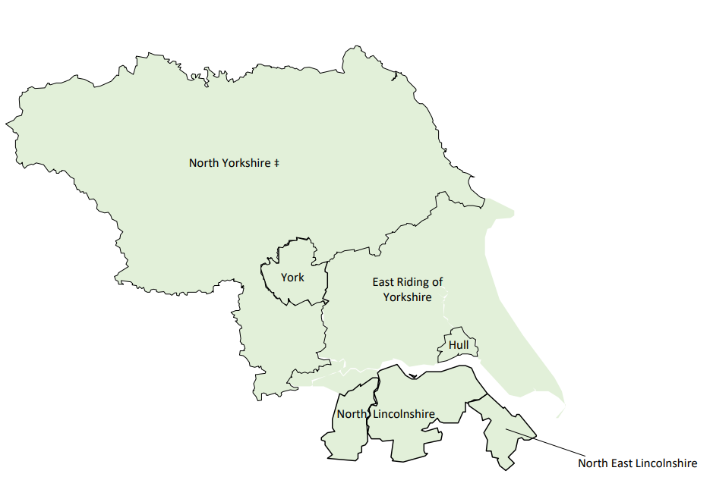
If we can do it – you can do it!
DsPH Leadership aaa
Geographical area of more than 1,500 square miles and serve a population of 1.7 million people, all with different health and care needs. Our area includes the cities of Hull and York and the large rural areas across East Yorkshire, North Yorkshire and Northern Lincolnshire.
There are stark inequalities in the region:
Hull has the highest smoking rates in England (22%) versus 9.2% in York (9th lowest)
Notes:
Identifying and maximising opportunities
Do the ground work
Leadership ICB and DsPH
Opportunity for Funding
Hull 22%
North East Lincolnshire 16.5%
North Lincolnshire 12.3%
York 9.2%
East Riding 10.2%
North Yorkshire 11.1

Slide 9

Thank You

