Slide 1
Working in Partnership to Treat Tobacco Dependency in Devon
November 2021
Dr Helena Posnett, Speciality Registrar in Public Health and Public Health SRO for TTD Workstream.

Slide 2
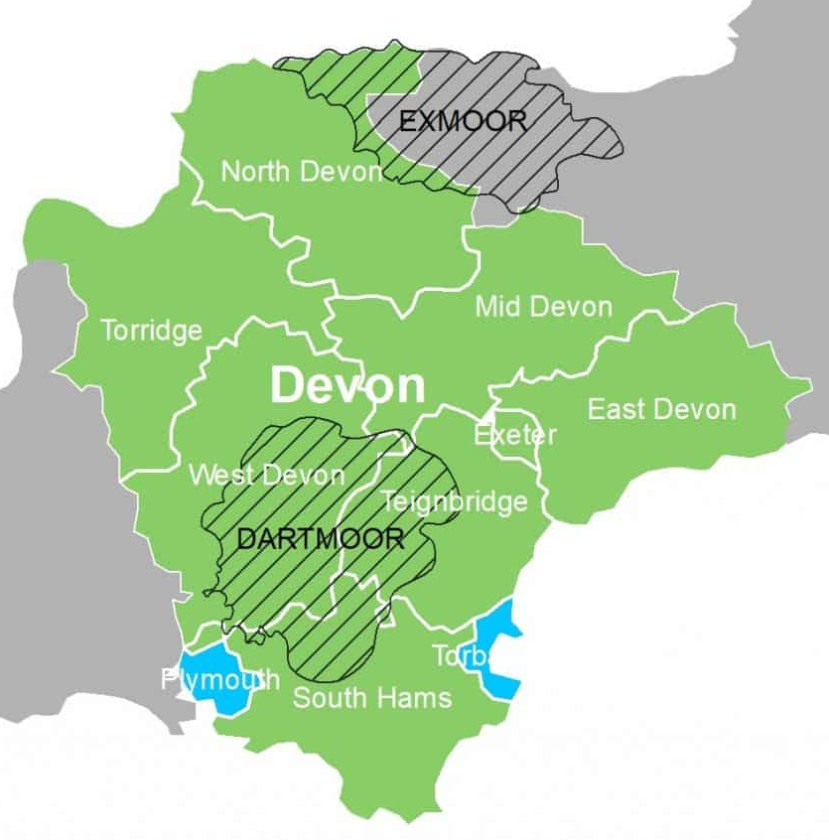
Our Experience in Devon
Devon and Our Population
Our Provider Landscape
Our journey to forming a TTD Project Steering Group
Our Values and Behaviours, and Governance Structure
Stakeholder views on ‘what partnership feels like’ – the good, and not so good
What is helping us
Next steps

Slide 3
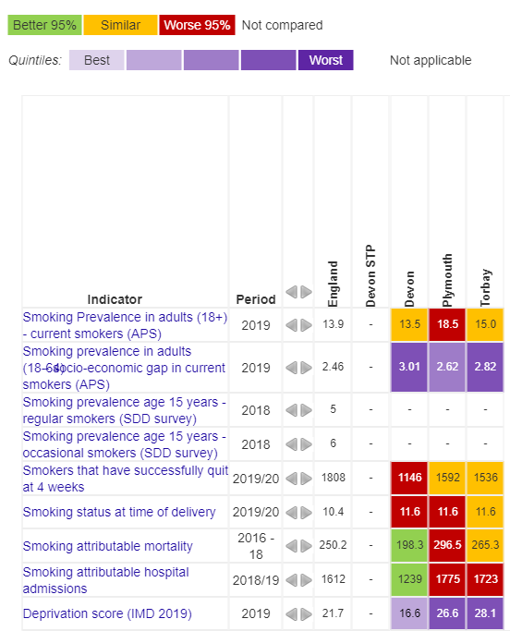
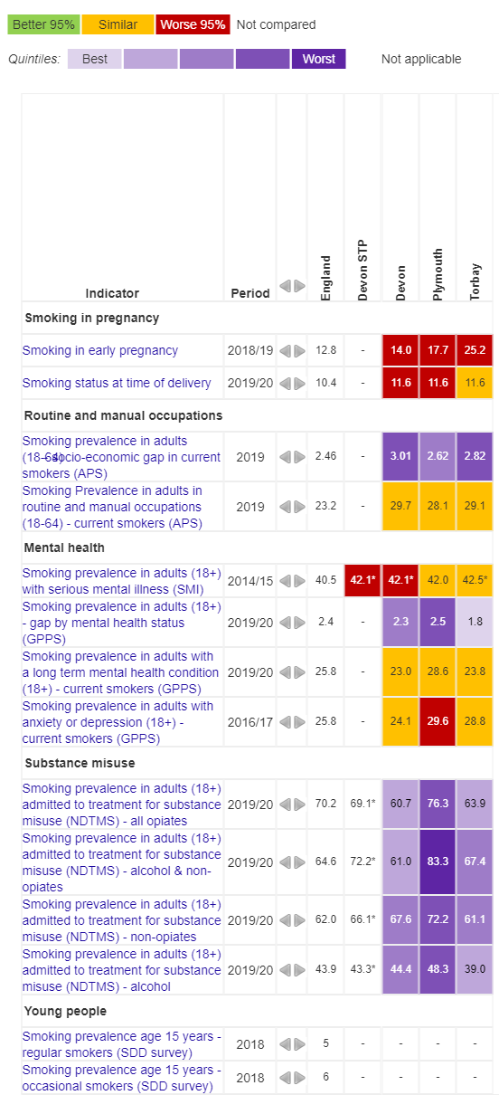
The Devon Population is large and diverse, and spread across rural and urban areas.
1.2 million residents
Complex patterns of rural and urban deprivation
Diverse needs
Barriers to accessing services across a large geographic area
Source: OHID Fingertips

Slide 4
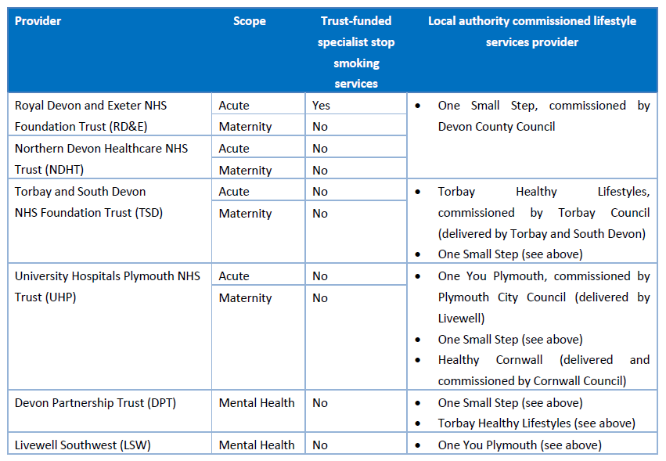
The Provider Landscape also varies. 4 Implementation Groups.
6 Trusts across 3 Local Authorities
3 PH-commissioned life style services providers
All Trusts refer to Lifestyle Services
RD&E has inhouse stop smoking advisor
Different degrees/stages of integration
1
2
3
4

Slide 5
It’s complex, and we have been working together since June 2021
TTD Project Steering Group Membership:
Public Health Senior Responsible Officer (SRO)
Local Maternity Neonatal System SRO
Clinical Lead – tbc
Local Authority Public Health x3
Lifestyles providers x3
Trusts x5 (strategic, clinical and operational leads)
OHID National and Regional rep, NHSE SW rep
Devon ICS Health Inequalities and Prevention Programme Manager and Project Manager
Academic Health Science Network rep
Devon ICS/Devon Smokefree Alliance (Alliance) - CLeaR
Devon ICS presented options to Alliance
Devon ICS shared Draft Investment Plan to Alliance & ICS Health Inequalities Exec Group.
Animated Feedback
TTD Project Steering Group formed Sep 2021
(3 pathways)

Slide 6
What Values and Behaviours have we signed up to?
A focus on the communities in Devon, Plymouth and Torbay we serve, and their needs.
An inclusive culture of listening and supportive challenge, to hold itself – the Steering Group - to account
An agile, ‘Can do’ approach, underpinned by the evidence base, and when lacking, a robust approach to monitoring and evaluation
A commitment to turn up and be present; members acting as ambassadors for their respective populations, and contributing positively to discussions to target action and investment to areas of greatest need, wherever it may be in Devon
A willingness to share and learn within Devon, and contribute to the wider evidence base

Slide 7
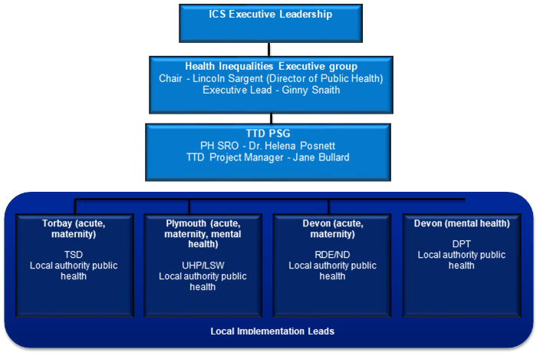
What is Our Governance Structure?

Slide 8
What does partnership working feel like?
Continual reflection and learning is enabling us to seed and grow innovation.
Striving for a truly cohesive system approach is challenging. The system is complex and ‘budgets’ are real.
I’ve learnt about perspectives I wasn’t aware of. Colleagues bring expertise
Frustrating, at times. I can’t control what happens outside the hospital in the community. Some of our patient information systems don’t talk to each other.
It’s rewarding. If we can negotiate the way to make this work, we can take lessons to other programmes.
Hard work, but valuable and the right thing to do – to capture local expertise and deliver the best service and outcomes possible for our local populations.
Finding common ground among such a diverse membership needs us to value and learn from a platform of trusting relationships

Slide 9
What do we feel has helped us work together?
Leveraging existing relationships
Keeping a System focus, but allowing for variation
Open and collaborative culture
Demonstrable evidence of tangible benefits
Use of available national tools, transparently
Pragmatism and respect for colleagues’ time
A tight scope - but recognition that for some, this can be limiting
Support from regional and national colleagues
Welcoming challenge and debate – framing it as part of the journey

Slide 10

Where are we now?
Establishing local steering groups
Maternity pathway audit underway
Developing an evaluation framework
Of course, questions remain unanswered…..
Who is our ICS clinical lead?
How do we bring the patient voice into our steering group?
How do we mitigate a £1m shortfall/ annum?

