Slide 1



The national Smokefree 2030 ambition and the role of the NHS
Hazel Cheeseman
Deputy Chief Executive
Action on Smoking and Health
@HazelCheeseman
Hazel.Cheeseman@ash.org.uk
ASH receives funding from:

Slide 2
Who we are
Set up 1971 by Royal College of Physicians - respiratory physicians have played a key role in ASH throughout its history
Core funding: BHF + CRUK remainder project and contract funding, legacies and donations
ASH does not receive funding from any commercial organisations
Networking: coordinate Smokefree Action Coalition >300 orgs and local government, NHS, mental health and smoking in pregnancy networks; secretariat for All Party Parliamentary Group on Smoking and Health. Member of the SPECTRUM public health research collaboration.

Slide 3
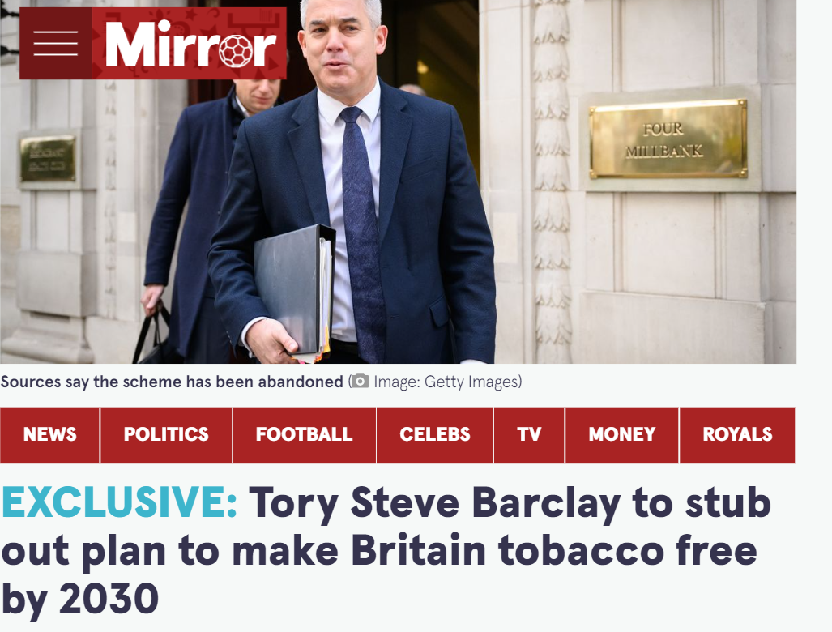
Where have we got to on Smokefree 2030
2019 Conservative government ambition for England to be smokefree by 2030 (5% or less adult smoking rates) announced
Commitment to ‘bold action’ and investigating new sources of funding to make it happen. Since then prevarication and delay
In 2020 committed to new Tobacco Control Plan in 2021
In 2022 commissioned Khan Independent review to inform TCP to be published by end 2022

Slide 4
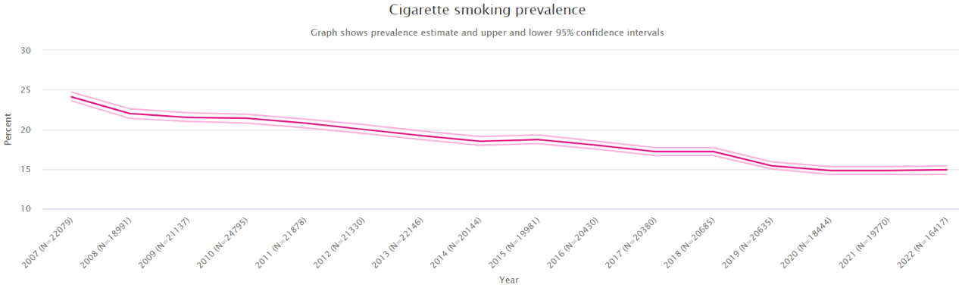
Smokefree 2030 not on track
In 2019 CRUK calculated <5% would take till 2037 for England to be smokefree
Since then UCL indicate slowing of progress (latest official stats run to 2021)

Slide 5
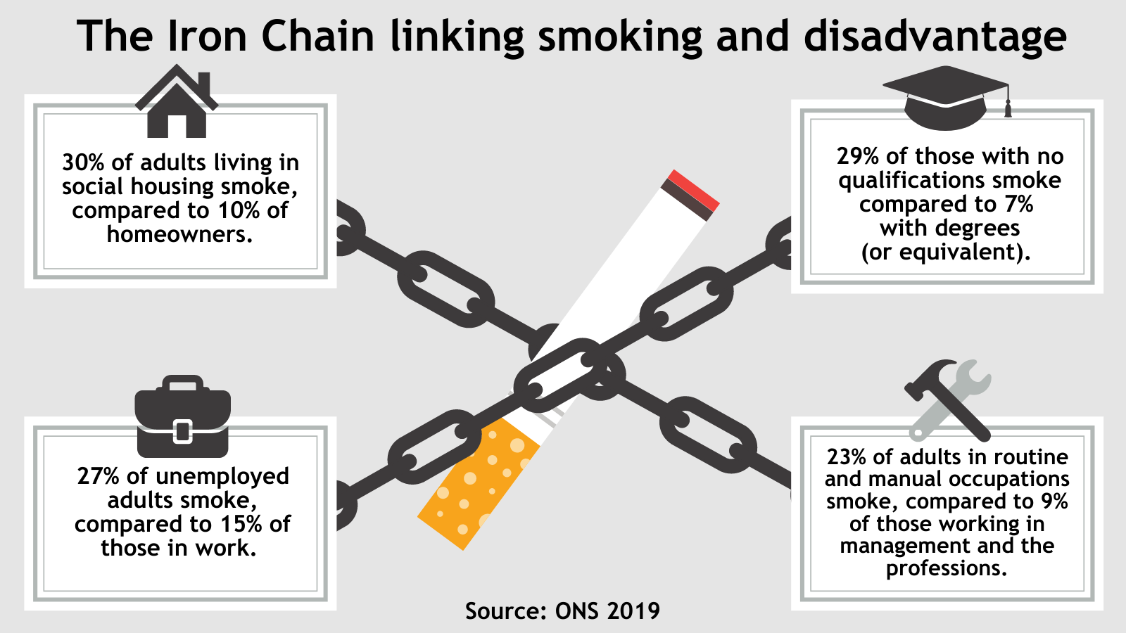

Slide 6
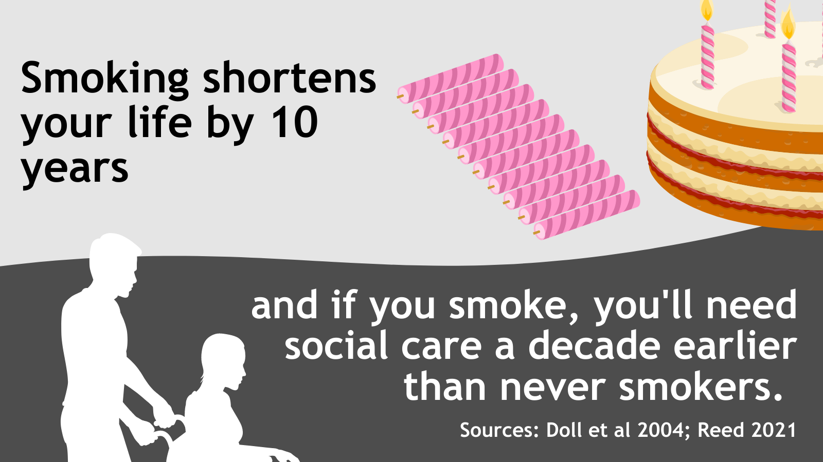
Smoking harms quality and length of life
Smokefree 2030 helps deliver government manifesto commitments to reduce inequalities, level up and increase healthy life expectancy by 5 years by 2035

Slide 7
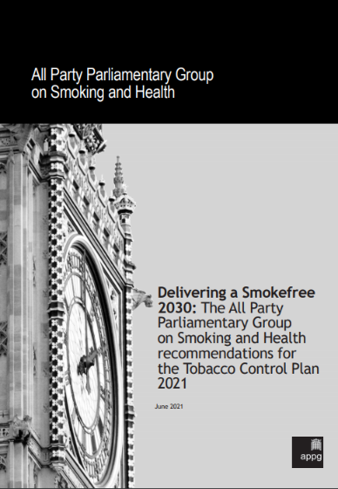
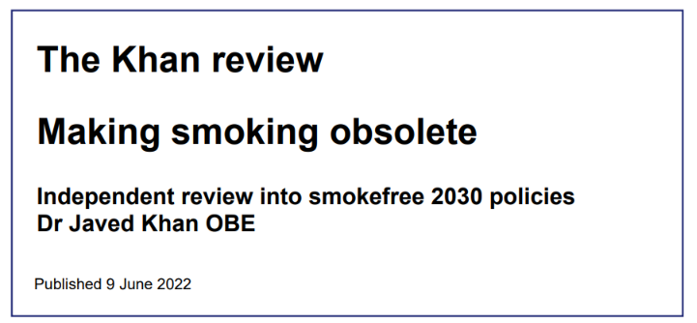
HIGH IMPACT INTERVENTIONS TO:
  REDUCE INEQUALITIES
  REDUCE UPTAKE
  INCREASE QUITTING

Slide 8
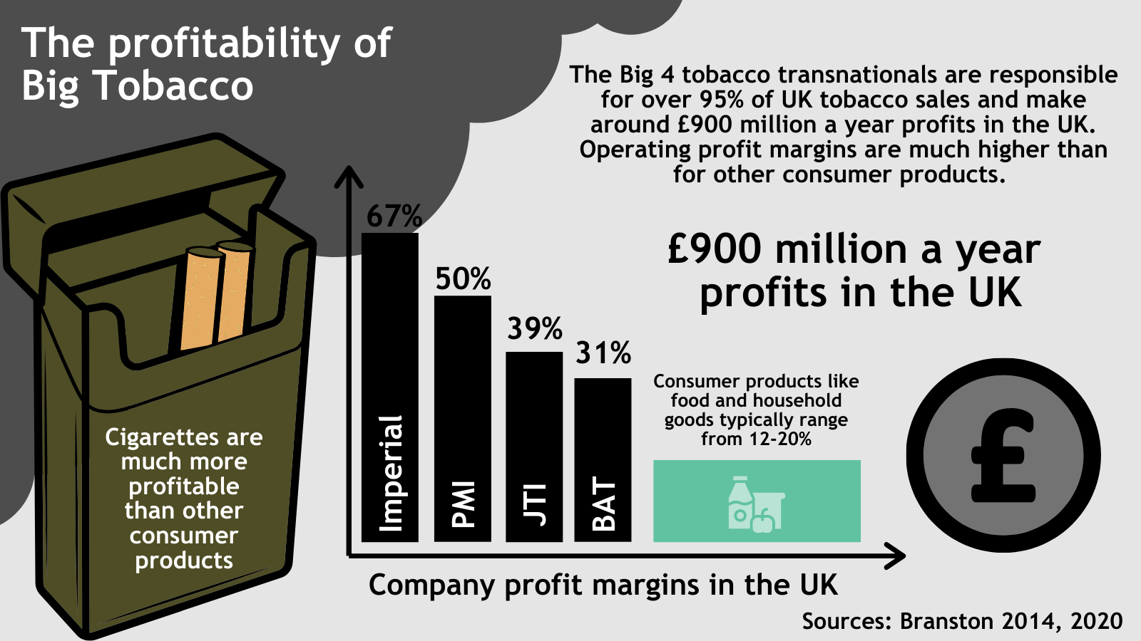
Funding: the ‘polluter pays’ levy
CMO, “a small number of companies can make profits from the people who they have addicted in young ages, and then keep addicted to something which they know will kill them.”
If profits limited to 10% fund could raise £700M a year given current sales

Slide 9
Population interventions key
Regional tobacco programmes
Behaviour change mass media campaigns
Universal access to Stop Smoking Services + opt-out referral
Financial incentives to use Stop Smoking Services
Tougher regulation
APPG Smoking & Health report and recommendations developed by ASH with support from SPECTRUM academics – in particular UCL Emma Beard, Jamie Brown & Lion Shahab

Slide 10
Population interventions | Role of the NHS
1. Regional tobacco programmes | Commissioning/ partnering
2. Behaviour change mass media campaigns | Funding/ advocating for
3. Universal access to Stop Smoking Services + opt-out referral | Funding/ delivering/ advocating for
4. Financial incentives to use Stop Smoking Services | Funding/ delivering/ advocating for
5. Tougher regulation | Advocating for

Slide 11
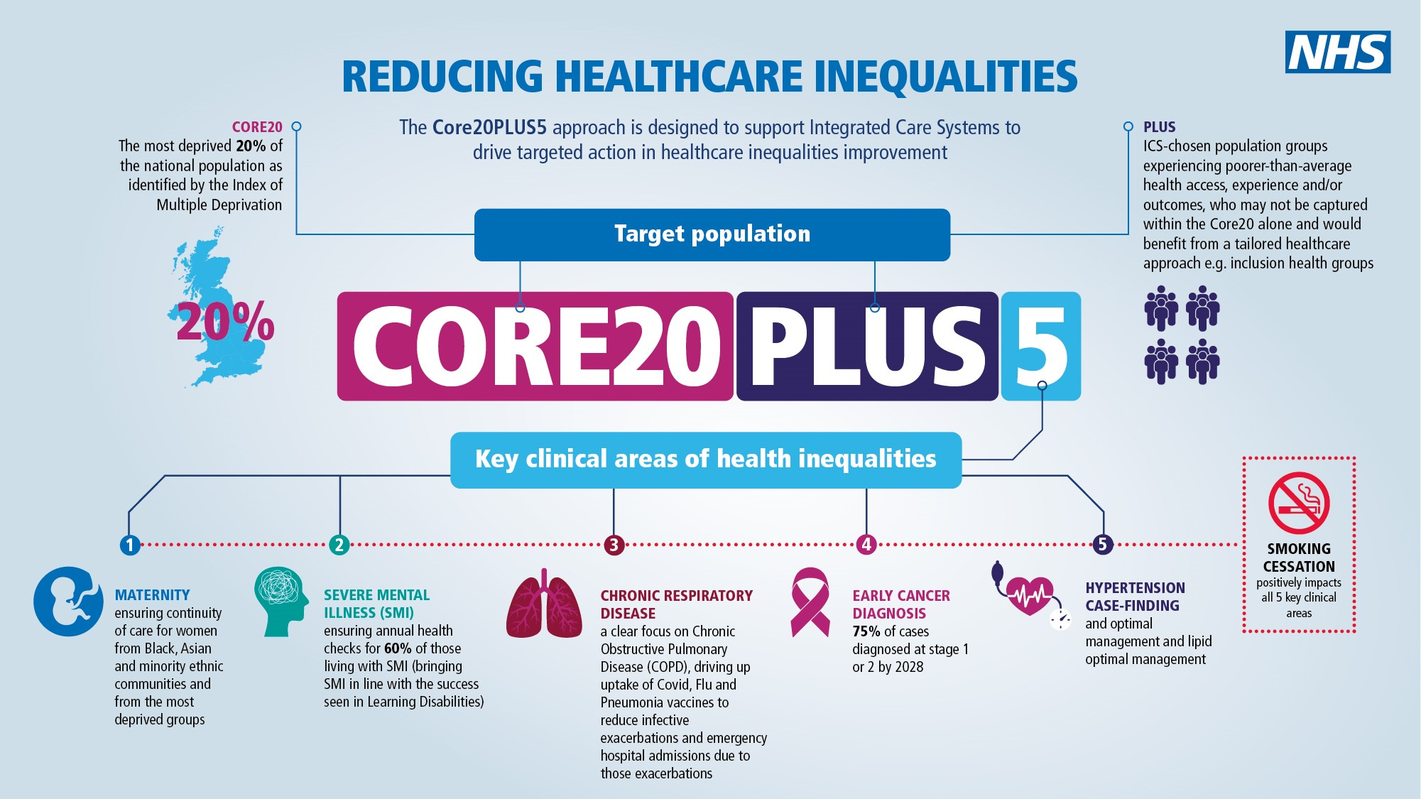
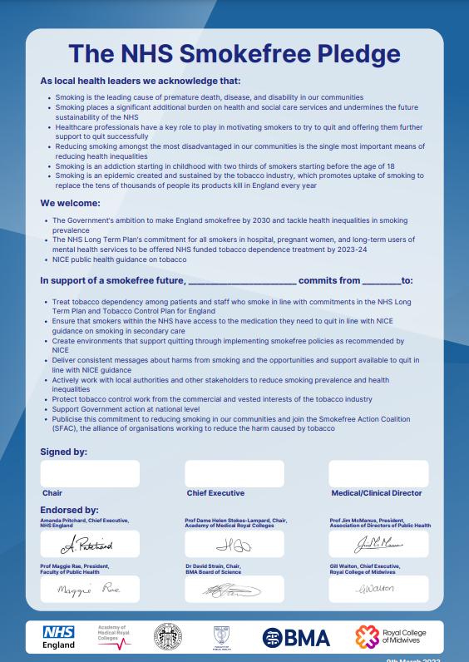
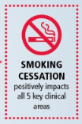
NHS leadership is crucial
Internally – drive forward culture change needed to embed new services and support
Across region – support and collaborate with local government on shared vision
Nationally – to secure the change we need

Slide 12
What does NHS leadership on tobacco look like?
Visible commitment from the top – utilising the NHS Smokefree Pledge
Fully implemented Tobacco Dependency Treatment services across all three strands and for staff plus longer term commitment to maintain
Clear objectives and commitments in strategies: Trust and ICB; Prevention and health inequalities
Creative partnerships with local government that address smoking in vulnerable populations
Exploration of wider opportunities to address smoking e.g. through system-wide/ regional action

