Slide 1


System wide tobacco control approach: ASH Webinar
10/7/23
Ailsa Rutter OBE Director of Fresh and Balance

Slide 2
10 minutes
Who we are/how set up
Our key focus
Our advocacy role
Find out more

Slide 3
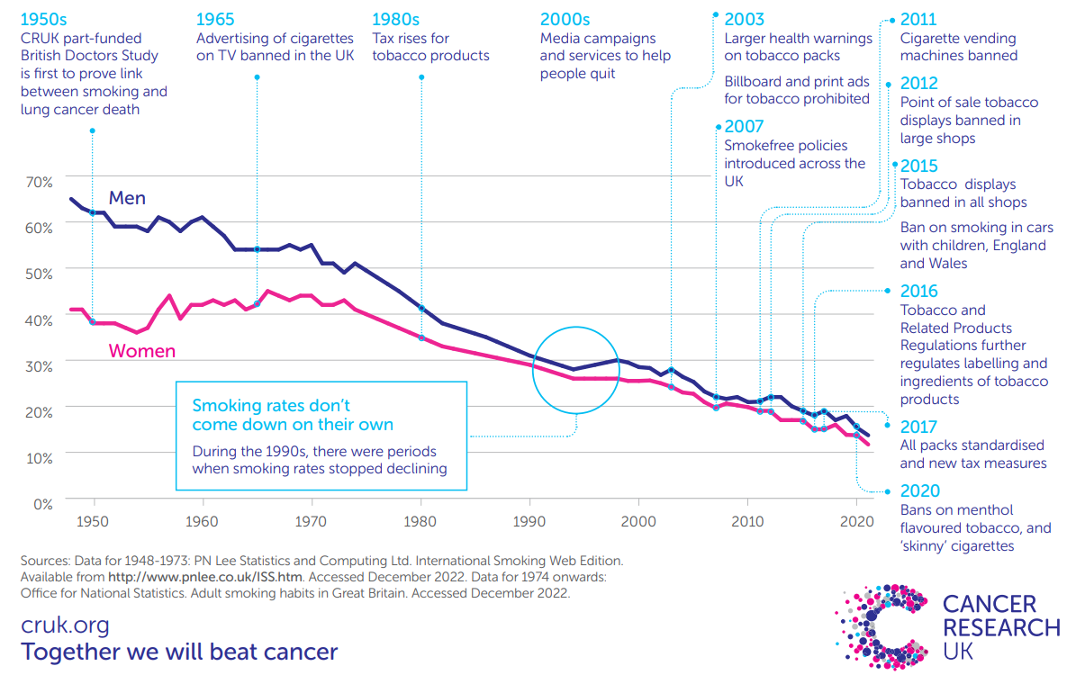

Slide 4

Fresh Programme launched 2005
Evidence base 1962
International to local level
Population level working – as opposed to simply targeting individuals – recognition around role of industry
Shifting societal norms- importance of making tobacco use/industry less attractive, affordable, accessible
Comprehensive- synergistic
Partnership and collaboration key e.g. OHID, ASH
Also help coordinate SFNHS as parallel programme- separate funding
Notes:
Bringing the model to life: some examples

Slide 5
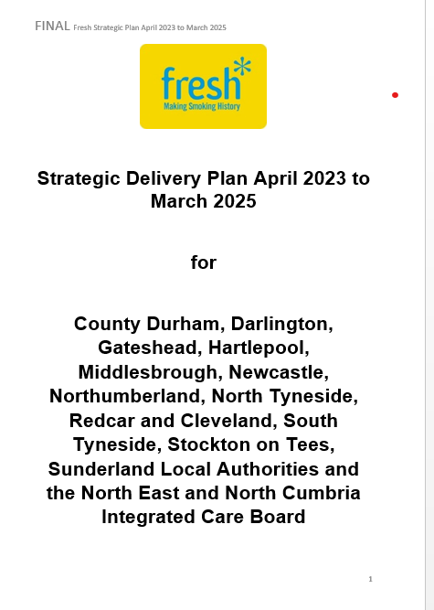
Fresh Strategic Delivery Plan 23-25
Joint funding 50/50 LA12 and North East and North Cumbria NHS Integrated Care Board
0.27p per head from both LAs and ICB= 0.54p (circa £1.53M)
Durham County Council lead commissioner (Amanda Healy DPH)
Hosted by County Durham and Darlington NHS FT (since 2012)
Population level focus
Partnership approach: suggested roles and responsibilities
Local tobacco alliances important

Slide 6
Our advocacy focus

Slide 7

Advocacy approach-
ASH at the helm
Set clear objectives e.g. 5% by 2030 (and also Fresh talking about making smoking ultimately a thing of the past)
Clear ask e.g. we need a properly funded new TC Plan (profit of TI flag) with key policy asks incl T21
Work collaboratively- leadership of ASH leading the SFAC e.g. responding to consultations – Major Conditions Strategy last week. Local role crucial too.
Frame the debate e.g. 2023 increasingly around economic recovery
Build the evidence and the case for e.g. costs to health, social care, economy (use Ash ready reckoner)
Develop political champions- e.g role of APPG on Smoking or Health and Fresh role with this – NE MPs
Show them the votes, keep tracking public opinion- e.g. annual YouGov survey
Power of real people – their voices are crucial
Find the lever- E.g. Economic and regeneration bill- Smokefree pavement licenses

Slide 8
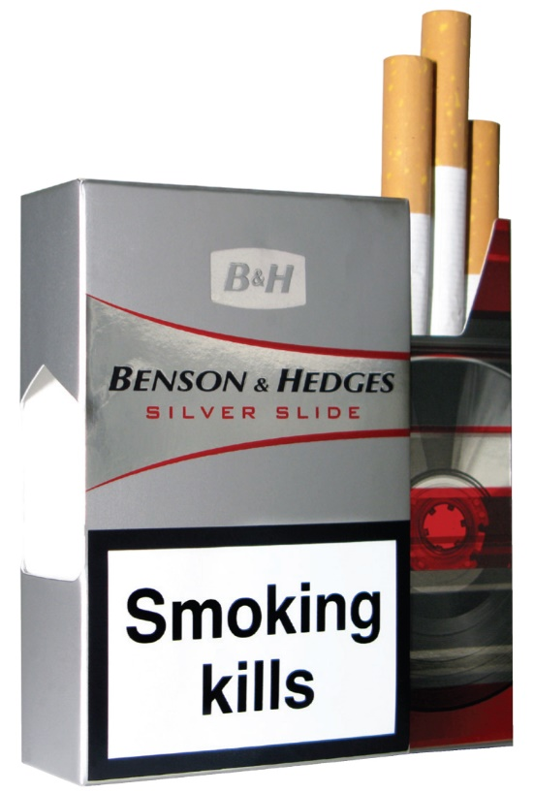
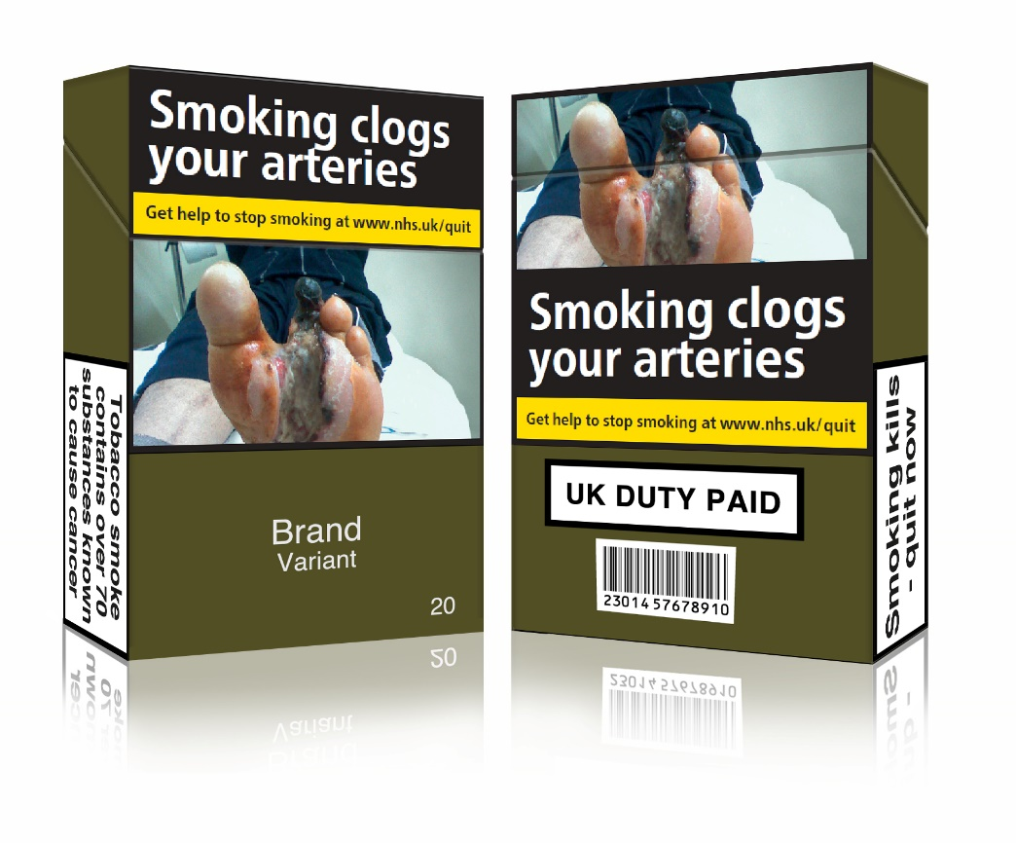


Set clear objectives
Notes:
Good example of a long, hard fought campaign
It shows what a unified PH community can do

Slide 9
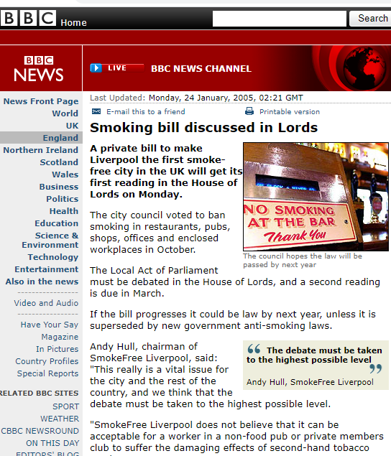
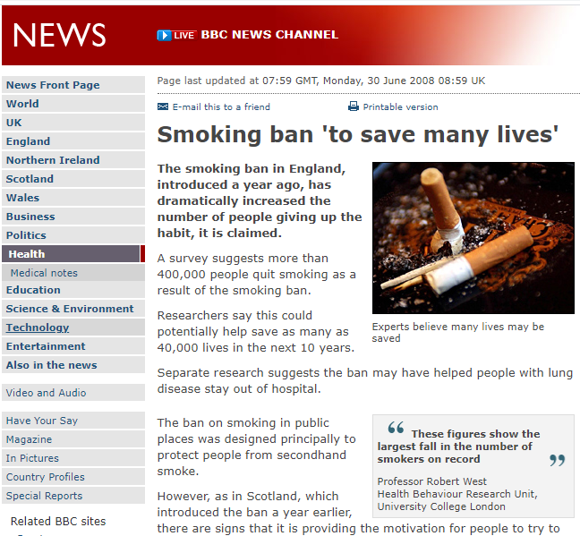
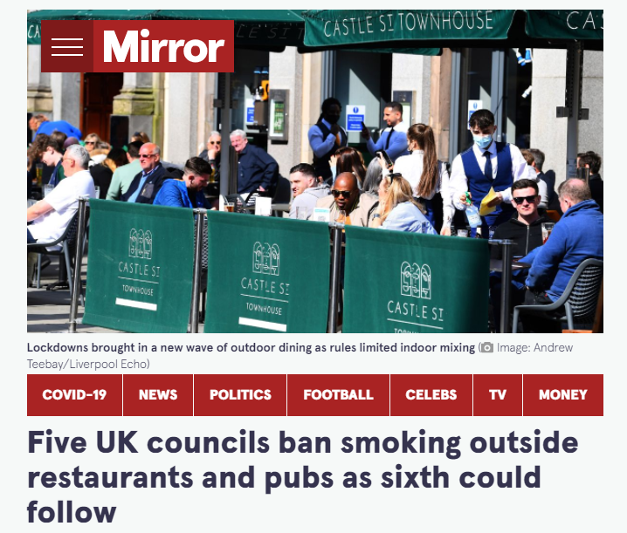
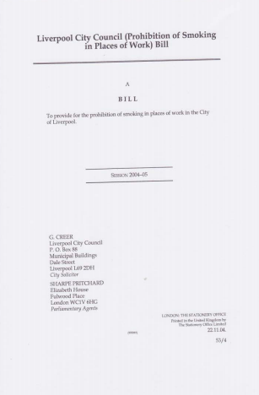
Advocacy-
Local champions- regional coordination- national impact
https://extranet.who.int/kobe_centre/sites/default/files/pdf/WCTOH-2012_04_Smokefree-Liverpool_DawsonJ.pdf

Slide 10
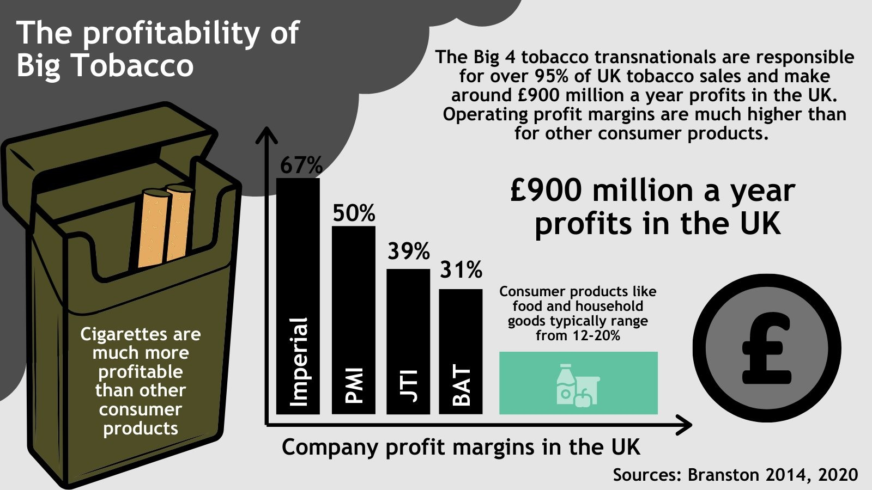
Advocacy – our key ask right now- funding for a comprehensive tobacco control plan
Notes:
Good example of a long, hard fought campaign
It shows what a unified PH community can do

Slide 11




Critical recommendations - ‘must dos’ from the Khan Review
INCREASE THE AGE OF SALE
Increasing the age of sale from 18, by one year, every year until no one can buy a tobacco product.
IMPROVE PREVENTION IN THE NHS
NHS needs to prioritise - embedding at every opportunity including primary care.
INCREASED INVESTMENT
Urgently invest £125 million per year.
A tobacco industry levy is preferred option.
PROMOTE VAPING
Provide accurate information on the benefits of switching.
Whilst preventing young people’s uptake.

Slide 12
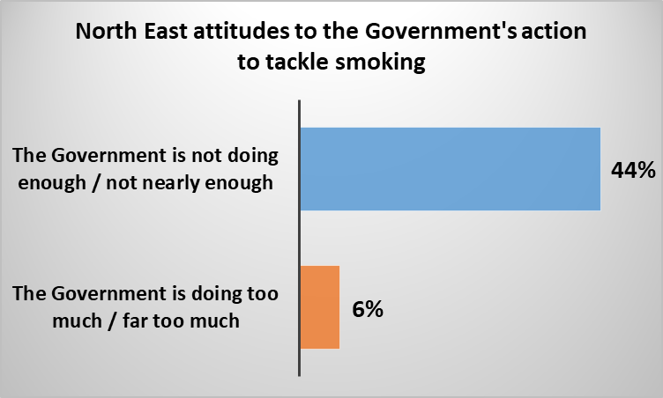
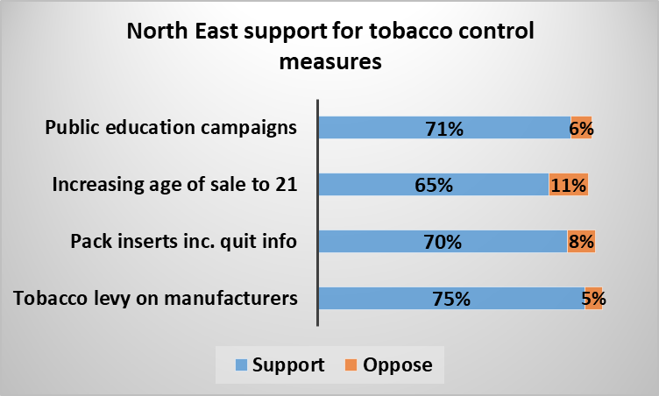
High level of support for Government action
YouGov PLC Smokefree Great Britain Survey (2021), based on an unweighted North east sample of 487

Slide 13
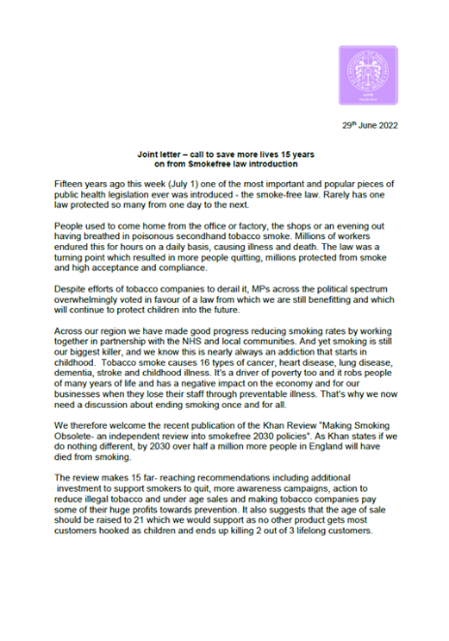
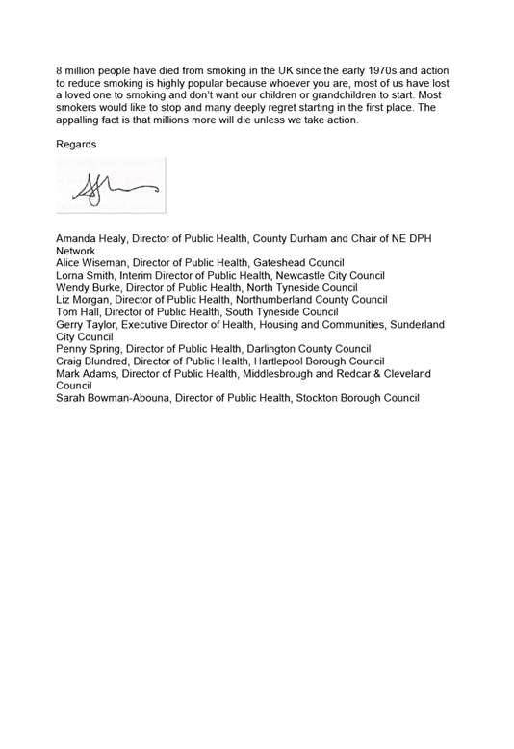
Leadership from many – unity for your cause

Slide 14
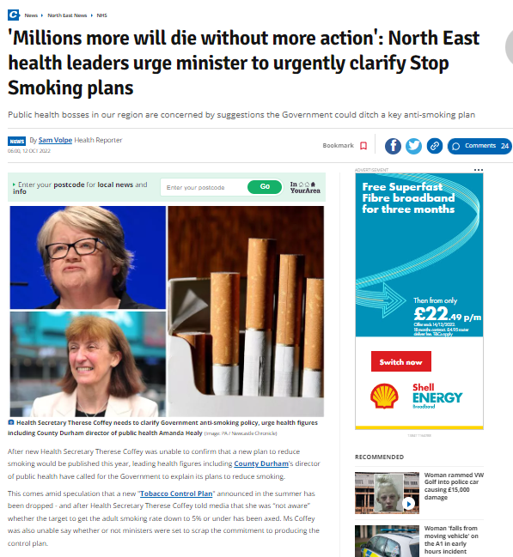
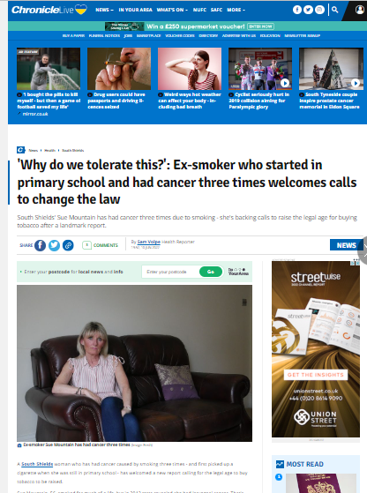
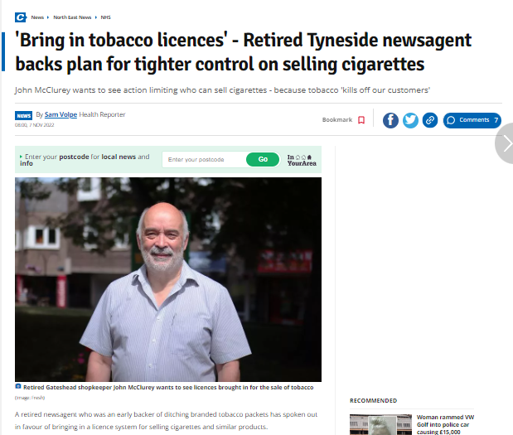
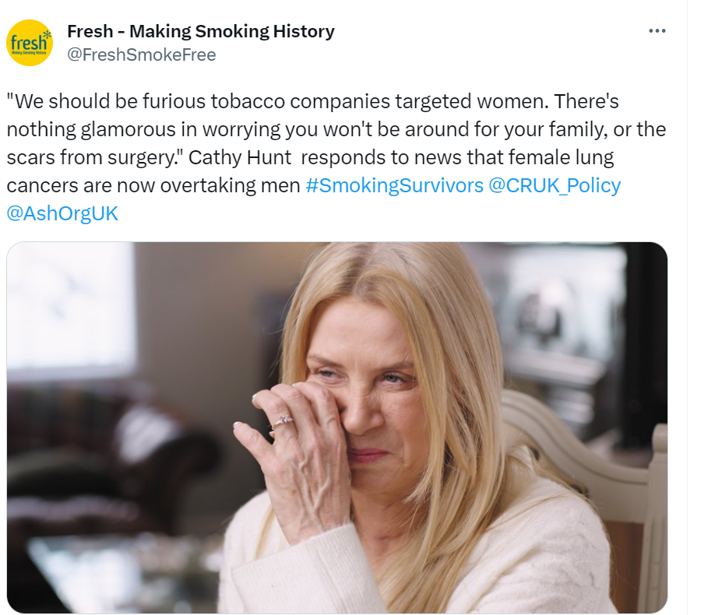
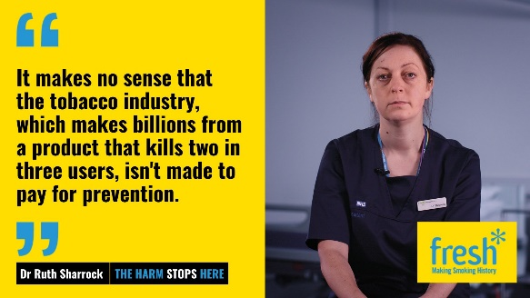
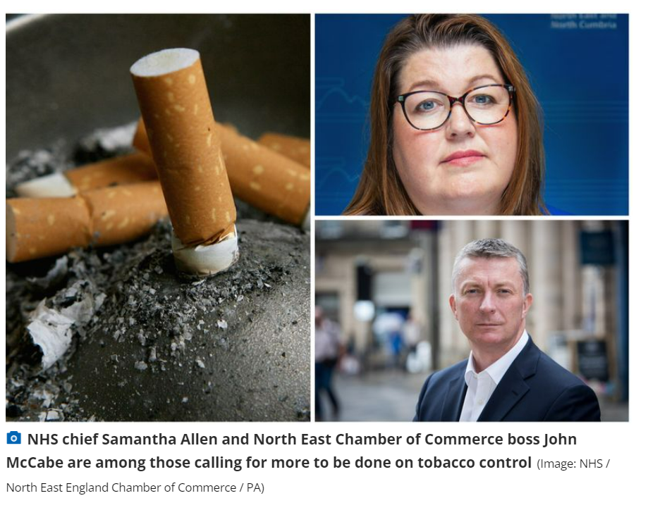
Many messengers for same messages

Slide 15
Advocacy also part of year round media and communications
Year round PR/earned media- lots of different topics
Fresh is a 24/7; 365 days press office – be responsive- proactive and reactive- autonomy to respond key- have clear leader/s who can respond very quickly-clear sense of vision of what striving for now
Average £2-3M coverage PA
Also insight led mass media campaigns
www.freshquit.co.uk as hub to find out all about quitting in the North East

Slide 16
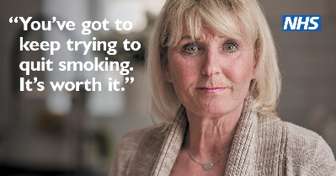
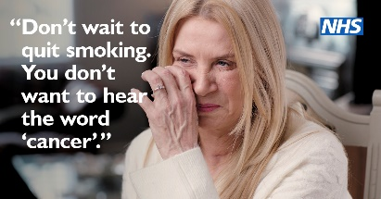
Smoking Survivors- can become your biggest advocates
Sue 40 second TV ad https://youtu.be/TXE9Bj62vJw
Sue 20 second https://youtu.be/C9f2DjCDPfU
Cathy 40 second TV ad https://youtu.be/8Xzq8vu1aDs
Cathy 20 second https://youtu.be/u-iQ901R61U

Slide 17
Advocacy lessons learned
Things don’t happen quickly- be tenacious– and still lots to do to achieve a Smokefree 2030:
  Importance of endorsing APPG on Smoking report; Khan review; ASH Smokefree NHS Pledge; ASH Local Government Declaration
  Importance of collaboration with SFAC for your programme
  Keep going and be ambitious and bold- be positive things will, should and can change
  Feel confident to ‘out’ the role of the industry
There is political will amongst voters and we need to use this
Not just about health- wealth, economy, mental health, environment, social justice
Real people over stats- a compelling narrative
Yours, our loved ones

Slide 18
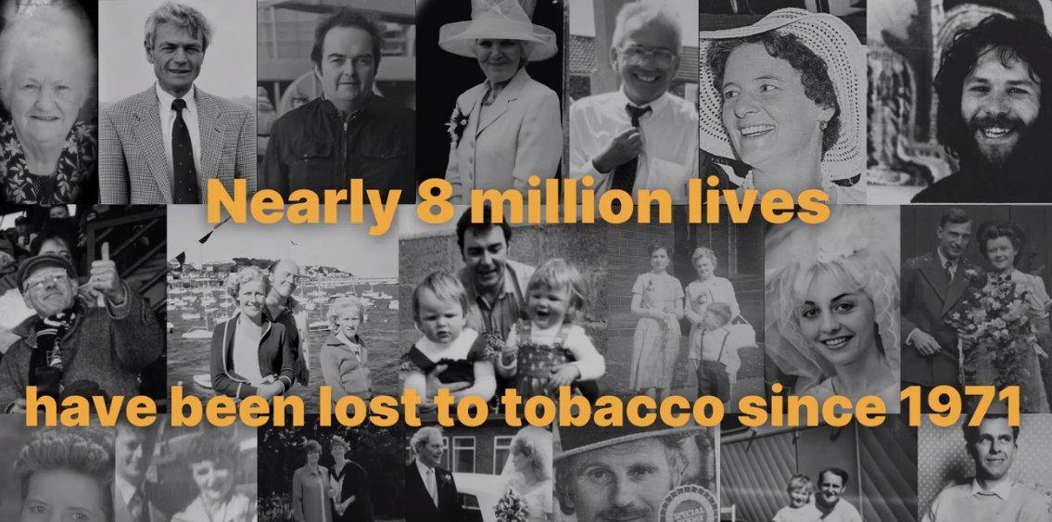
26% of all deaths in last 50 years due to the tobacco industry

Slide 19
More information?
@FreshSmokeFree
@BalanceNE (Alcohol)
@SmokeFreeNHS_NE
@keep_it_outUK
info@fresh-balance.co.uk
www.freshquit.co.uk
www.keep-it-out.co.uk
www.fresh-balance.co.uk- NEW WEBSITE
Join the Smokefree Action Coalition
CRUK focus: Petition now- have you signed?

