Slide 1




Charlotte Jaques – Partnership Commissioning Manager, Public Health, Wakefield Council
Lisa Hay- Senior Specialist, Yorkshire Smokefree Wakefield (SWYPFT)
Shelly Gascoigne - Smoking Cessation Specialist Midwife – Mid Yorkshire Hospitals Trust (MYHT)
Tracy Morton - Senior Commissioning Manager Maternity and Children’s Services, NHS Wakefield CCG
3rd November 2021
ASH Webinar – Building Partnerships to Implement the Long Term Plan
Smoking in Pregnancy in Wakefield

Slide 2
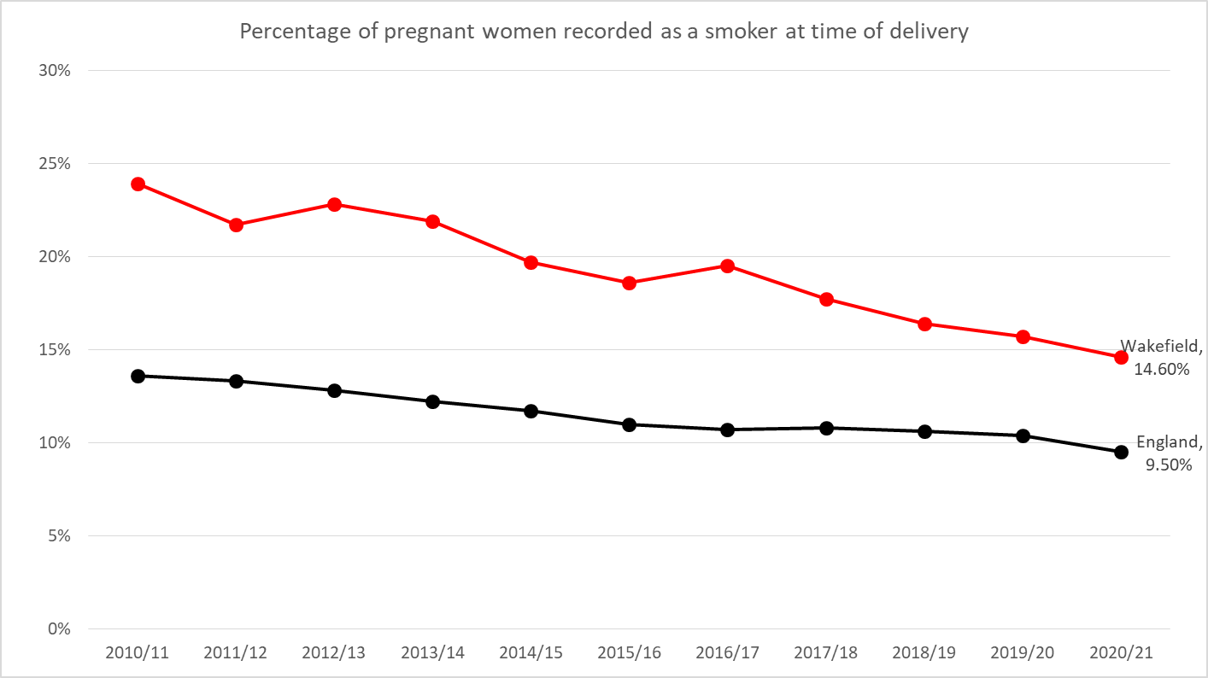
Smoking in Pregnancy- Wakefield
14.6% of Wakefield Pregnant mums Smoking at Time of Delivery (SATOD) in 2020/21
SIP rates highest in most deprived areas of Wakefield
Stopping smoking in pregnancy is the single biggest change that can improve the health of mum and baby.
Stopping smoking is the single most effective thing we can do to reduce risks
Wakefield JSNA – Further details

Slide 3
Addressing rates of maternal smoking:
Investment (short term) from NHS England in 2016 supported the following Projects:
  Carbon monoxide monitors and consumables
  Improving data recording and quality to ensure women can be identified and information shared appropriately
  Stop Smoking Champion/Specialist Midwife
  Incentivised stop smoking programme - Personal Financial Incentives (PFI)
The Specialist Midwife role and the PFI scheme have evaluated as successful resulting in identifying further funding (currently non-recurrent - see dates on next slide) from Wakefield Public Health and Wakefield CCG.

Slide 4
Working in partnership; reducing Smoking in Pregnancy
Successful partnership working between services ensures there is consistent support and approach for those smoking in pregnancy. E.g MYHT, SWYPFT Specialist Stop Smoking Service, CCG, Public Health, Council. Meeting regularly; e.g- Smoking In Pregnancy Meetings, Tobacco Alliance, MYHT Smokefree Environment Meeting
Stop smoking midwife post within MYHT- Currently funded by Wakefield CCG until end of March 2022. Educator, innovator, role model and leader. Mandatory training, Staff recording data on smoking status, Opt out scheme implemented.
Personal Financial incentive (PFI) Voucher Scheme- Funded by Wakefield Public Health until end of December 2021 (150 single use CO monitors funded via Wakefield CCG)
Specialist Stop Smoking Service – Funded by Wakefield Public Health
Smokers are identified as a high risk pregnancy by MYHT with additional input and supervision. E.g Saving Babies Lives bundle and reducing still births, more ultrasonography capacity delivers an enhanced service to mums who are smoking. These extra scans which started on 1st Oct 2020 will be at 32, 36 and 40 weeks.
Local Maternity System (LMS) 28 Recommendations for SIP
Declaration on Tobacco Control – including Health and Wellbeing Board joint declaration
Long Term Plan (LTP) - Ongoing discussions in Wakefield and regionally (via the West Yorkshire and Harrogate Care Partnership) identifying areas of SIP work to be funded through LTP

Slide 5
Any Questions?

