Slide 1


Getting back on track: Delivering a smokefree start for every child
A report by Action on Smoking and Health (ASH) & the Smoking in Pregnancy Challenge Group
John Waldron, Senior Policy and Public Affairs Officer, ASH

Slide 2
Getting back on track: delivering a smokefree start for every child
Purpose of the report:
  Understand why national smoking in pregnancy (SATOD) rates have only declined from 11% to 10.4% since 2015, despite a Government ambition to reduce SATOD rates to 6% by 2022
  Set out recommendations to inform the 2021 Tobacco Control Plan, maximise the impact of the NHS Long Term Plan, and get us on track to achieve a smokefree 2030
Based on:
  Analysis of the available data
  Interviews with key stakeholders and frontline professionals from healthcare, public health, maternity, local government

Slide 3
22 recommendations for…
Achieving the smokefree 2030 ambition
Overcoming variation
Meeting training needs
Tackling smoking in high prevalence communities
Using nicotine in pregnancy
Improving data collection
Building back better after COVID-19
Recommendations apply to national and local government, PHE, NHS organisations, Royal Colleges…

Slide 4
Counting the cost of smoking in pregnancy
Financial impact: As well as human costs, smoking during pregnancy presents significant financial costs for the NHS, with pregnant smokers requiring more care and placing additional costs on NHS trusts compared to their non-smoking counterparts
Estimated that maternal smoking cost the NHS over £20 million in 2015/16
Audits from NHS trusts:
  Barnsley Hospital NHS FT: 10 women who smoked cost the maternity unit approximately £46,820 compared to £13,548 for the 10 non-smoking women
  Poole Hospital NHS FT: Smoking pregnant women cost the Trust £737.88 extra per patient, compared to non-smokers

Slide 5
Rates of smoking in early pregnancy by deprivation decile (2018/19)

Slide 6
Rates of smoking in early pregnancy by age (2018/19)

Slide 7
National strategies
The Tobacco Control Plan for England (2017) aims to reduce Smoking at time of delivery to 6% by 2022
Prevention Green Paper (2019) sets the ambition of a making England smokefree by 2030
Maternity Transformation Programme established to improve outcomes in maternity care. Included publication of the Saving Babies’ Lives Care Bundle – package of measures to reduce stillbirth prevalence – reducing smoking in pregnancy is number 1
The NHS Long Term Plan commits to delivering an opt-out smokefree pregnancy pathway for expectant mothers and their partners

Slide 8
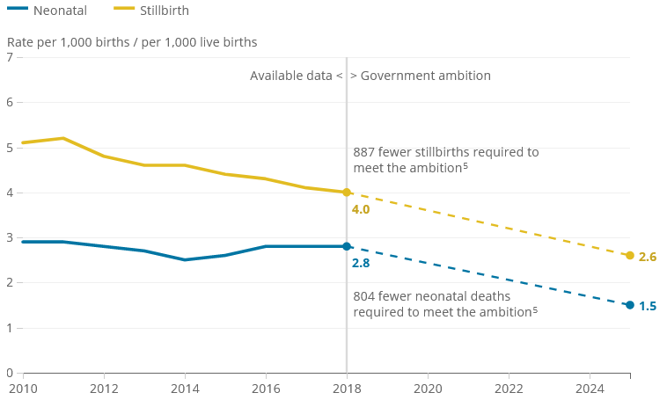
Progress against the ambition to halve stillbirths and neonatal mortality in England, 2010 to 2018

Slide 9
Why aren’t national SATOD rates falling fast enough?
Lots of contributing factors
Significant regional and local variation in service delivery and outcomes
The number of pregnant smokers accessing local authority stop smoking services has declined by a fifth since 2015
Public health grant for local authorities cut by a fifth since 2015 = less funding for smoking cessation
Smoking in pregnancy remains concentrated in younger, more disadvantaged groups who require enhanced support to quit

Slide 10
Regional change in SATOD rates between 2015/16 and 2019/20

Slide 11
CCG change in SATOD rates between 2015/16 and 2019/20
SATOD has increased by 1 percentage point or more in a fifth (20%) of CCGs
SATOD has fallen by 1 percentage point or more in just under half (44%) of CCGs
Only includes CCGs in existence from 2015/16 to 2019/20 (176 out of 191)

Slide 12
How effective is the system at linking pregnant women with stop smoking services?
Of women in England who were smokers at the start of their pregnancy in 2018/19:
  16.5% set a quit date with local authority stop smoking services
Varies substantially across regions
Just getting women through the door of stop smoking services is a big challenge

Slide 13
Results from a survey of specialist stop smoking in pregnancy support
43% of NHS trusts commissioned specialist stop smoking support for pregnant women.
Of trusts that commissioned support for pregnant women:
  Two thirds co-funded that support with local authorities.
  A third reported not having a budget for NRT.
  Almost half were unable to say how many women set a quit date after receiving support from the trust – primarily because data was not readily available.
When asked to name the database software used to record quits every answer was different – with trusts using a mixture of local systems, excel spreadsheets, bespoke systems, and patient care notes.

Slide 14
Key recommendations for improving delivery in trusts
Priority should be given to reinstating Element 1 of the Saving Babies Lives Care Bundle as we emerge from the pandemic
Every trust should have a named person to be responsible for the delivery of smokefree pregnancies
LMSs should ensure that there is a system-wide pathway to support women and communities before, during, and after pregnancy

Slide 15
National recommendations
Implement the recommendations set out in the Roadmap to a Smokefree 2030
Set a new target for reducing smoking in pregnancy to get us on track to reach a smokefree 2030
Set out a national strategy for improving the provision of smoking cessation training to health professionals treating pregnant women
Develop interventions to address relapse to smoking postnatally, and smoking among fathers, partners and other high prevalence groups
Introduce financial incentives to support women in high smoking prevalence communities to quit

Slide 16


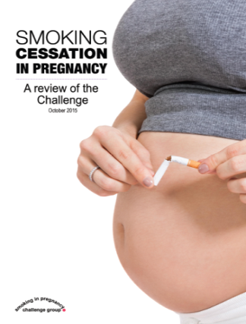

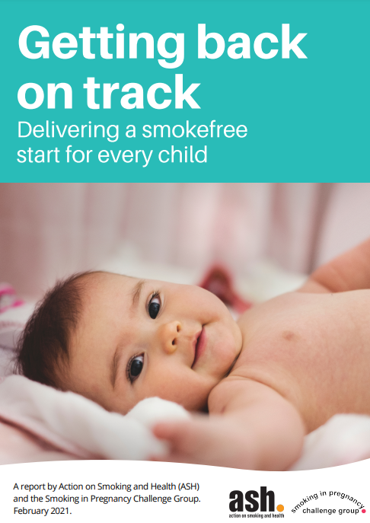
Challenge Group resources
National strategy reports:
2013
2015
2018
2021

Slide 17
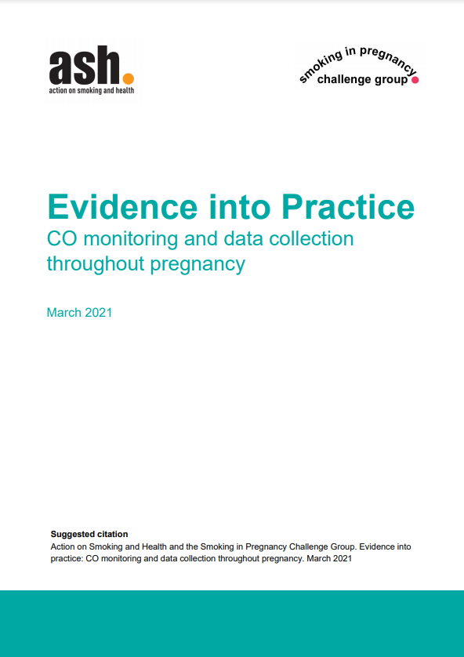

Briefings…
Briefings for commissioners:
Evidence into Practice
Annual LMS briefings with local and regional data and national case studies

Slide 18
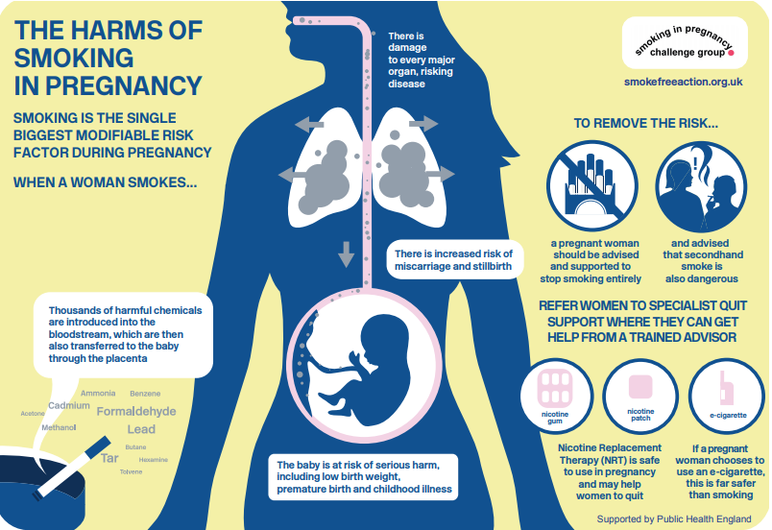

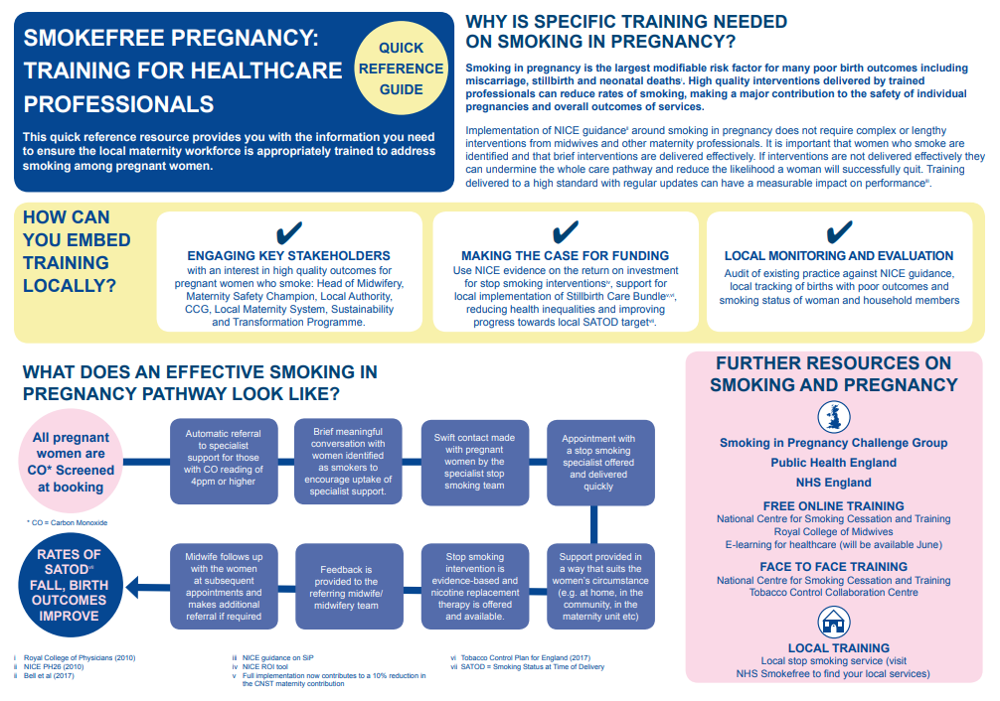
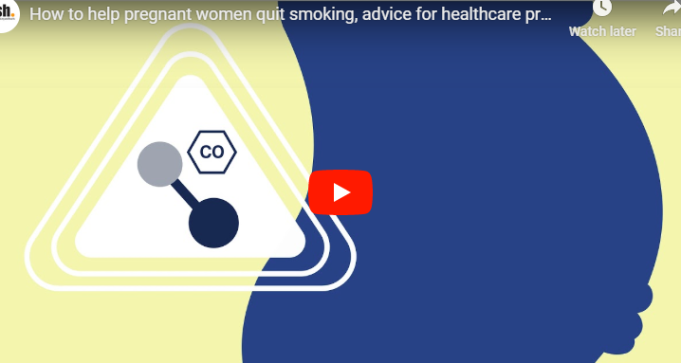
Challenge Group Training materials

Slide 19
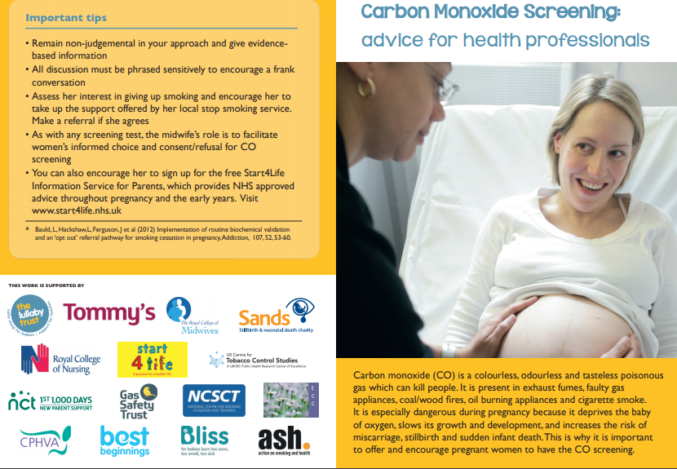
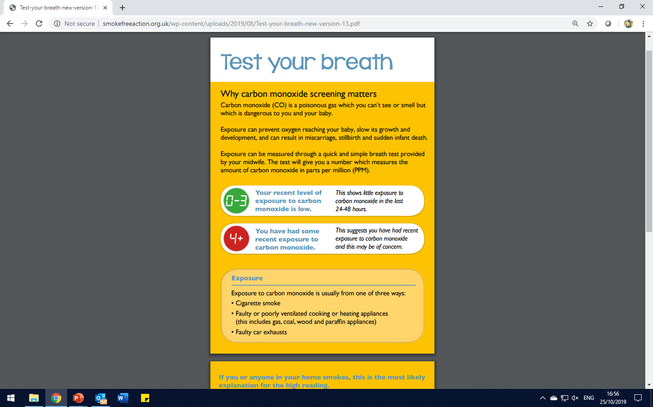
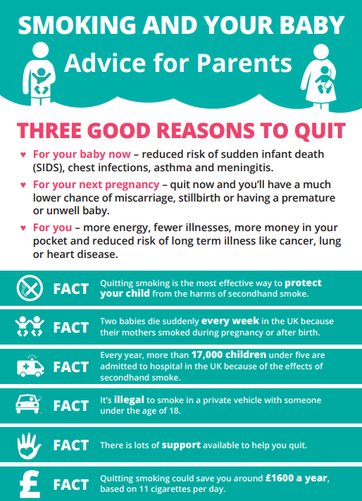
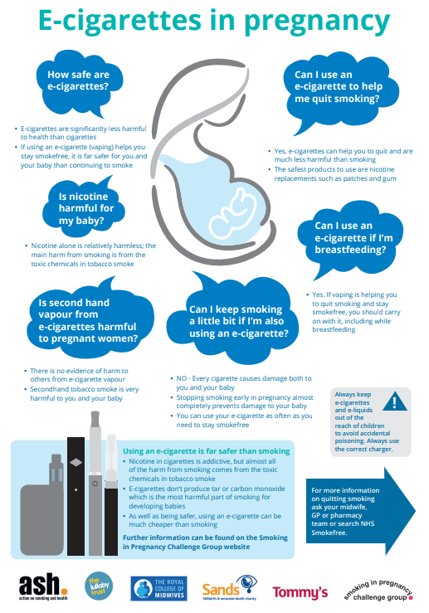


Slide 20
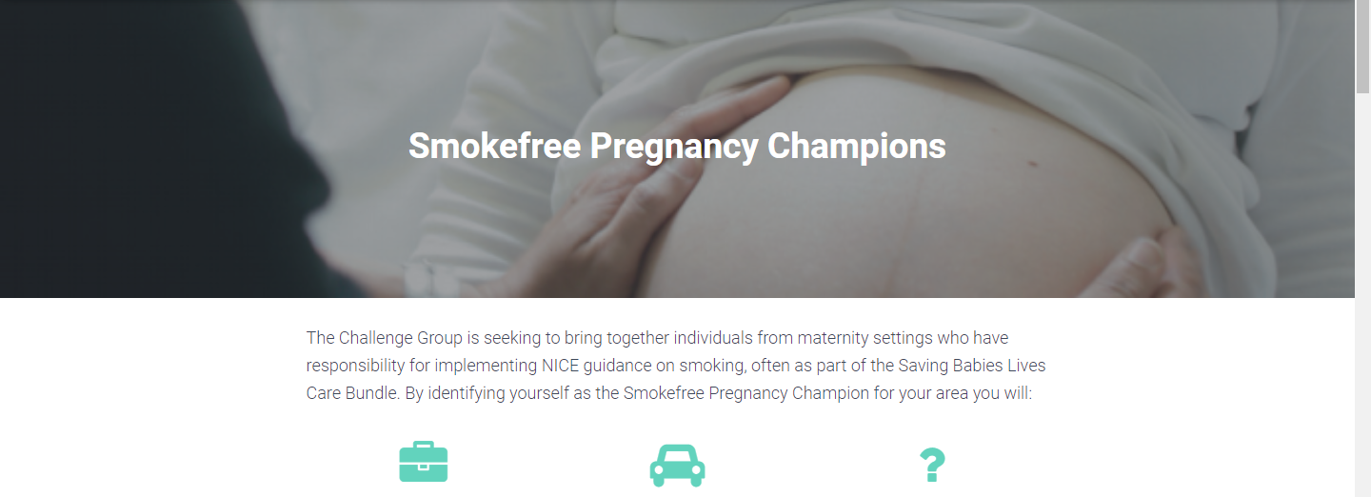
Champions!
Network of Smokefree Pregnancy Champions in every NHS Trust
Champions:
  Receive tailored information and resources;
  Have the opportunity to feed into regional/national events;
  Have the opportunity to share practice and ask questions of others working on similar activities around the country.

Slide 21
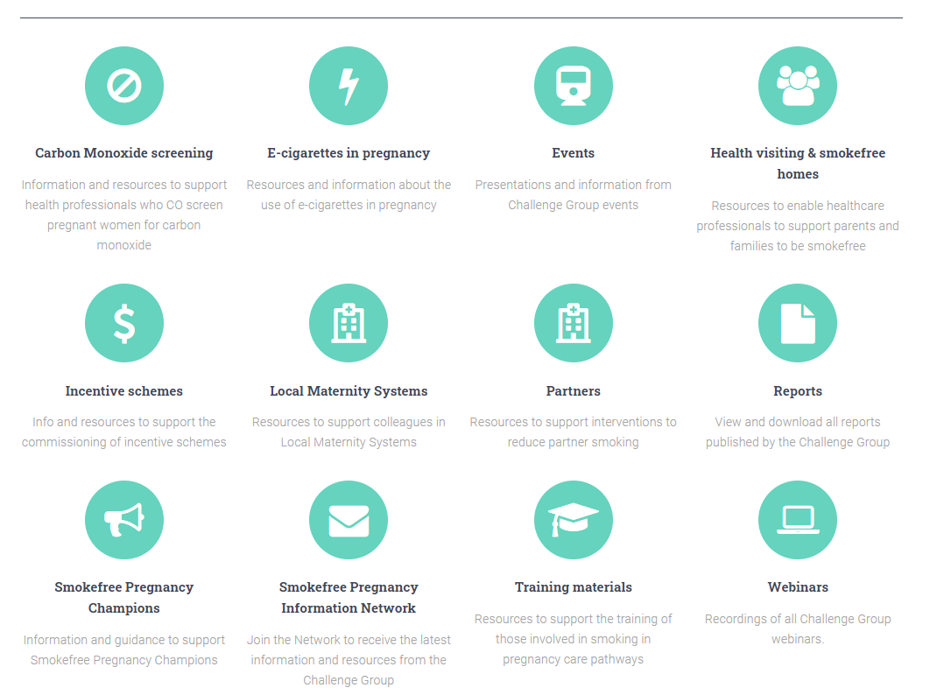
Challenge Group website

Slide 22
Thankyou!
Email: john.waldron@ash.org.uk
View the report and our resources on the Challenge Group website: bit.ly/sipchallenge

