Slide 1


Implementing smokefree mental health settings
2 March 2022, 1:30 – 3:00
Chaired by Deborah Arnott, Chief Executive, ASH

Slide 2
Housekeeping
The meeting is being recorded, and a recording of the event will be circulated to all attendees and uploaded to the ASH webinar page after the event.
Please can all panellists and attendees keep themselves muted and turn their videos off unless they are presenting. ASH staff will mute anyone who is unmuted and not presenting.
We encourage all attendees to submit questions and reflections in the meeting chat, to be discussed during the Q&A session.

Slide 3
Agenda
1:30 – 1:40 Introduction from the Chair
Deborah Arnott, Chief Executive, ASH
1:40 – 1:55 Insights from ASH’s 2019 report on progress towards smokefree mental health services and reflections on changes since the pandemic
Hazel Cheeseman, Deputy Chief Executive, ASH
1:55 – 2:05 Restrictive practice and smokefree policies
Mary Yates, Nurse Consultant – Health Promotion & Wellbeing & Smoke-Free Lead, South London and Maudsley NHS FT
2:05 – 2:15 Early implementer site update - East London NHS Foundation Trust
Ogechi Anokwuru, Stop smoking service lead, East London NHS Foundation Trust
Dr Sally Macvinish, Public Health Registrar, East London NHS Foundation Trust
2:15 – 2:30 Looking beyond inpatient settings: supporting smoking cessation in the community
Aideen Dunne, National Medical Director’s Clinical Fellow, NHS England
2:30 – 2:40 Experience of going smokefree
Richard Roberts, Matron, Mill View Hospital, Sussex Partnership NHS Foundation Trust
2:40 – 2:55 Q&A
All panellists
2:55 – 3:00 Closing remarks
Deborah Arnott, Chief Executive, ASH

Slide 4
Why we need to address smoking now
Smoking prevalence among people with a mental health condition is more than 50% higher than in the general population
For those with SMI rates are even higher at 40.5%
People with mental health conditions die on average 10-20 years earlier than the general population – smoking is the single largest factor accounting for this difference
People with mental health problems are just as likely to want to stop smoking as those without – BUT they are more likely to be highly addicted and heavily dependent on tobacco, and therefore need more help

Slide 5
Shorter, sicker lives
For every person who dies from smoking another 30 are suffering a serious smoking related disease
On average, smokers report difficulty completing tasks 7 years earlier, and receive care support 10 years earlier, than never smokers
On average, smokers and ex-smokers receive 3.6 times as many hours care as never smokers indicating higher levels of overall need
Smokers are less likely to be employed than never smokers, linked to the much greater likelihood of working age disability
ASH, The Cost of Smoking to the Social Care System, 2021 https://ash.org.uk/wp-content/uploads/2021/03/SocialCare.pdf
ASH, Smoking, Employability and Earnings, 2021 https://ash.org.uk/information-and-resources/reports-submissions/reports/smokingemployability/

Slide 6
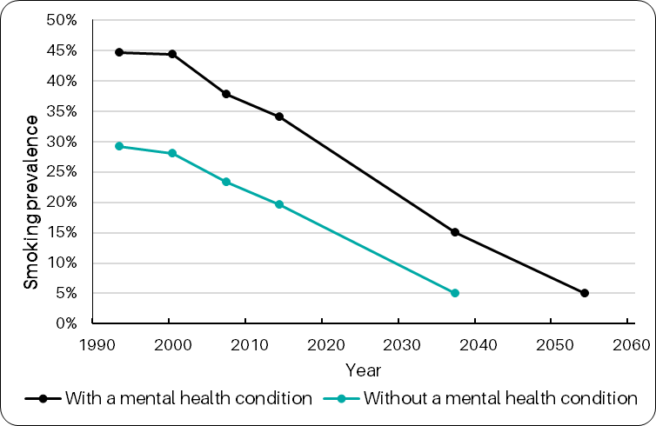
20 year gap in securing smokefree goals
Projected rate of decline among smokers with & without a mental health condition
People with MH conditions won’t reach smokefree (5% prevalence) until 20 years later than people without at the current rate of decline
Richardson & Robson (2021) Adapted from Richardson et al (2019) Smoking and quitting behaviours by mental health conditions in Great Britain (1993-2014) Addictive Behaviours 90:14-10

Slide 7
Q&A session
Please submit your questions to the meeting chat.

