Slide 1
NHS Long Term Plan:
A Smokefree Pregnancy
Misha Moore
National Speciality Adviser for Obstetrics (Public Health)
NHS England & Improvement

Slide 2
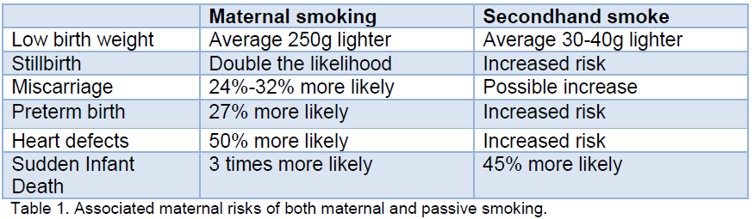
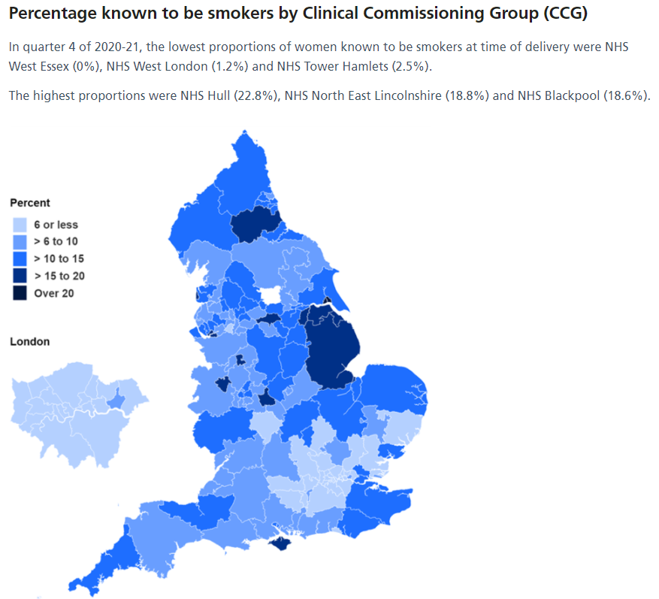
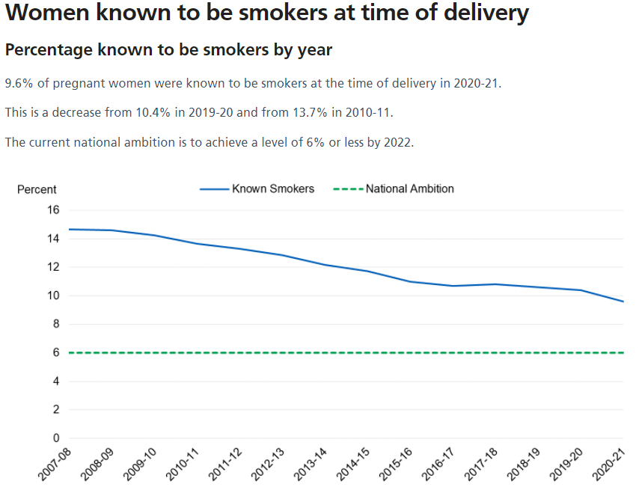
Smoking is still the single largest modifiable risk factor for poor pregnancy outcomes
Notes:
Smoking affects mothers, the developing foetus and child health; doubling the chances of still birth and increasing the risk of sudden infant death threefold.
Smoking prevalence in pregnancy is approximately 9.6% and over a number of years and has arguably not reduced at the rate seen in the general population – until the impact of COVID.

Slide 3
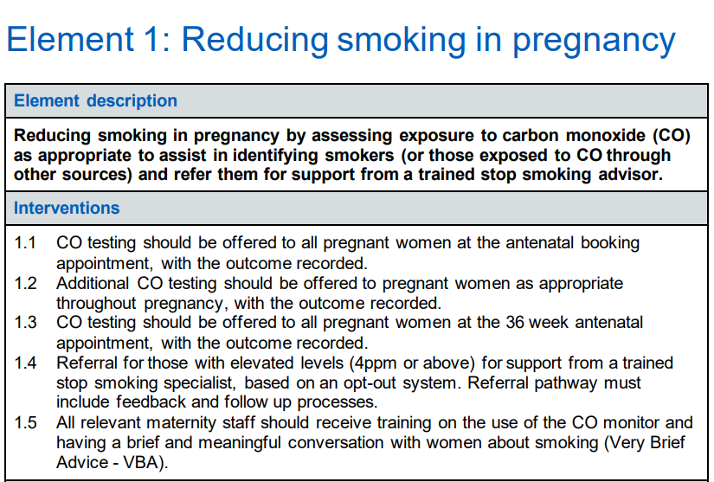
The Saving Babies Lives Care Bundle: Version Two
Notes:
Evolution
What we have already
Equity and equality
Current assurance framework -

Slide 4
NHS Long Term Plan commits that all pregnant women will have access to NHS-funded tobacco dependence treatment
By 2023/24, all people admitted to hospital who smoke will be offered NHS-funded tobacco treatment services.
    The model will be adapted for pregnant women and their partners, with a new smokefree pregnancy pathway including focused sessions and treatments.
COVID has impacted rollout, but we are still working to the original LTP timescales.
Notes:
Prevention is a core component of the NHS Long Term Plan (LTP). The LTP commitments set out the NHS’ contribution to tackling tobacco dependence.
These commitments are designed to:
be the NHS’s contribution to helping deliver a smokefree generation and
It is not designed to backfill where progress has not been delivered as part fo the SBLCB, but to take services further.
have a level of national direction, but are for local development and delivery.
Rollout started with 3 early implement sites and gathering learning from areas like Greater Manchester.

Slide 5
Recommended Delivery Model
https://future.nhs.uk/LocalTransformationHub/view?objectId=14293872
Based on NICE guidance and learning from the Greater Manchester Smokefree Pregnancy model:
Identifying smokers
Opt-out referral to an in-house service:
Intensive face-to-face specialist behavioural advice combined with nicotine replacement therapy
1:1 tobacco dependence adviser at antenatal booking or very soon after.
Nicotine replacement therapy at first contact.
Weekly face-to-face appointments for at least four weeks
Six further face-to-face appointments throughout pregnancy
Notes:
Targets early intervention, increased engagement, improve the pathway for the woman.

Slide 6
NHS Long Term Plan: delivery trajectory
There is still a staged incremental approach to delivery, but there is significant overlap in 2021/22 and delivery may be backloaded into the last 2 years.
The timeline is iterative and continues to develop:
2020/21
> Establishing EIS
> Incorporating tobacco into 21/22 Operational Planning
2021/22
> Delivery of EIS
> Sharing learning
> Prioritisation of rollout and trajectories
> Development of 21/22 delivery plans
> Wider phased rollout starts
> Gearing up activities for services starting in 22/23
2022/23
> Delivery of first wave of services
> Next rollout phase started and delivered.
> Gearing up activities for services starting in 23/24
> EIS – MH specialist services
2023/24
> Establish and deliver last wave of sites
> Rollout in MH specialist services
> Delivery of inpatient and maternity LTP commitments

Slide 7
Summary
Unique opportunity to change and develop current pathways
Recommended Smoke Free Pregnancy Model
Intensive and targets early intervention
In-house
    part of the pregnancy journey
    has to be a sustainable element of the maternity pathway
    maternity ownership and accountability
  Flexibility in delivery, with the ability to:
  use different staff groups e.g. MSWs
  commission across organisational boundaries
  expand, intensify or accelerate delivery using local resources.
  however should facilitate the recommended delivery model and in-house approach

Slide 8
Contacts at a national level
Paul Cilia La Corte Jane Coyne Misha Moore
Snr Programme Manager National Implementation Lead Midwife National Speciality Adviser
p.cilialccorte@nhs.net jane.coyne@nhs.net misha.moore@nhs.net
https://www.longtermplan.nhs.uk/areas-of-work/prevention/treating-and-preventing-ill-health/
Join our Future NHS platform at https://future.nhs.uk/NHSpp/grouphome

