Slide 1

The role of nicotine vapes in treating tobacco dependency in the NHS in Greater Manchester
Dr Matthew Evison
Consultant Chest Physician, Manchester University NHS Foundation Trust
Clinical Lead, Greater Manchester Make Smoking History Programme

Slide 2

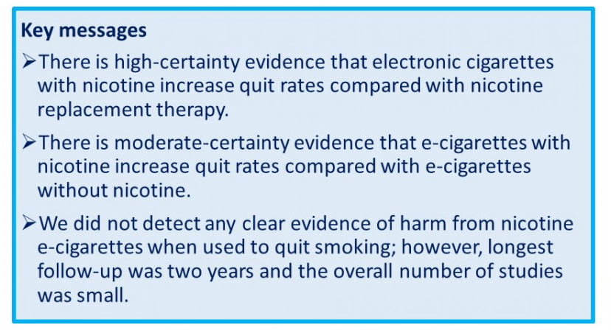
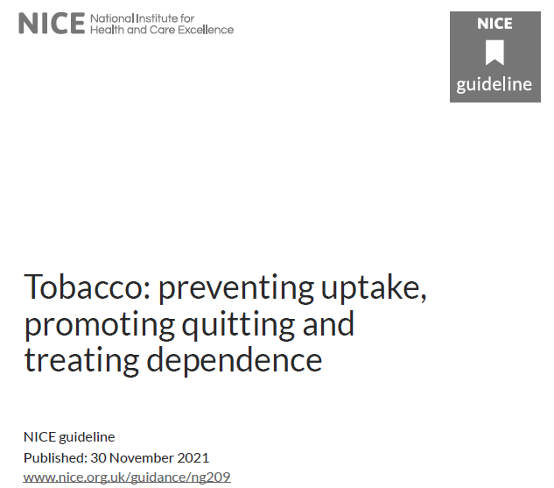

Cochrane Living Systematic Review
‘Nicotine e-cigarettes help people to stop smoking’
2022
Electronic cigarettes for smoking cessation - Hartmann-Boyce, J - 2021 | Cochrane Library

Slide 3

Systematic review and network meta-analysis: Effectiveness of treatments for tobacco dependency 2021
October 2021

Slide 4
Embedding vaping into NHS care for tobacco dependence
Given the clinical effectiveness, cost effectiveness & popularity we must embed an offer of vaping
Clinical environments where finally there is a viable & acceptable alternative to smoking tobacco
Risk to bystanders thought to be ‘negligible’
More effective than NRT but highly effective to combine with NRT
Develop Senior clinical & executive support for this strategy
Develop confidence and competence in our tobacco dependency specialists
Provide standardised information and access to all tobacco dependent patients

Slide 5
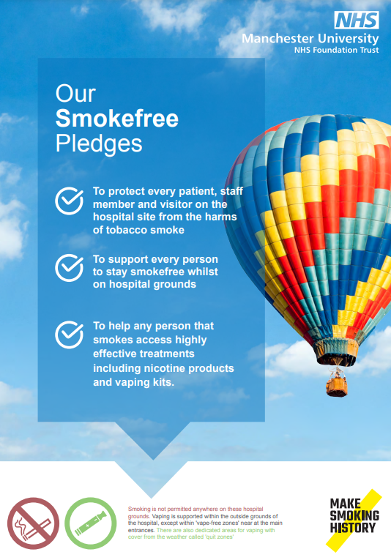


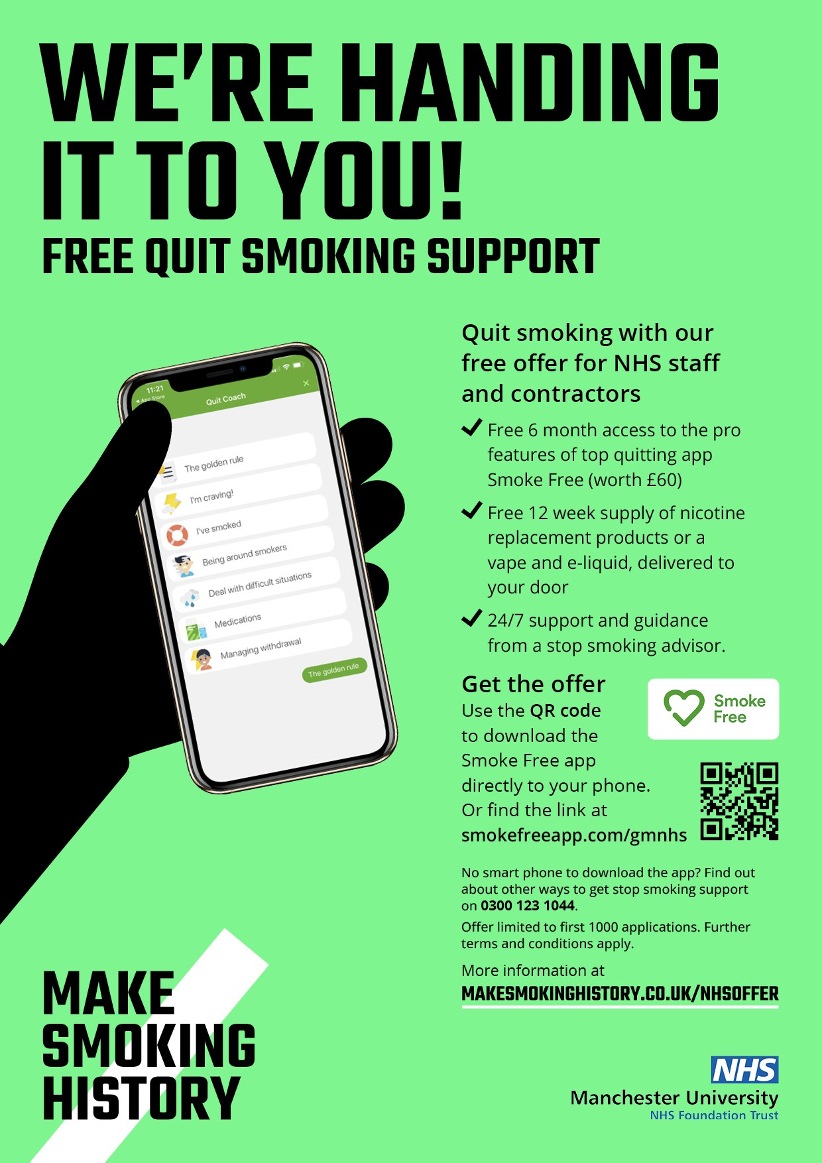
Treating Tobacco Dependency in the NHS in GM
CURE
Acute care trusts - inpatients
Smoke-free hospital sites
Smoking in Pregnancy
NHS staff treatment offer
CURE
Mental Health Trusts
Targeted Lung Health Checks

Slide 6
The Journey to date at MFT

Slide 7
Uptake of vaping in the CURE Inpatient Service
NHSE tobacco dependency data submission- inpatients – Feb 2023
630 patients referred to CURE via opt out model across all MFT
630 patient seen by CURE specialist team
28% (175/630) provided with vaping device and liquids (offer at 1/3 MFT site)
62% (108/175) of patients provided with a vape was in combination with NRT
All patients provided with a vape were supported with behaviour change
Equates over 2000 patients per year supported with vaping as part of their treatment (and still 2/3 sites to launch offer)

Slide 8
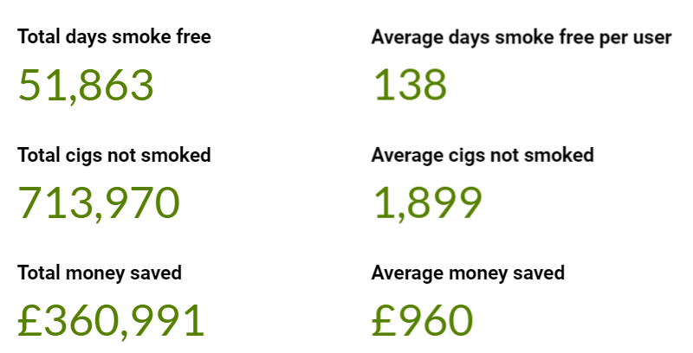
NHS Staff Offer at MFT: deep dive analysis:
Enrolments Feb – May 2022 (n=150)
42% selected vaping alone
32% vaping + NRT
7-day point prevalence abstinence at 12 weeks = 44%
12 week continuous abstinence = 31% (CO verified)

Slide 9

Manchester Lung Health Check Programme 2022
Area | Patients booked | Accepting Support from CURE | Opt-out | Accepting NRT/Vape | Accepting onward referral to Community Smoking Cessation team
Tameside & Glossop | 3472 | 2140 (62%) | 1332 (38%) | 1695 (79%) | 461 (22%)
North Manchester (in between surveillance years, interval scans only) | 512 | 343 (70%) | 169 (30%) | 256 (75%) | 104 (30%)
2483 patient seen by CURE
507 accepted a vaping kit (all in combination with NRT) = 20%

Slide 10
Smoke free Hospital Grounds
  Unique moment to truly deliver a smoke-free NHS
  CURE service offering vapes to inpatients
  Staff offer providing vapes to NHS staff
  Visitors can but vapes form Hospital pharmacy or local vape shops
  New smoke-free policy
  The removal of all smoking-related estate, including smoking shelters, ashtrays and cigarette bins
  Smoking is not permitted anywhere on the Hospital grounds
  Any person that is tobacco dependent will be supported to be tobacco-free and is encouraged to vape on the external grounds including within designated ‘quit zones’ where there are areas of cover from the weather.
  There is no vaping within ‘vape-free zones’, at entrances to the Hospitals to minimise the social nuisance vaping may present to others.

Slide 11
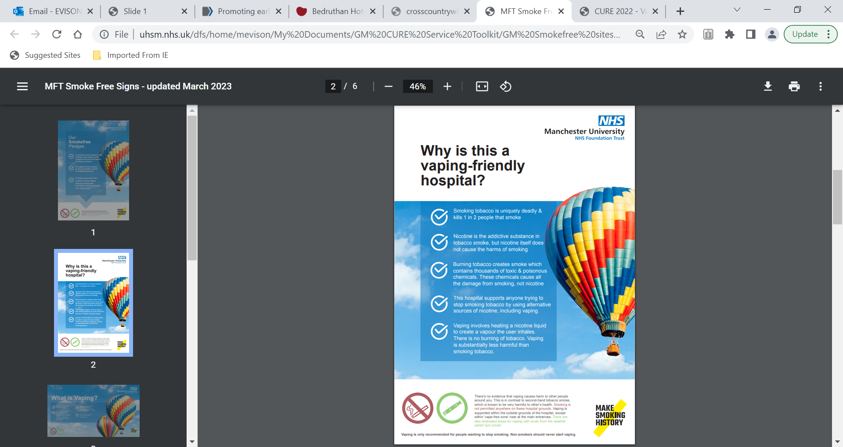
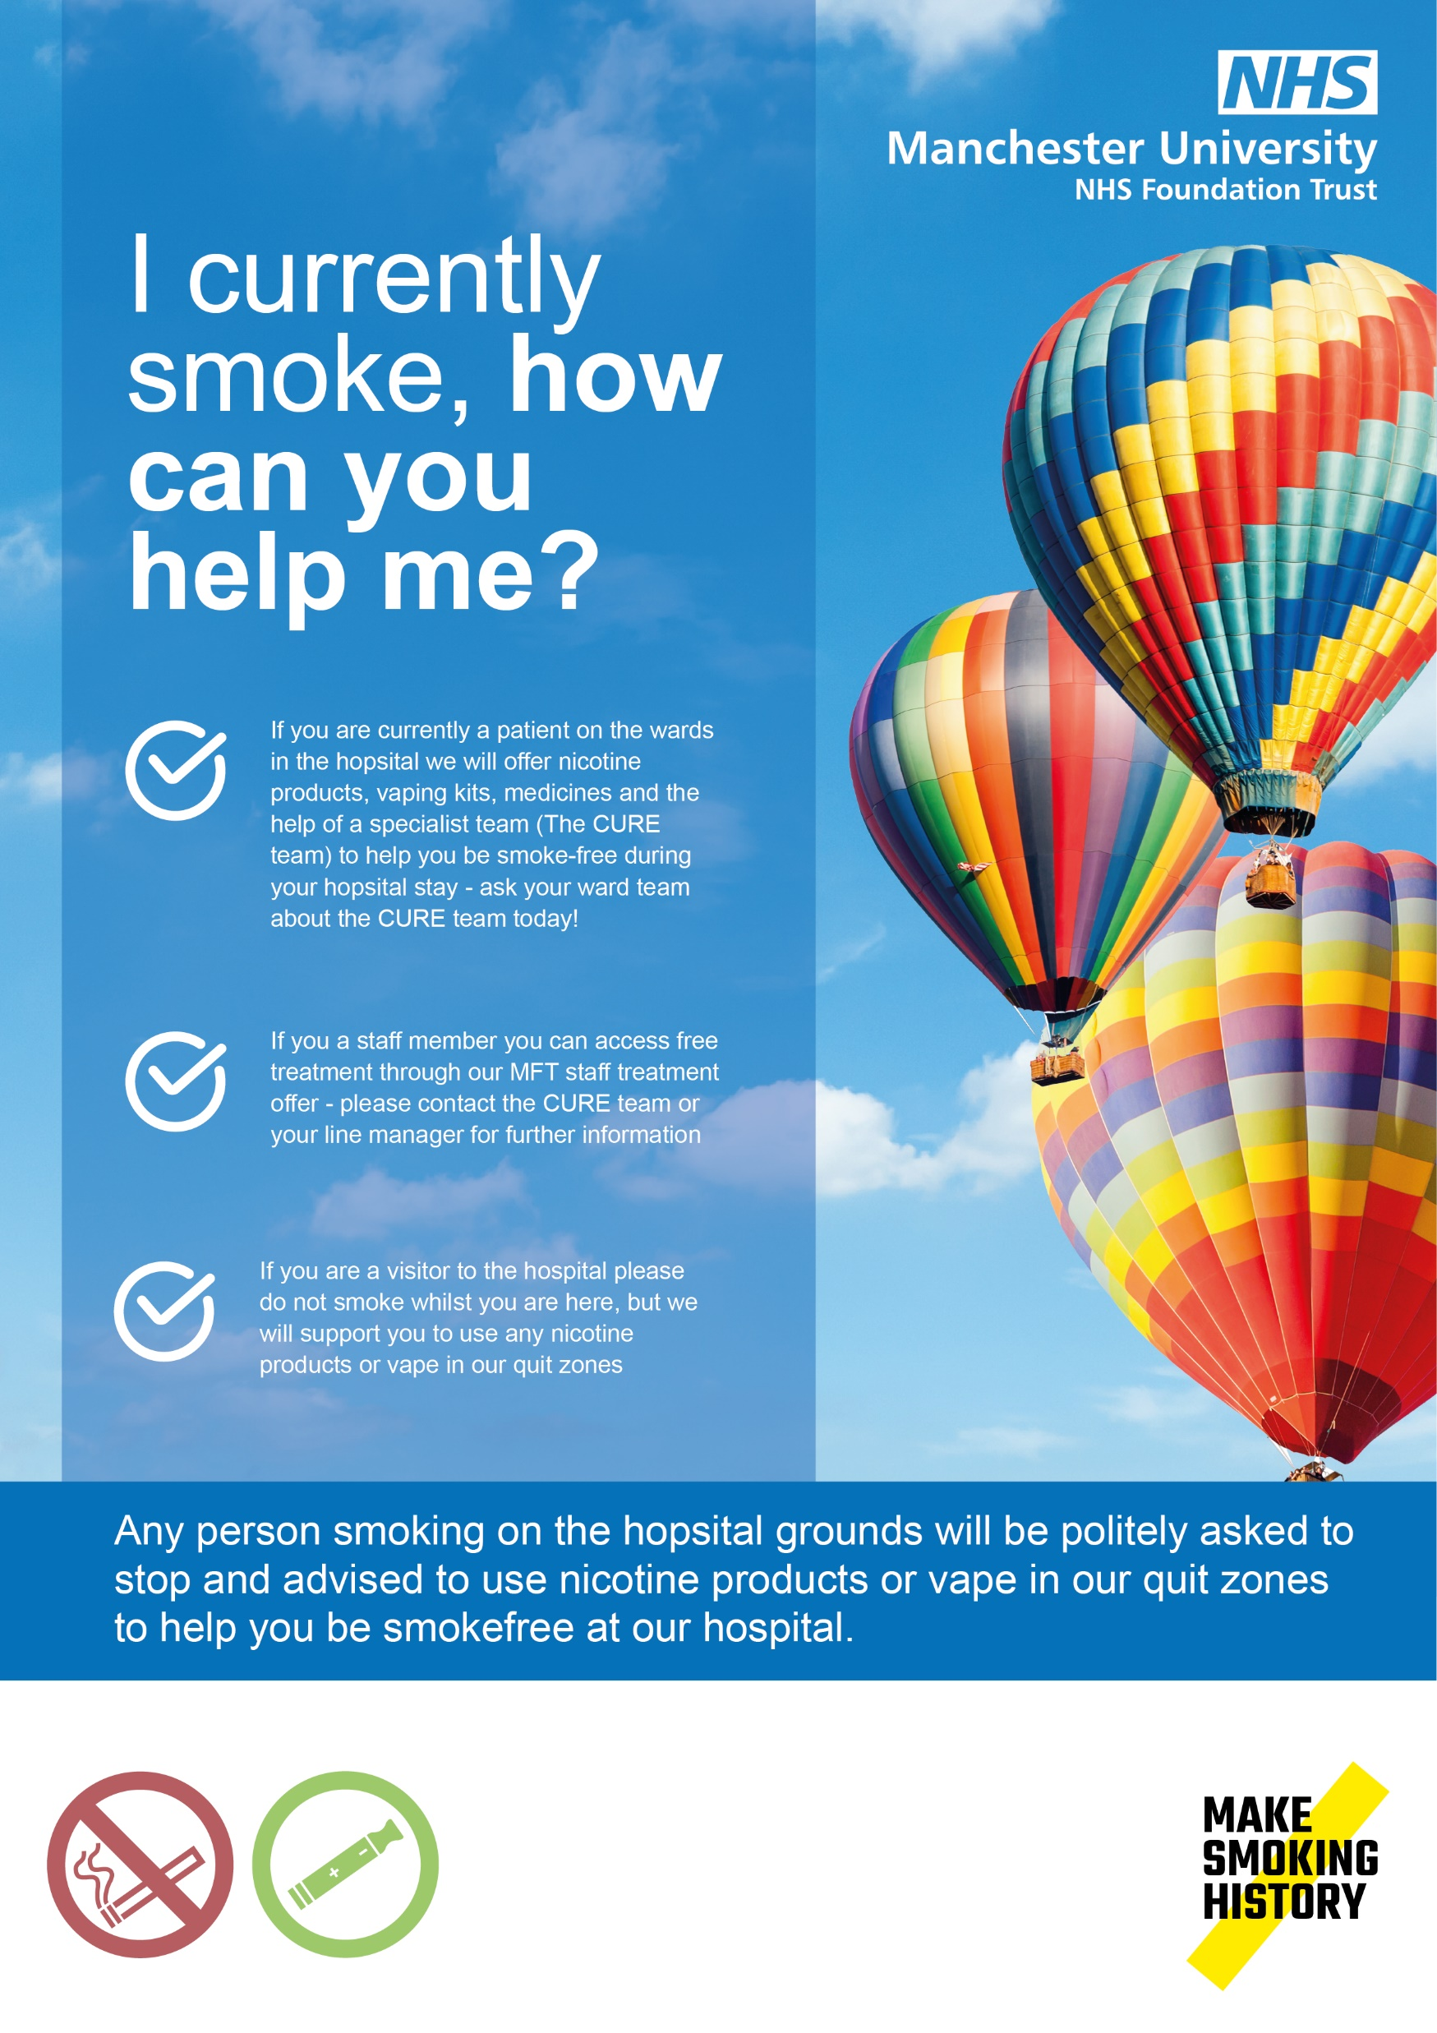

Slide 12
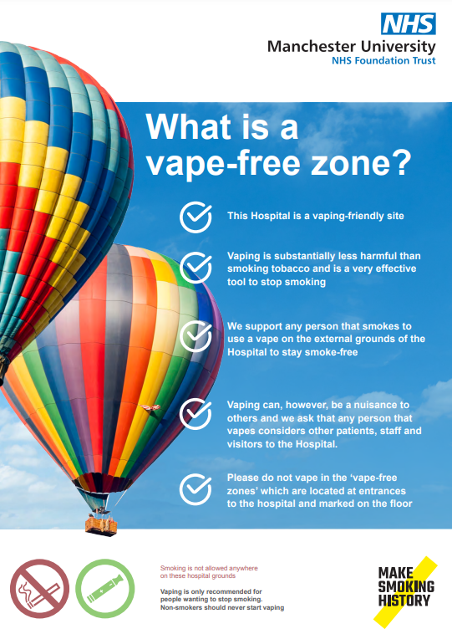
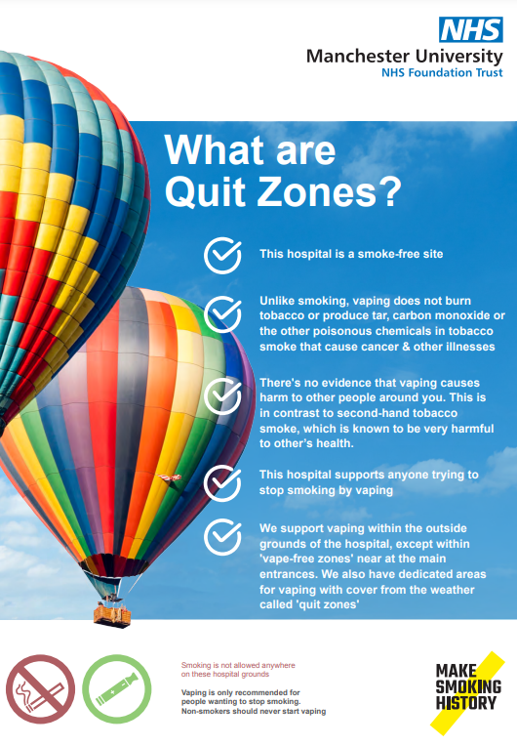

Slide 13
Conclusions
Vaping is a central component of a personalised treatment plan for tobacco dependency
The NHS has a responsibility to ensure access to the intervention in tobacco dependency treatment programmes
Uptake is excellent when it is accessible as part of a treatment plan and WILL increase effectiveness (high certainty)
As a viable & acceptable alternative to tobacco as a source of nicotine, it provides an unprecedented opportunity for a truly smoke-free NHS grounds

