Slide 1
Access to NRT treatment!
What does a maternity pathway look like?
ASH Webinar 17.10.23
Heidi Croucher
Dorset ICS Treating Tobacco Dependency Programme Manager
Janette Beer
Smoking in Pregnancy Support Worker
University Hospitals Dorset

Slide 2

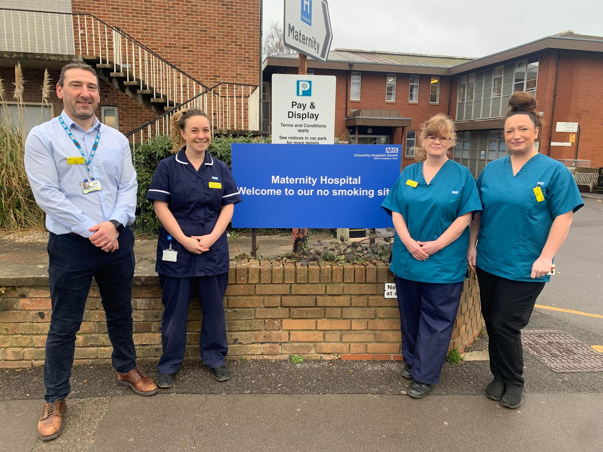
Meet the UHD Team

Slide 3
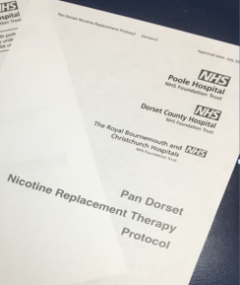











Setting up a protocol back in 2015

Slide 4




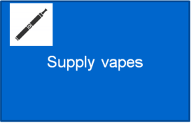




2019… include band 4 TDAs, partners and vapes

Slide 5

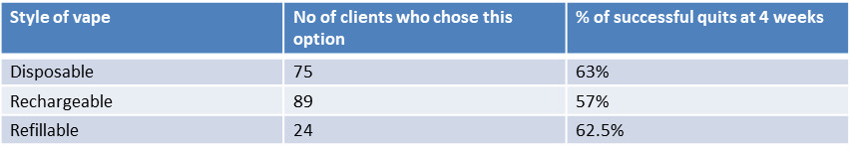
Oct 22-June 23 vape data…..
96% of clients chose a vape as part of their NRT during our quit programme
(pregnant women and household members)
Most popular flavours were fruit flavours, mango ice, watermelon ice, red crush, and sour blue razz!
Costing of vapes per 12 week quit programme is averaging at £140 per quit!

Slide 6
Clients feedback to vapes
“I Loved the choice and variety”
“I wouldn’t have agreed to a quit progamme without them”
“I didn’t want to stop smoking, but its been ok using my vape”
Household member “ I wouldn’t have supported my other half if I couldn’t have used a vape”

Slide 7


Slide 8
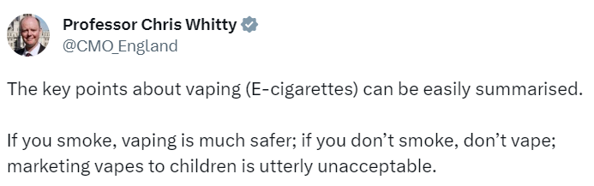
Where you can find information on vaping
Public Health Minister has announced a new ‘swap to stop’ scheme that will involve distributing vapes
Link to ASH resources on vaping in the chat
  Including evidence around common areas of misinformation/misunderstanding
Notes:
Added this as might come up as vapes not available as part of pharmacy service

Slide 9
Working & learning together
On the same team to end the harms of tobacco
We all want the best for patients & people in our lives who smoke
There is a great deal of misinformation around
    can be hard to navigate
    ASH provides evidence-based information & a forum for discussion
Guidance, especially when you disagree
    Ask questions, with aim to deepen understanding of their view
    Summarise their perspective to check you have understood them
    Be gentle as well as clear when you provide information
    Be open to new information

Slide 10
Where you can find information on vaping
Public Health Minister has announced a new ‘swap to stop’ scheme that will involve distributing vapes
Link to our resources on vaping in the chat
  Including evidence around common areas of misinformation/misunderstanding
Notes:
Added this as might come up as vapes not available as part of pharmacy service

Slide 11
Working & learning together
On the same team to end the harms of tobacco
We all want the best for patients & people in our lives who smoke
There is a great deal of misinformation around
  can be hard to navigate
  ASH provides evidence-based information & a forum for discussion
Guidance, especially when you disagree
  Ask questions, with aim to deepen understanding of their view
  Summarise their perspective to check you have understood them
  Be gentle as well as clear when you provide information
  Be open to new information

