Slide 1
Specialist Mental Health Tobacco Dependency Services:
Improving access to treatment through community based services
Aideen Dunne, National Medical Directors Clinical Fellow and Public Health Registrar (ST5)
March 2022

Slide 2
Tobacco dependency is a driver of health inequalities in people with SMI
There is very clear evidence of increased smoking rates and smoking-related harm among people with severe mental illness:
  Smoking is one of the most important modifiable risk factor that contributes towards the excess mortality in people with SMI¹.
  It is estimated that 50% of deaths in people with SMI are attributable to smoking².
  The prevalence of smoking in people with SMI is significantly higher compared to the general population (40.5% compared with 13.9%) ³ with rates as high as 70% in people with schizophrenia and bipolar disorder¹.
  Smoking is a deeply entrenched and complex behaviour in people with SMI.
    People with mental illness are also more likely to be heavier and more dependant smokers⁴.
    It is estimated that a third of all cigarettes smoked in England are smoked by people with a mental disorder⁵.
    There is evidence that a tailored/enhanced tobacco dependency treatment offer is likely to be more effective in people with SMI⁶.
Peckham et al (2017) Smoking cessation in severe mental ill health: what works? An updated systematic review and meta-analysis
Centre for Mental Health (2020) A time to quit
Office for Health Improvement and Disparities (2022). Local Tobacco Control Profiles
Rethink (2020) A time to quit. Experiences of smoking cessation support among people with severe mental illness.
Public Health England (2020) Health matters: smoking and mental health
Gilbody et al (2019) Smoking cessation for people with severe mental illness (SCIMITAR+): a pragmatic randomised controlled trial

Slide 3
Delivering the LTP commitments
The Marmot review (2020) ¹ highlights the importance of place in shaping people’s physical and mental health, this includes;
  Organisational policies
  Treatment availability
  Social and cultural norms - mostly driven by staff and patients
  Establishing tobacco dependency services within a place and the extent to which they are effectively embedded are impacted by relevant organisational policies being fully implemented, the timely availability of high quality and NICE aligned treatment options, staff attitudes and behaviours that support patients/clients into treatment.
  The inpatient tobacco dependency services focus on “place” being acute and mental health trusts, and this commitment is also complemented by the NHS staff tobacco offer currently being rolled out.
  Place based approaches also refer to communities that people exist within, and the community based specialist tobacco dependency services aim to improve access outside of inpatient settings.
Marmot et al. (2020) Health equity in England: The Marmot Review 10 years on.

Slide 4
Specialist tobacco dependency services for people with SMI
We are now progressing our third tobacco related LTP commitment:
  “A new universal smoking cessation offer will also be available as part of specialist mental health and learning disability services”.
  In operationalising this commitment we faced a number of challenges:
    There is no universal definition of what good looks like in practice and therefore there are a number of variations of a service model being delivered
    There was no clear understanding of the cost to deliver these services (given that they were not universally available and where they were provided there was variation in what was delivered)
    The evidence base for tobacco dependency in people with SMI is less developed than for the general population and some high risk groups.
  We had a number of factors in our favour:
    There were established expert and reference groups that were very passionate about these services
    There were some excellent examples of this type of service being delivered that we could learn from
    We had an example of a robustly tested intervention in the UK (SCIMITAR)
  Working with service providers, key academic and topic experts and national organisations we developed a proposed service model that was further tested during a Task and Finish Group.

Slide 5
Proposed model of what good in practice looks like
Systematic identification of people that smoke and they are offered an opt out referral
Services are delivered by a dedicated stop smoking advisor with mental health expertise/experience
Clients are offered support that is tailored in duration and intensity to their needs
All NICE recommended treatment options are available and offered to clients
Flexibility in terms of lead time before setting a quit date, supporting a harm reduction approach/ structured cut down
Flexibility in terms of how and where appointments are delivered – focusing on what is best for the client
Good communication with the client’s clinical team – inform medicines review
Sessions may continue after the quit date for a duration and intensity that is tailored to the client’s needs
Through our engagement we also recognised that additional aspects may be best determined at a local level.
Notes:
Through our engagement we also recognised that additional aspects may be best determined at a local level such as:
Offering tobacco dependency support to partners/carers of clients that smoke
Interpretation of flexibility in how and where appointments are delivered (such as decisions regarding offering home visits and off site visits)
Whether or not there is a limit on the number of times a client can restart the service

Slide 6
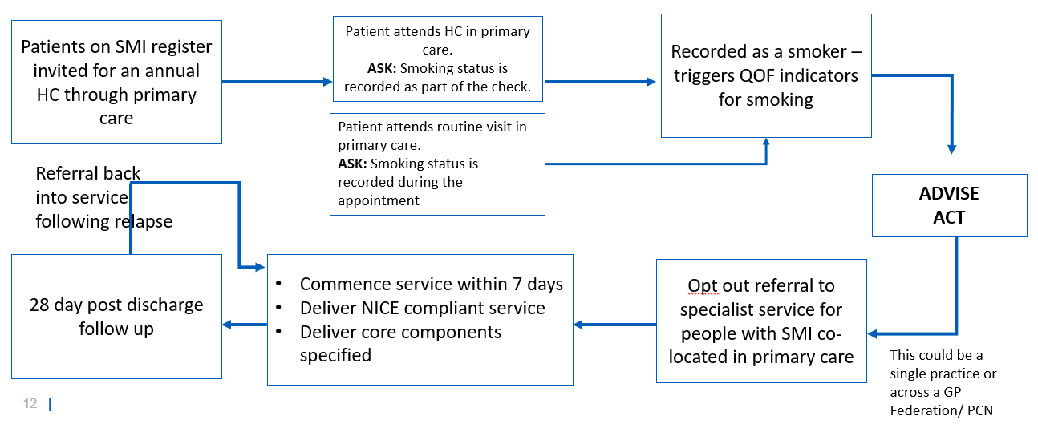
Patient Pathways
Targeted services for people with SMI should be enhanced by improving systems for identifying people within primary care and [secondary] mental health settings.
We defined three patient pathways that these services could sit within, linking in with existing systems, services and infrastructure:
  Co-locating services in primary care linking with the physical health check for people with SMI
  Building on the inpatient offer to patients post discharge and linking with outpatient clinics
  Co-locating services with community mental health services adopting a making every contact count approach

Slide 7
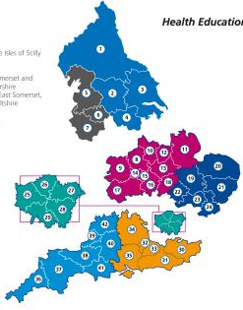
Early implementer sites
Early Implementer Sites offer the opportunity to bridge the gap between research and practice, and understand from an operational perspective what good looks like. They will also play an important role in informing the national rollout of services in 2024/25.
We have been working with NHS EI Regions to identify 7 Early Implementer Sites to be mobilised in 2022/23.
7 Early Implementer Sites
2 EIS delivering the Inpatient/ Outpatient Model
NENC: Primary Care Model
2 EIS delivering the Primary Care Model
CM: CMHS Model
Nottinghamshire: Inpatient/Outpatient
3 EIS delivering CMHS Model
N&W: Primary Care Model
NEL: CMHS model
Sussex: Inpatient/Outpatient
C&IoS: CMHS model

Slide 8
Early Implementer Sites
North East & Yorkshire: North East North Cumbria – Primary Care Model
North West: Cheshire and Merseyside – Community Mental Health Services Model
Midlands: Nottingham and Nottinghamshire – Inpatient/ Outpatient Model
East of England: Norfolk and Waverly – Primary Care Model
London: North East London – Community Mental Health Services Model
South East: Sussex – Inpatient/ Outpatient Model
South West: Cornwall and Isles of Scilly – Community Mental Health Services Model

Slide 9
Next steps
Mobilisation of EIS
Evaluation and data collection
Deliver a further three Task and Finish Group focused sessions
  Learning infrastructure to support service mobilisation
  Evaluation (Part 2)
  Co-Production and what good looks like
Developing a plan for the National roll out

