Slide 1

Alice Wiseman
ADPH Vice President and Director of Public Health Gateshead
On the path to ending smoking: Using new funding
Director of Public Health Reflections

Slide 2
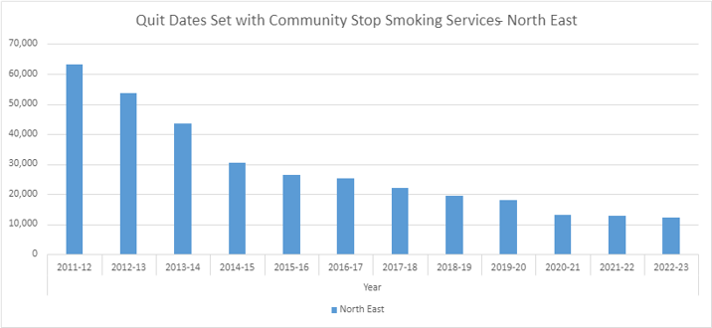
Trends in stop smoking services
The number of people accessing Stop Smoking Services is declining year on year.
In the North-East, this translates to a change from 63,300 in 2011/12 to 12,180 in 2022/23​.
Notes:
Given the year on year declines in attendance, this funding is very welcome and will allow us to work differently and with local partners to create a stop smoking system which encourages smokers to make a quit attempt by whatever means best suits them while encouraging them to link into best evidence support

Slide 3
What we’re doing locally
£3.6m in additional funding for stop smoking support in our region represents a one-off opportunity to make a significant impact to end smoking​.
The ASH briefing paper and its recommendations will inform our decisions at the local level in Gateshead.
For example, we will be reviewing our local strategy and partnerships against the goal to end smoking.
We will also ensure that there is sufficient investment in stop smoking activity to motivate as many quit attempts as possible.
Although we have freed up some existing funding for this, the new allocation is very welcome and will allow us to employ staff to develop and coordinate a system approach with our partners across Gateshead.
Regionally, the North-East consists of 12 Local Authorities (LAs) each with its own stop smoking offer​.
Notes:
This is the ASH briefing paper link:
On-the-path-to-ending-smoking-DPH-briefing.pdf (ash.org.uk)
These are the recommendations from that they'd like you to touch on – I've worked the Gateshead angle for 1,2 and 3 into the first slide, but the bulk of it focuses on collaboration.
1. Review local strategy and partnerships against the goal to end smoking.
2. Allocate sufficient investment in activity to motivate people who smoke in all communities to quit.
3. Skill up stop smoking services to increase capacity and act as hubs of excellence for wider services.
4. Identify activity best delivered collaboratively across local authority boundaries to maximise impact.

Slide 4
What we’re doing regionally
Our Tobacco Commissioners Network consists of Leads from each of the 12 North-East LAs.
They have already developed a regional ‘helping smokers to quit’ position statement and signed up to the North-East Declaration for a Smokefree Future.
The Tobacco Commissioners Network​ has been scoping out opportunities for collaboration to maximise impact and build on the broader tobacco control work carried out through the Fresh programme.
Proposals are currently being developed for consideration by our ADPH North-East group​ and the next few slides provide an update on this work.

Slide 5
Initial proposals for local action
Regional collaboration to address the challenges and focus on three main areas:​
  Universal regional stop smoking support (expansion of LA offer). ​
  Maximising workforce impact.
  Measuring success and impact.
Maintain flexibility to respond to local needs and national emerging evidence-based opportunities​.
Similar discussions in other parts of the country, with a briefing developed by ASH and endorsed by ADPH recently published​.
Over and above current funding for regional tobacco control through Fresh. ​

Slide 6
1. Universal regional stop smoking support​
Expanding access to LA supported quits by targeting those who are unlikely to access specialist support (NB the 48.4% making unsupported quit attempts)​.
Promotion and enhanced offer of premium Smoke Free app.
Digital source of clear, accessible advice on the range of ways to quit and available support.
Driven by regional insights-driven comms campaign​.
Notes:
Bullet 2 - TBC: regional app modifications to be explored via T&F group; aim to exhaust any local app licenses before additional ask​
Bullet 3 - Via enhanced Fresh-Quit.co.uk website, including additional language options
Bullet 4 - TBC: how this fits with Fresh comms/current funding

Slide 7
2. Maximising workforce impact​
Recognising and utilising current expertise, acknowledging different current local training offers​.
Professional development of the stop smoking workforce.
Tiered and bespoke training offer.
Aim to improve the consistency of evidence-based messaging.
In collaboration with NHS colleagues.
Notes:
Bullet 2 - Facilitated peer support and sharing of best practice and evidence, including annual conference​
Bullet 3 - Based on local health equity audit and training needs assessment​

Slide 8
3. Measuring success and impact​
Complimenting regional Health Equity Audit approaches and monitoring health inequalities.
Qualitative client insight work.
Measures of success other than four-week quits.​
Smoking in England toolkit​.

Slide 9
Next steps
Engagement with each LA through one-to-one meetings:
  Opportunity for new ideas and to understand local opportunities/concerns/queries​.
  Ensure proposals are grounded in understanding the local system and local nuances​.
Prioritisation workshop with whole Tobacco Control Network:
  Ranking options and ideas (eg decision analysis tool). ​
  Ensure agreement for overall proposals​.
​Further collaboration through Task & Finish group: ​
  Opportunity to bring in others to answer questions/address concerns/build evidence base​.
  Work with partners​.
  Develop specific asks to allow for more accurate costings.​
Understand practicalities including commissioning and procurement, recruitment, responsibility for regional money etc. ​
Develop timeline and sequencing of actions​.

